Slide 1
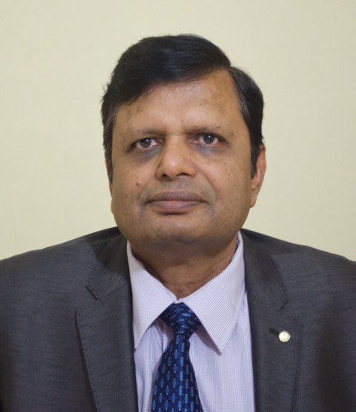
SHYAM SUNDAR
Professor of Medicine, IMS, BHU
Program Director & Nodal Officer of ART Center & Center of Excellence
Visiting Professor : Jawaharlal Institute of Postgraduate Medical
Education & Research
Important Fellowships:
- Fellow (FRCP) Royal College of Physicians, London
- Fellow (FAMS) National Academy of Medical Sciences, India
- Fellow (FNASc) National Academy of Sciences, India
- Fellow (FASc) Indian Academy of Sciences, India
Fellow (FNA) Indian National Science Academy, India
Fellow (FTWAS) The World Academy of Sciences, Italy
AWARDS -
International:
Anne Maurer Cecchini 2010 Award, Geneva Switzerland
IDSA AIDS Fellowship, Infectious Diseases Society of America
National – 11
State and other Awards - 16
Author: Harrison’s Principle of Internal Medicine – 18th, 19th and 20th Editions
Davidson’s Principle and Practice of Medicine, 20th , 21st, 22nd and 23rd Editions
RESEARCH GRANTS for several international projects approx. 50 Crores
Publication Highlights:
Publications: 542 (8 Papers in Journals with impact factor >30)
h-index : 71

Slide 2
Elimination of Kala-azar from India
Is it realistic?
Shyam Sundar
Department of Medicine, Institute of Medical Sciences Banaras Hindu University

Slide 4
Visceral Leishmaniasis – Clinical Features
Fever with rigor & chills
Remarkable splenomegaly
Mild hepatomegaly
Anemia & its consequences
Leukopenia
Thrombocytopenia
Bleeding manifestations
Liver and Renal Dysfunctions - Occasional

Slide 6
Secondary infections
Tuberculosis
Pneumonia
Herpes zoster
Scabies
GI infections
Amebic dysentry
Bacillary dysentry
Gastroenteritis
If untreated, most patient dies

Slide 7
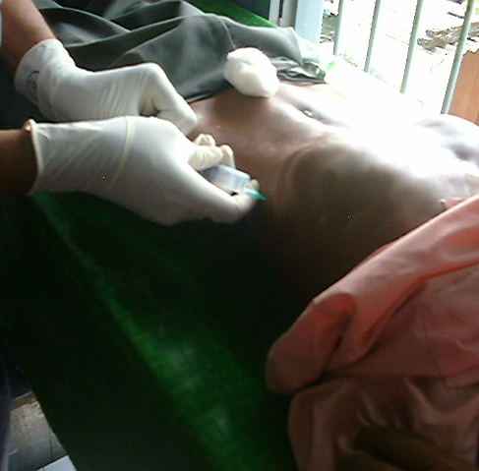
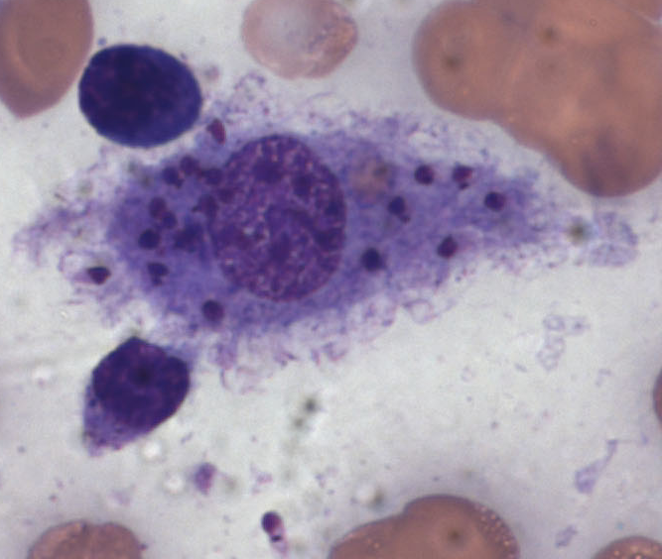
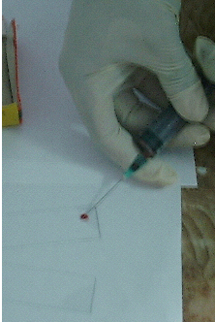
Diagnosis of Visceral Leishmaniasis
Photography: Kyra
Fine needle splenic aspirates are taken for diagnostic purposes

Slide 8
rK39 Immunochromatographhi Test
(Sundar et al, Lancet1998)

Slide 9
Treatment of VL
Sodium stibogluconate (SSG) resistance became widespread in India
Treatment with conventional amphotericin B was difficult to execute in the endemic areas
Oral miltefosine (hexadecylphosphocholine) was first tested for VL in a pilot study (Sundar et al, Lancet 1998)

Slide 10
Miltefosine
Sundar et al, N Engl J Med. 2002; 347: 1739-46
Dose: 100 mg (>25 kg); 50 mg (<25 kg); Children 2.5mg/kg
Duration: Four weeks
Long term cure rate 94%
Side – effects:
Vomiting occurs in ~40%
diarrhea in ~20%.
Asymptomatic transient elevation of hepatic enzymes
Skin allergy, nephrotoxicity are occasionally seen
Cannot be used in pregnant females [teratogenic], and those refusing contraception (for the treatment period and another three months)

Slide 11
Kala-azar Elimination Program
In 2002 Miltefosine was approved for treatment of VL in India
rK39 immunochromatographic test was available at affordable cost.
In 2005 Kala-azar Elimination Program was launched in India, Nepal and Bangladesh

Slide 12
Why Kala-azar Elimination Is Possible?
KA is confined to limited areas in 3 countries
Unique epidemiology
Man is the only reservoir
There is only one vector (Phlebotomus argentipes)
Effective, relatively safe oral drug available (Miltefosine)
Rapid diagnostic test available for use in field condition(rK39)
Effective vector control policy (IRS)
Strong political will and commitment by the 3 countries

Slide 13
VL elimination
PREPARATORY PHASE (2 years)
ATTACK PHASE (5 years)
CONSOLIDATION PHASE (3 years)
MAINTENANCE PHASE

Slide 16
Single Dose AmBisome Therapy in VL
In 2010 we demonstrated clear efficacy of single dose (10 mg/kg) liposomal amphotericin B (AmBisome) [Sundar et al, N Engl J Med 2010]
This regimen was endorsed by the WHO expert committee
Indian National Programme has adopted this regimen.

Slide 17
Therapeutic options for VL
There are reports of growing resistance to miltefosine (India) or low efficacy (Nepal & Bangladesh).
In National Programme a transition from oral miltefosine to newly developed single doseliposomal AmB treatment has been going on in the endemic regions.
At District Hospitals, PHCs single dose AmBisome treatment is to be used
If cold chain is not possible
A 10 day comb treatment with Paromomycin & Miltefosine is indicated

Slide 18
Challenges in VL Elimination

Slide 19
Asymptomatic Infections

Slide 20
Asymptomatic infections vs. clinical disease
Ratio incident asymptomatic infections to symptomatic clinical disease
Sudan 2.4:1
Kenya 4:1
Ethiopia 5.6:1
Bangladesh 4:1
Iran 13:1
Brazil 6:1 to 18:1
Spain 50:1
India and Nepal 8.9:1

Slide 21
Serology and qPCR in asymptomatic individuals in Endemic Areas
 | PCR Positives: % (N) | DAT Positives: % (N) | rK39 ELISA Positives % (N)
No VL in the house | 24.6% (37/150) | 14.0% (21/150) | 18.1% (27/149²)
House hold contacts | 20.6%(20/97) | 14.4% (14/97) | 19.5% (19/97)
VL Past cases | 23.0% (9/39) | 89.0% (35/39) | 74.3% (29/39)

Slide 22
qPCR & serology in Asymptomatic Individuals

Slide 23
Key Challenges and management of asymptomatic infection for VL elimination
Large endemic population of asymptomatic individuals
Can serve as reservoir
Can develop disease
Can not undergo chemotherapy
Can not be detected by conventional method
Om Prakash Singh, Epco Hasker, David Sacks, Marleen Boelaert, Shyam Sundar (2014) Asymptomatic leishmania infection: A new challenge for leishmania control; Clinical Infectious Diseases. doi: 10.1093 /cid/ciu102.

Slide 24
Are these asymptomatics capable of transmitting infection?

Slide 25
HIV-VL Coinfection

Slide 26
HIV-VL Co-infection
First reported from Mediterranean Basin
A disease of children
But in HIV co-infected, adults are the dominant victims
A lower CD4 count predisposes to VL
AIDS defining illness in the endemic region

Slide 27
HIV-VL Co-infection
Still not a big problem in the Indian Sub-continent
~5% incidence of HIV-VL Co-infection
VL is largely a rural disease
Little overlap so far
Incidence is on increase
Co-infected patients highly infectious to sand flies
Multiple Relapses common

Slide 28
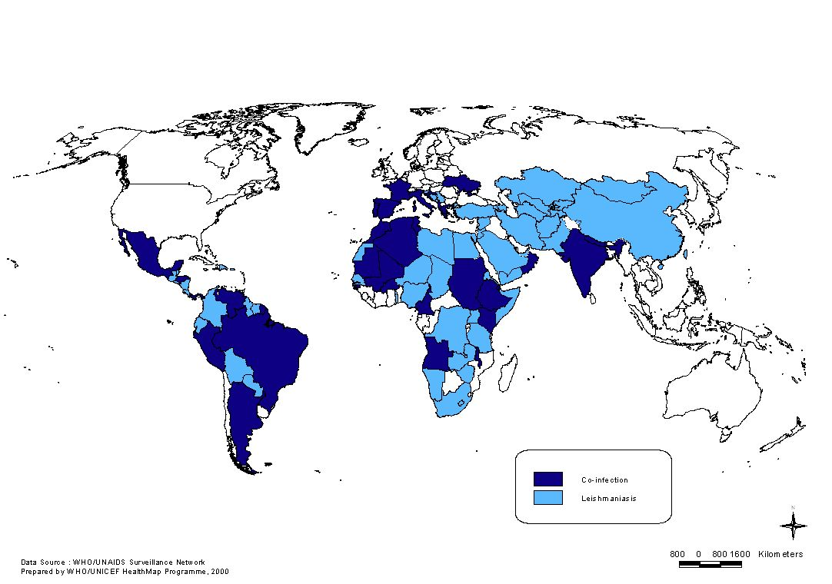
LEISHMANIA / HIV CO-INFECTIONS: 35 countries
LEISHMANIA / HIV C0-INFECTION: 34 COUNTRIES

Slide 29
HIV-VL Co-infection – Clinical features
Fever, pancytopenia, & hepatosplenomegaly is found in 75%
GI manifestations –
Dysphagia or odinophagia
Epigastralgia,
Diarrhoea or rectal discomfort
Mucositis, Ulcers are common
Amastigotes can be recovered from mucosa

Slide 30
HIV-VL Co-infection - Diagnosis
Serology – IFAT, ELISA & Western Blot are most commonly employed. K39 ELISA has only~50% sensitivity
Demonstraton of amastigotes – Spleen, bone marrow, L nodes
Buffy coat
Culture
PCR

Slide 31
HIV-VL Co-infection - Treatment
Antimony (20 MKD x 28 days) – 66% cure rate (Chemical pancreatitis – 30%; Cardiotoxicity – 14%)
Ampho B deoxycholate (0.7 MKD x 28 days) – 62% cure rate (nephrotoxicity – 36%)
AmBisome – 4 MKD on days 1–5, 10, 17, 24, 31, and 38. – 89% Cure rate (FDA and NVBDCP/NACO approved)
Relapse is common usually within 1-8 months

Slide 32
Maintenance:
Abelcet (ABLC) - 3 mg/kg every 21 days
AmBisome – 5 mg/kg or
Pentamidine -4 mg/kg every 2-4 weeks
Antiretroviral Therapy (HAART) is the key to postpone relapse

Slide 33
Post Kala-azar Dermal Leishmaniasis

Slide 34
PKDL
PKDL patients are infectious to sand flies.
5-10% in India develop skin manifestations
Nodule
Macule
Mixed
In India it occurs 6 months to several years later after the episode of VL
Spontaneous healing is unknown in India

Slide 35
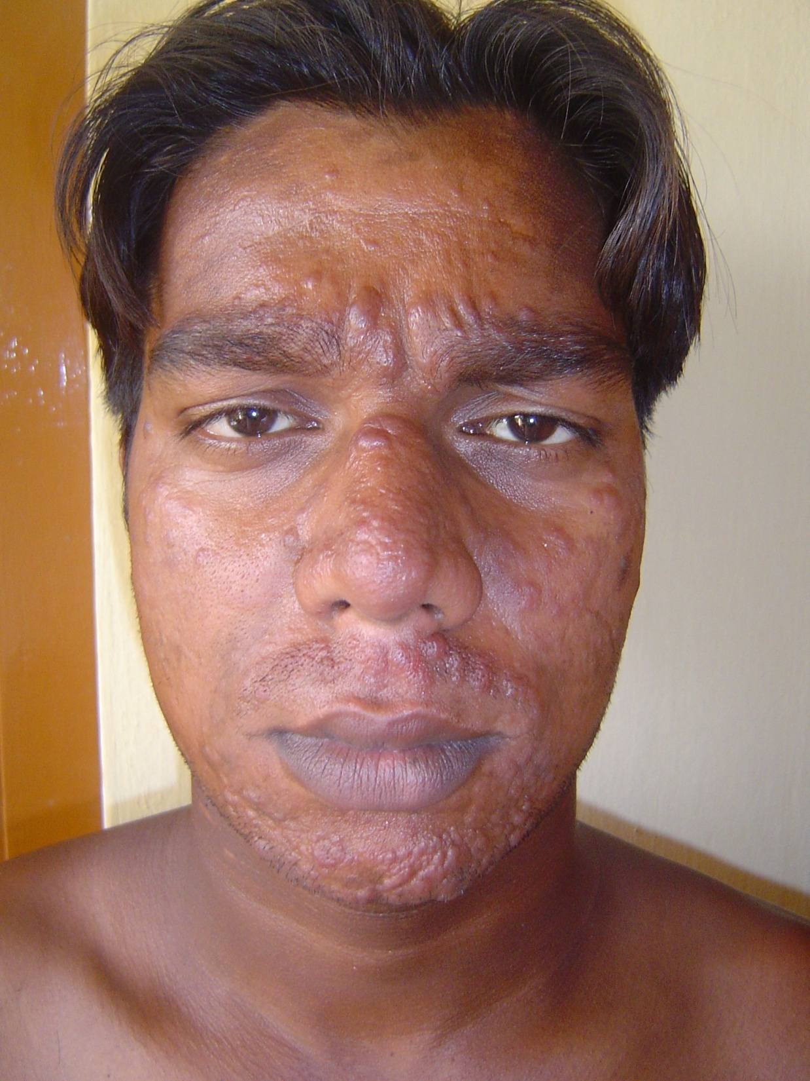

Slide 36
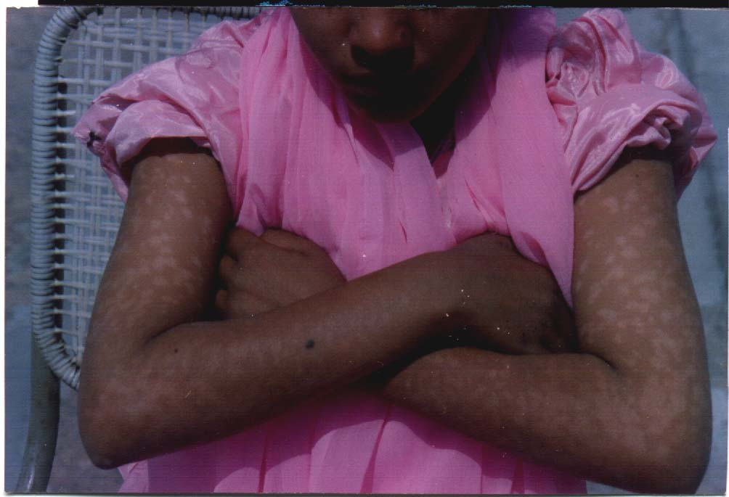

Slide 37
Diagnosis of PKDL
Typical history of VL
Serology positive in ~90%
Slit skin smear demonstrates parasites
Culture of aspirates from lesions

Slide 38
Tretment of PKDL
Sodium stibogluconate (20 mg/kg) IV/IM for 120 days in India
Amphotericin B – (1 mg/kg infusions daily on days 1-20, 21-40 and 61-80) to a total of 60 infusions (Indian data)
EXISTING TREATMENT REGIMEN IMPOSSIBLE TO DELIVER TO PATIENTS
None compliance is the rule
Miltefosine – 100 mg daily for 3 months (WHO 2010; Sundar et al, AJTMH 2014)

Slide 39
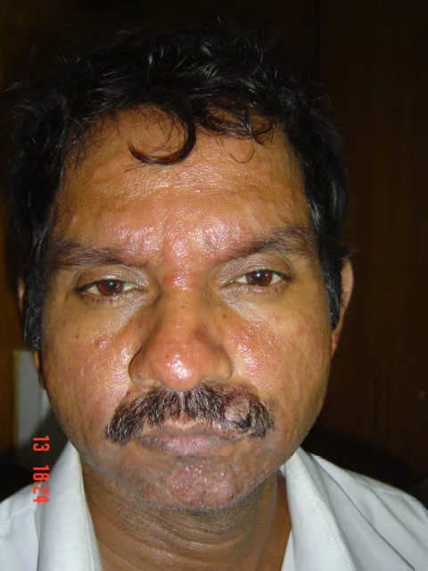
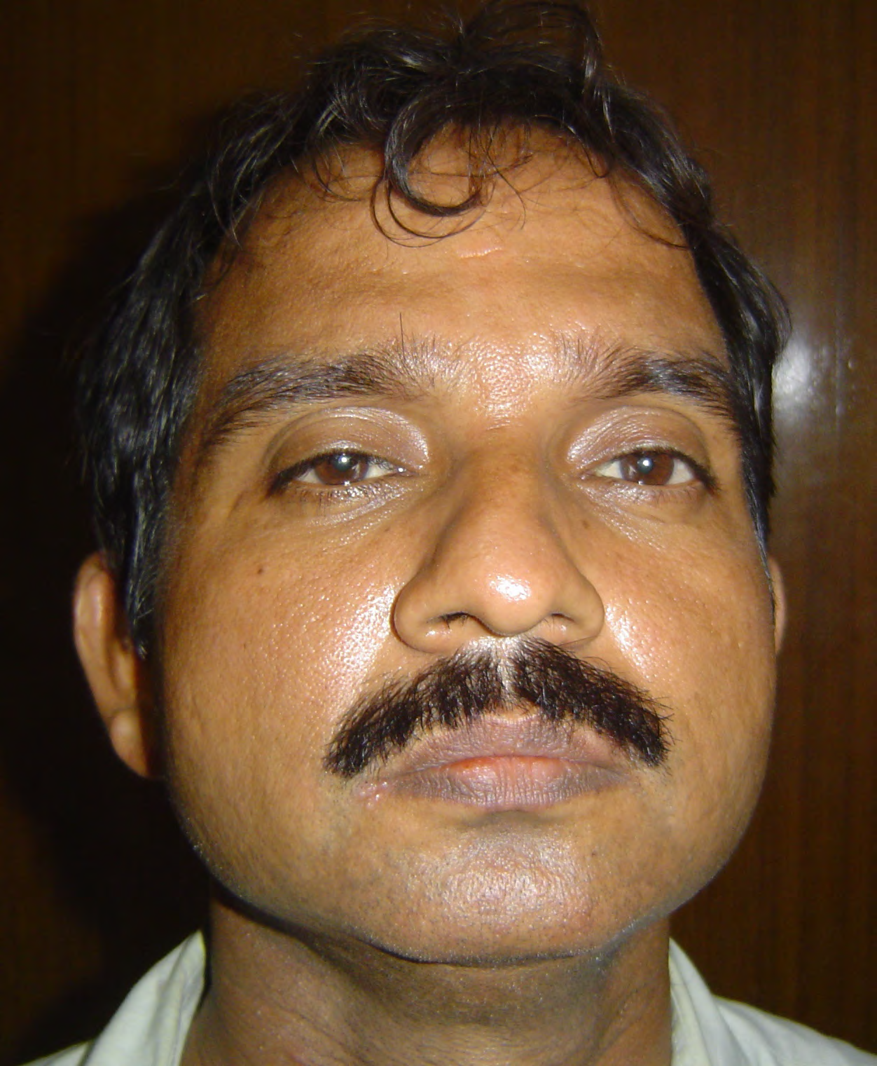
PKDL: Before & After Miltefosine Tt

Slide 40
PKDL : The problems
As cases of PKDL are considered important reservoir of infection, their detection and treatment are important for VL elimination.
As patient are asymptomatic they often don’t come forward for the treatment
Clinicians not trained may confuse it with leprosy/fungal infection.
When diagnosed, treatment is difficult

Slide 41
What are the possible solutions: Way Forward?
Asymtomatics -
Although there is no evidence that these transmit the infection, studies are ongoing to gather the evidences
No treatment is safe enough to be administered to healthy individuals
Orally administrable, absolutely safe antileismanial drugs are needed
Better regimens for the treatment of PKDL
Early detection & treatment of HIV/VL
Co-infection

Slide 42
Conclusions
Despite many barriers and obstacles, substantial progress has been made over past years
Eliminating VL as a public health problem is technically possible and operationally feasible, particularly following the renewed commitment by the three countries' governments as well as local and international stakeholders.
Asyptomatic infection, HIV-VL co-infection and PKDL are potential threats to sustain the elimination target.

Slide 43
