Slide 1
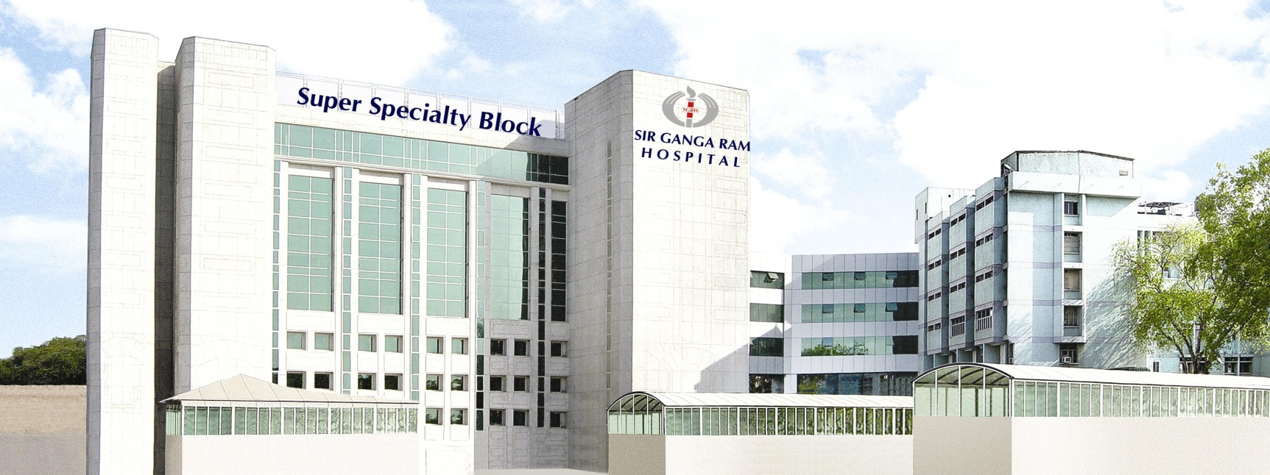
Management of difficult dyslipidemia
Dr. J.P.S. Sawhney - DM,FESC,FACC
Chief of Clinical Cardiology
Chairman - Dept. of Cardiology
Sir Ganga Ram Hospital, New Delhi, India

Slide 2
Rising life expectancy
Cardiology has contributed to 7 of the 10 years increase in life span
      50 % life style
        Exercise
        Diet
        Tobacco cessation
        Risk factor control
      40% drugs
        ANTIPLATELETS
        ß – BLOCKERS
        ACEI/ARB
        STATINS
      10% intervention (CABG,PTCA)
Oncology 2.4 months

Slide 3
Multiple Factors Contribute to Increased CV
Risk, and Lipid Disorders are a Critical Component
Genetic Variations/
Family History
Lipid Disorders
(LDL-C ↑, HDL-C↓, TG↑)
Hypertension
Type 2 Diabetes
Increased CV
Risk
Smoking, Physical Inactivity
High CRP
Prior CV Event
Obesity
Age, Sex
Metabolic Syndrome
LDL-C = low-density lipoprotein cholesterol; HDL = high-density lipoprotein; TG = triglycerides; CV = cardiovascular; CRP = C-reactive protein.
1. National Cholesterol Education Program (NCEP) Expert Panel on Detection, Evaluation, and Treatment of High Blood Cholesterol in Adults
(Adult Treatment Panel III). Circulation. 2002;106:3143-3421.

Slide 4
In the absence of a
hypercholesterolaemia
(raised LDL-cholesterol or remnants)
it is virtually impossible
to cause atherosclerosis
in an experimental model
Anitschkow N. Arteriosclerosis, 1933

Slide 5
AHA/ACC, AACE, IAS, ESC/EAS, and ADA Recommend LDL-C Lowering to Reduce CVD Risk
AHA/ACC
Guidelines^{1,2}
AACE
Guidelines³
IAS
Recommendations⁴
ESC/EAS
Guidelines⁵
ADA
Recommendations⁶
Assessment of Risk Levelª
Determines Statin Therapy Intensity
Determines Target LDL-C Level
AACE = American Association of Clinical Endocrinologists; ACC = American College of Cardiology; ADA = American Diabetes Association; AHA = American Heart Association; EAS = European Atherosclerosis Society; ESC = European Society of Cardiology; IAS = International Atherosclerosis Society
ªCriteria for risk level assessment vary by specific guideline or recommendation
1. Stone NJ, et al. J Am Coll Cardiol. 2014;63:2889-2934. 2. Keaney JF, et al. N Engl J Med. 2014;370:275-278. 3. Jellinger PS, et al. Endocr Pract. 2012;18(suppl 1):1-78. 4. Grundy SM, et al. J. Clin Lipidol. 2014;8:29-60. 5. Reiner Z, et al. Eur Heart J. 2011;32:1769-1818. 6. American Diabetes Association. Diabetes Care. 2014;37(suppl 1):S14-S80.

Slide 6
Clear Cardiovascular Benefits of Aggressive LDL-C Lowering with statins
30
▐
4S - Pl
Secondary Prevention
25
▐
Rx - Statin therapy
Pl – Placebo
Pra – pravastatin
Atv – atorvastatin
Sim - simvastatin
20
▐
4S - Rx
Event rate (%)
LIPID - Pl
15
▐
LIPID - Rx
CARE - Pl
CARE - Rx
IDEAL-Sim
Primary Prevention
▐
HPS - Rx
TNT – Atv10
HPS - Pl
10
PROVE-IT - Pra
WOSCOPS – Pl
TNT – Atv80
IDEAL-Atv
PROVE-IT – Atv
AFCAPS - Pl
6
▐
5
AFCAPS - Rx
MEGA-Pl
WOSCOPS - Rx
ASCOT-PL
MEGA-Rx
JUPITER-Rosu
ASCOT - Rx
JUPITER-Pl
0
▐
▐
▐
▐
▐
▐
▐
▐
40
(1.0)
60
(1.6)
80
(2.1)
100
(2.6)
120
(3.1)
140
(3.6)
160
(4.1)
180
(4.7)
200
(5.2)
LDL-C achieved mg/dL (mmol/L)
Exp Opin Emerg Drugs 2004;9(2):269–279, N Engl J Med 2005;352:1425–1435. JAMA 2005;294:2437; Lancet 2006;368:1155
Notes:
Waters DD, et al.2009:31, A2, and 33, B3

Slide 7
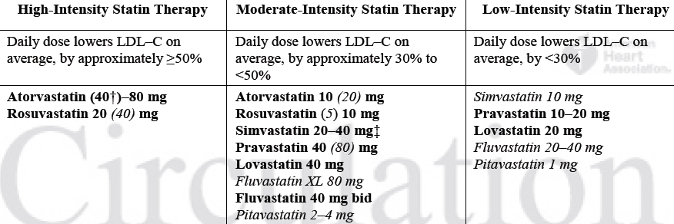




High- Moderate- and Low-Intensity Statin Therapy
Stone NJ, et al. 2013 ACC/AHA Blood Cholesterol Guideline
published online November 12, 2013 Circulation
JACC, Nov 12, 2013

Slide 8
Significant Numbers of the Highest Risk Patients Globally are Unable to Achieve LDL–C Goal
LDL-C
at goal
LDL-C
not at goal
Approximately 70% of patients at the highest risk* are not at optimal < 70 mg/dL (1.8 mm/L) LDL-C goal**
Countries included in this analysis: United States, Canada, Spain, Netherlands, France, Taiwan, Korea, Brazil and Mexico.
*High risk defined as: CHD plus ≥2 major risk factors
**Optimal goal <70 mg/dL (1.8 mmol/L) ¹
Waters DD, et al. Circulation. 2009;120:28-34.
Notes:
Waters DD, et al.2009:31, A2, and 33, B3

Slide 9
Management of difficult dyslipidemia
Familial Hypercholesterolemia
Statin Intolerance

Slide 10
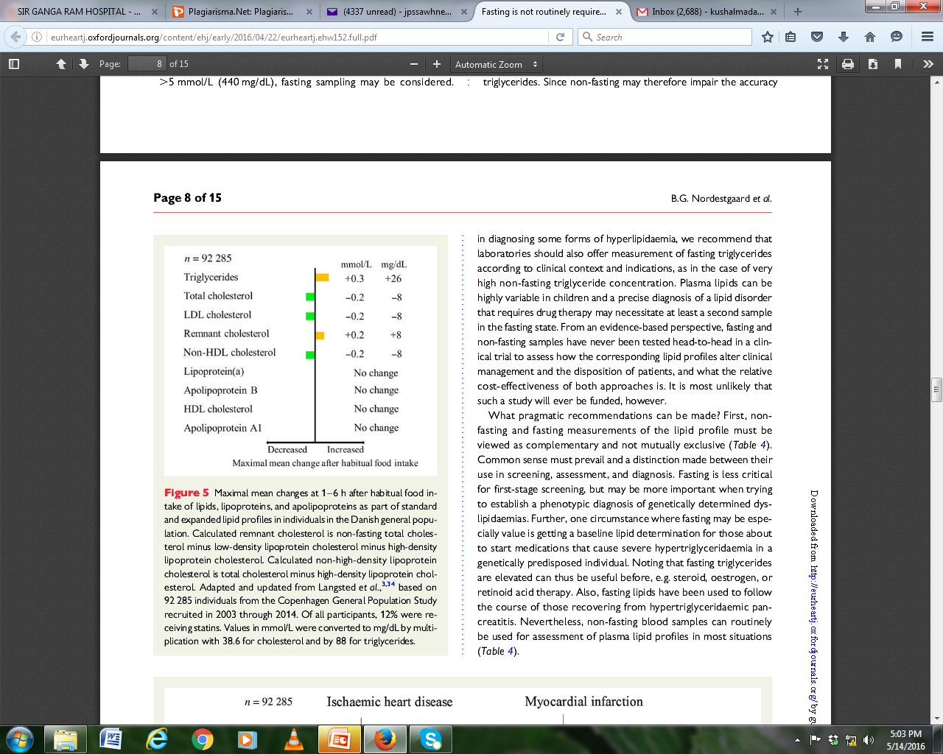
Fasting lipid profile no longer required
Dyslipidemia guidelines ESC 2016
Maximal mean change after habitual food intake
Simple
Compliance
More No.
Avoid early morning crowding
Maximal mean changes at 1-6 hr after habitual food intake of lipids, lipoproteins, and apolipoproteins as part of standard and expanded lipid profiles in individuals in the Danish general population.

Slide 11
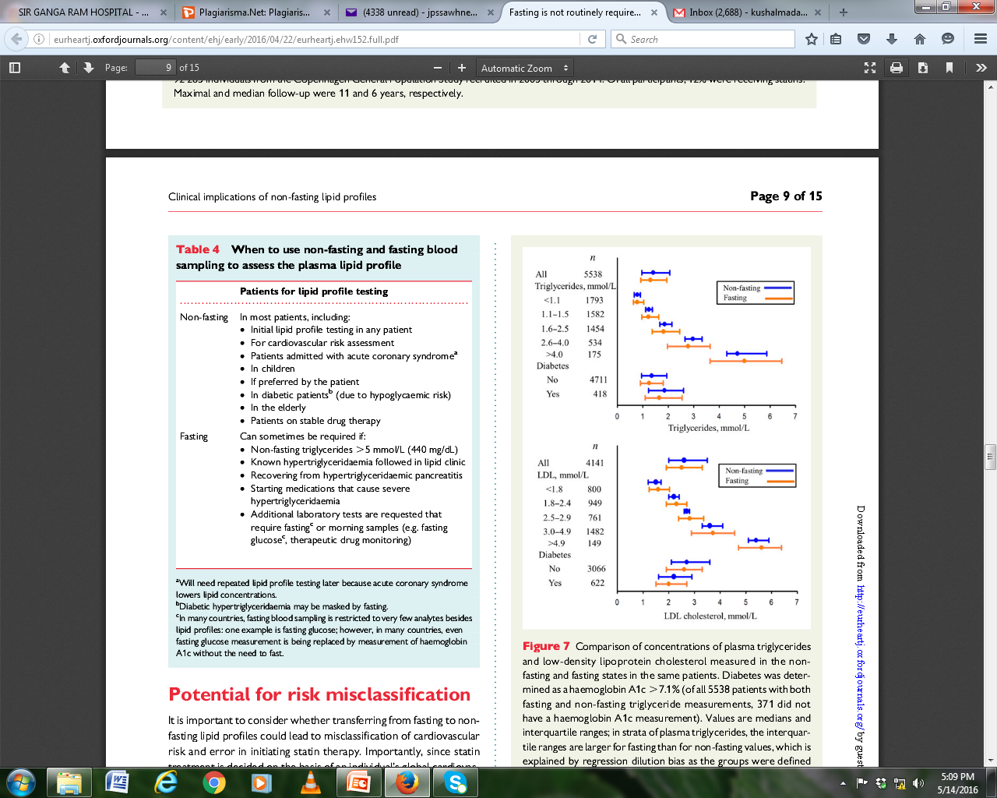
When to use non-fasting and fasting blood sampling to assess the plasma lipid profile

Slide 12
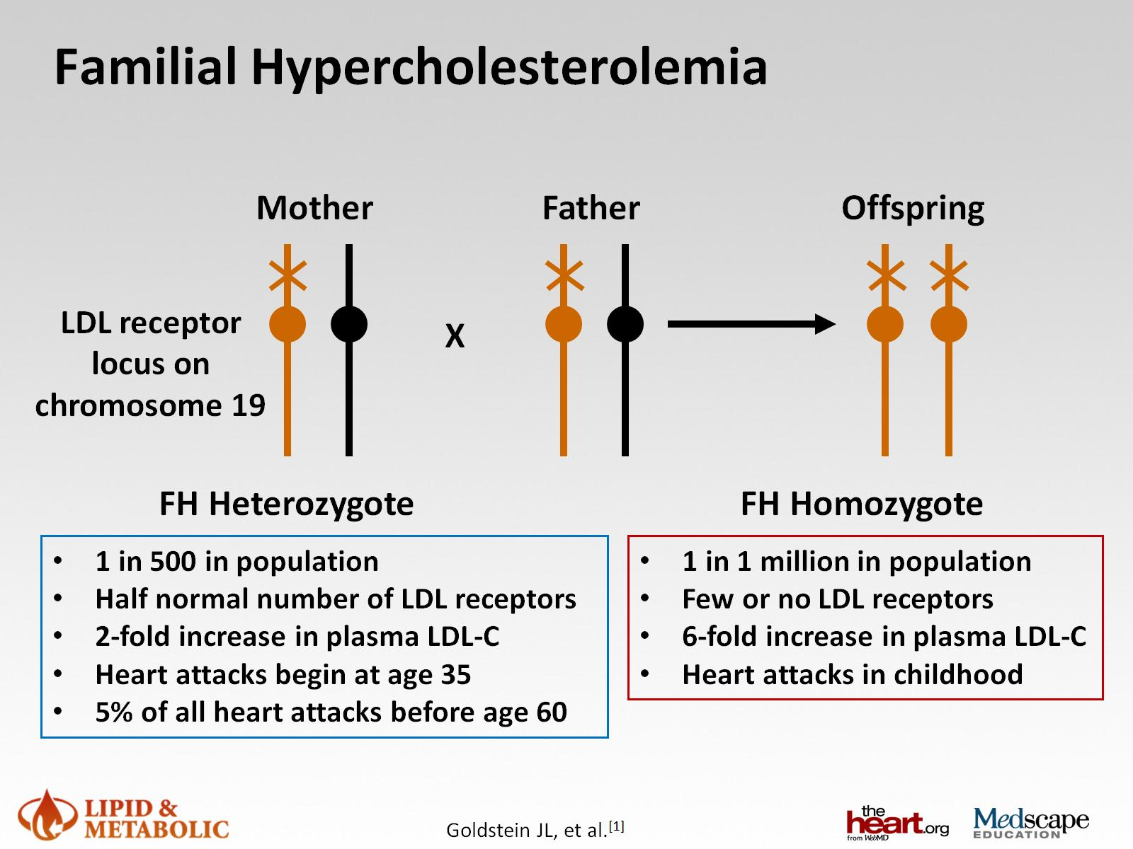
Familial Hypercholesterolemia
Under Diagnosed And Under Treated Clinical Entity
1% OF FH ARE DIAGNOSED IN MOST COUNTRIES

Slide 13
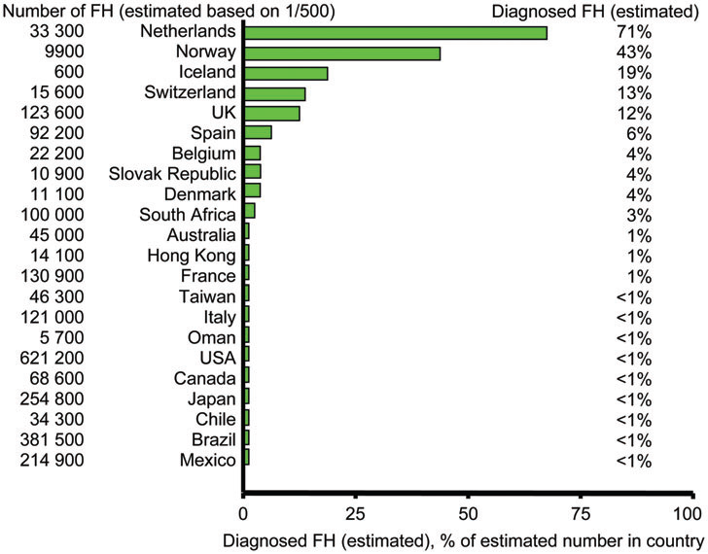
Estimated per cent of individuals diagnosed with familial hypercholesterolaemia in different countries/territories
Nordestgaard et al., European Heart Journal (2013) 34, 3478–3490

Slide 14
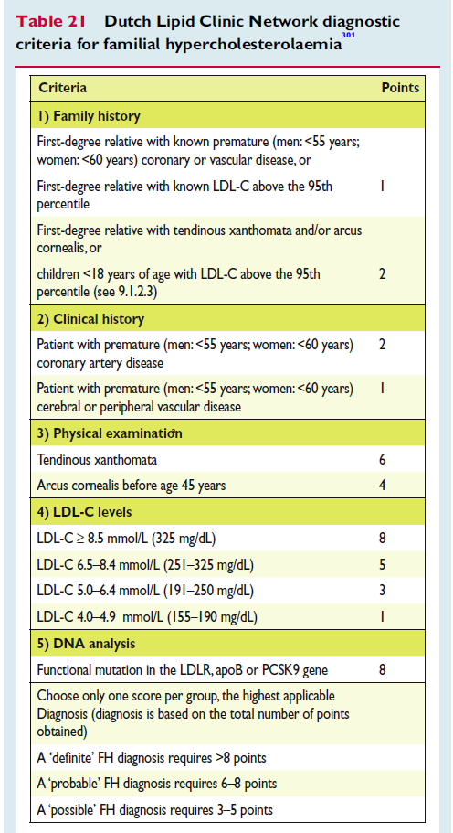
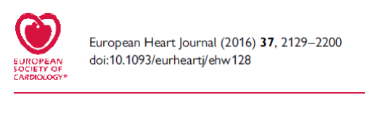
ESC Guidelines
Dutch Lipid Clinic Network diagnostic criteria for familial hypercholesterolaemia

Slide 15
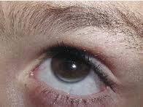

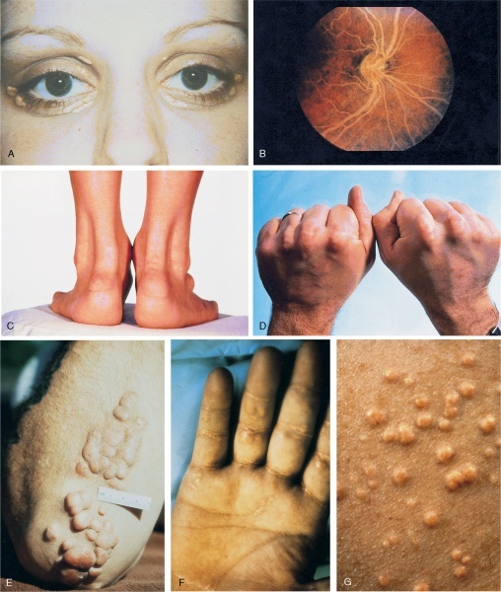
Visible Signs of FH
A- Xanthelasma
B – Corneal arcus (Arcus senilis)
C - Achilles tendon xanthomas
D - Tendon xanthomas
E - Tuberous xanthomas
F - Palmar xanthomas
Mahley RW et al. In Kronenberg: Williams Textbook of Endocrinology 2008
Notes:
Maley/19/Figure 36-22
What about arcus cornealis? Also can we note that tendon xanthomas [in asterix] may not be visible but detected through physical exam?

Slide 16
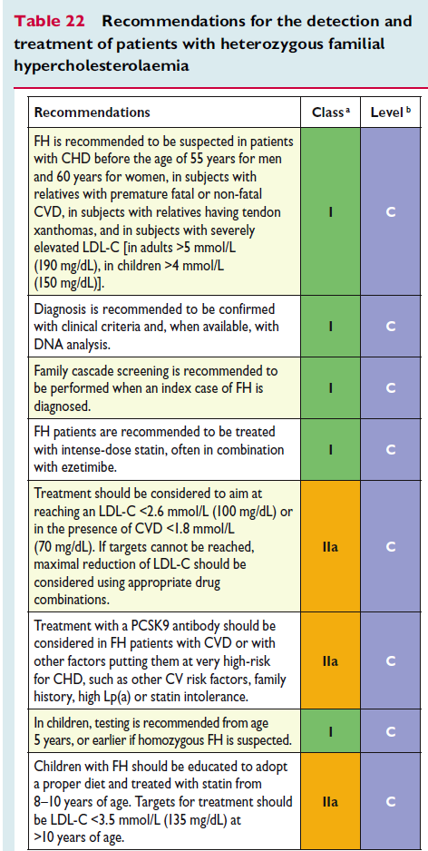
Recommendations for the detection and treatment of patients with heterozygous familial hypercholesterolemia
ESC Guidelines

Slide 17
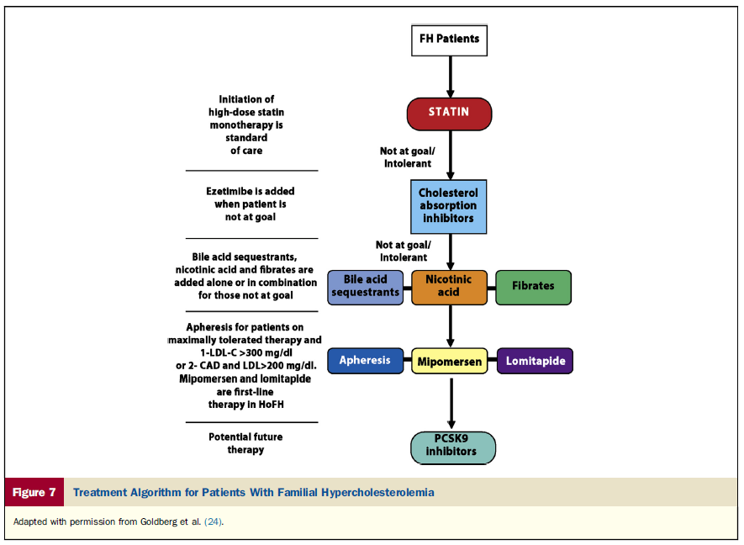
Treatment algorithm for patients with Familial Hypercholesterolemia
Mipomersen – ApoB synthesis Inhibitors
Lomitapide – MTP inhibitors
Goldberg et al

Slide 18
IMPROVE-IT: Study Design
Patients stabilized post ACS ≤ 10 days:
LDL-C 50–125*mg/dL (or 50–100**mg/dL if prior lipid-lowering Rx)
*3.2mM
**2.6mM
N=18,144
Standard Medical & Interventional Therapy
Simvastatin
40 mg
Uptitrated to
Simva 80 mg
if LDL-C > 79
(adapted per
FDA label 2011)
Ezetimibe / Simvastatin
10 / 40 mg
Follow-up Visit Day 30, every 4 months
90% power to detect
~9% difference
Duration: Minimum 2 ½-year follow-up (at least 5250 events)
Primary Endpoint: CV death, MI, hospital admission for UA,
coronary revascularization (≥ 30 days after randomization), or stroke
Cannon CP, N Engl J Med. 2015;372:2387
Notes:
Waters DD, et al.2009:31, A2, and 33, B3

Slide 19
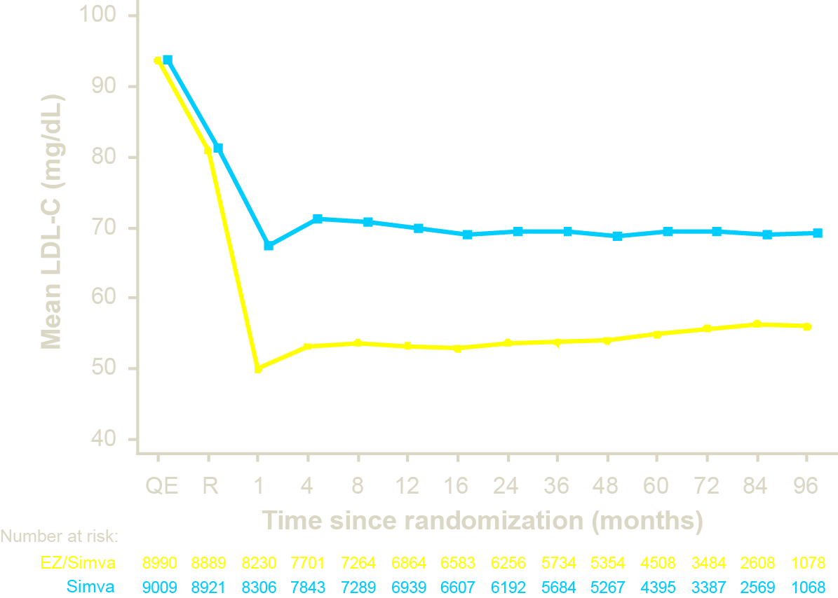
IMPROVE-IT: LDL-C and Lipid Changes
1 Yr Mean | LDL-C | TC | TG | HDL | hsCRP
Simva | 69.9 | 145.1 | 137.1 | 48.1 | 3.8
EZ/Simva | 53.2 | 125.8 | 120.4 | 48.7 | 3.3
Δ in mg/dL | -16.7 | -19.3 | -16.7 | +0.6 | -0.5
69.5
Median Time avg
69.5 vs. 53.7 mg/dL
53.7
Cannon CP, N Engl J Med. 2015;372:2387
Notes:
Waters DD, et al.2009:31, A2, and 33, B3

Slide 20
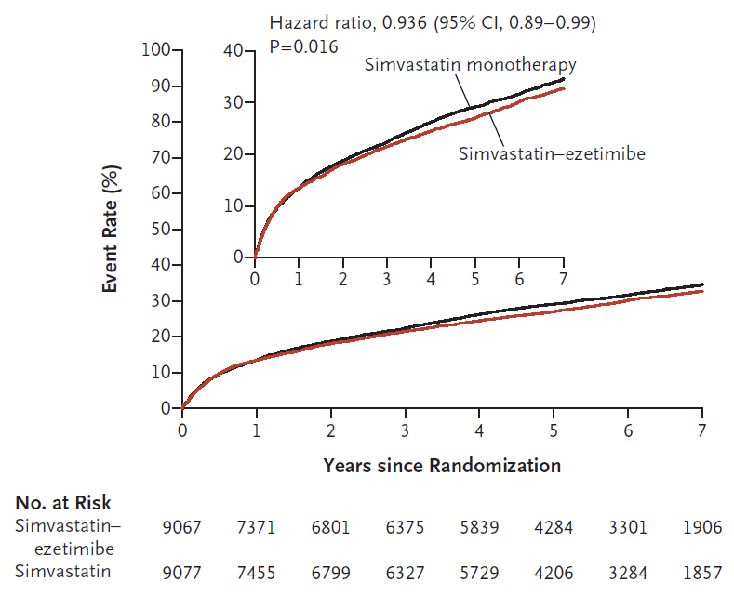
IMPROVE-IT: Primary Endpoint – ITT
Cardiovascular death, MI, documented unstable angina requiring rehospitalization, coronary revascularization (≥30 days), or stroke
Simva — 34.7%
2742 events
p=0.016
EZ/Simva — 32.7%
2572 events
RRR=6.64%
ARR=2%
NNT=50
Cannon CP, N Engl J Med. 2015;372:2387
Notes:
Waters DD, et al.2009:31, A2, and 33, B3

Slide 21
Why diagnosis of FH is important?
Cascade screening can identify sibling & children with dyslipidemia – Rx can prevent premature CAD.

Slide 22
Statin Intolerance
Statin intolerance - frequent problem (20%* ).
Common Side Effects : Myalgia and Myopathy, hepatotoxicity, Hemorrhagic stroke, cognitive decline, peripheral neuropathy, Diabetes, Insomnia,Tendinitis, Arthralgia, Arthritis, Cataract, gastrointestinal symptoms.
In population based studies, statin-induced myalgias is a major cause of discontinuation of treatment in the patients
Importance : In CAD patients
  statin intolerance is associated with 81% relative risk increase for MI and 53% relative risk increase for all-cause mortality.
DIABETES CARE, VOLUME 36, SUPPLEMENT 2, AUGUST 2013
* Journal of General Internal Medicine 2008:23(8):1182-86

Slide 23
PRIMO Study
Observational study on muscular symptoms in an unselected population receiving high-dose statin therapy
15-20% of 7924 patients reported Myalgia
Statin | Number of Patients | % patients with Muscular symptoms
Pravastatin 40 mg | 1901 | 10.9
Atorvastatin 40 or 80 mg | 1844 | 14.9
Simvastatin 40 or 80 mg | 1027 | 18.2
Fluvastatin XL 80 mg | 3121 | 5.1
Overall | 832/7924 | 10.5
Bruckert et al., Cardiovasc Drugs Ther. 2005; 19:403-414

Slide 24
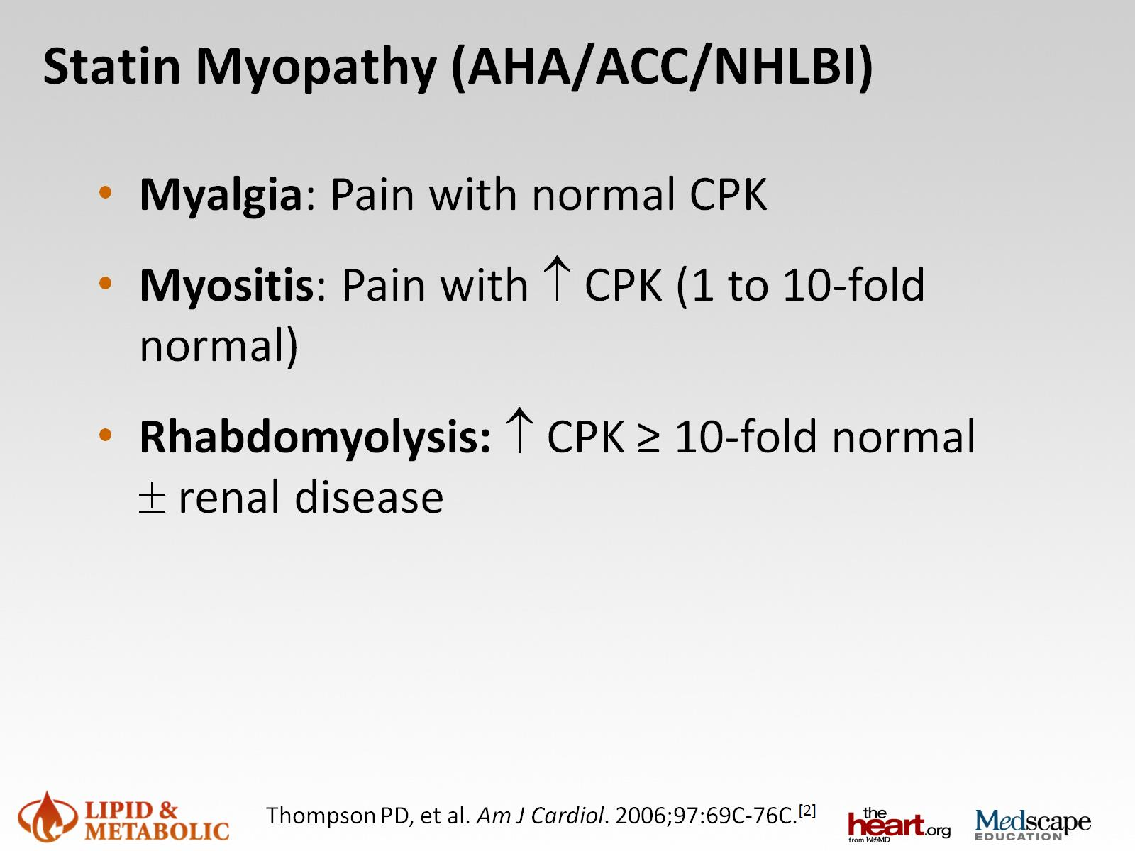
Statin Myopathy (AHA/ACC/NHLBI)
> 1000 units/L
> 10,000 units/L

Slide 25
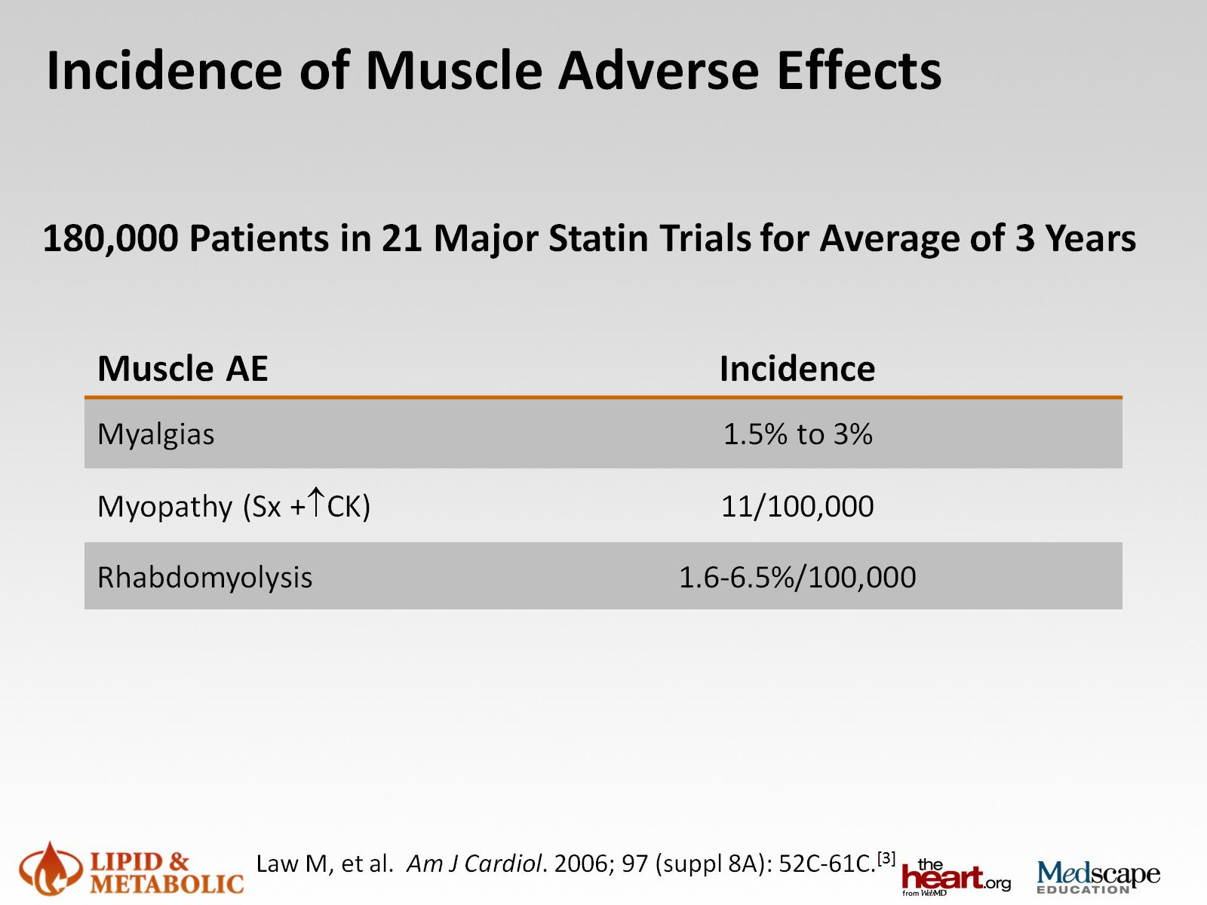
Incidence of Muscle Adverse Effects
Low incidence is because of Run in phase exclusion because of symptoms and increase CPK
Underrepresentation of vulnerable patients – elderly, patient with co morbidities , mayalgia as side effect was excluded from trial

Slide 26
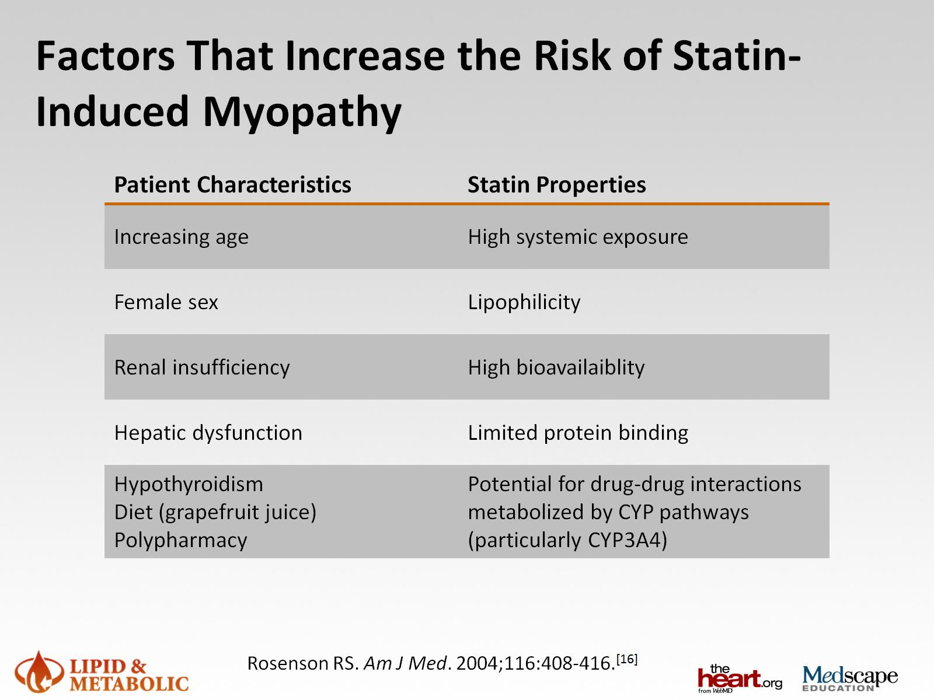
Factors That Increase the Risk of Statin-Induced Myopathy
*
**
* Atorva, Simva
**Antifungal, Macrolide, Fibrates, CCB
Hydrophilic – Rosuva/PRAVA

Slide 27
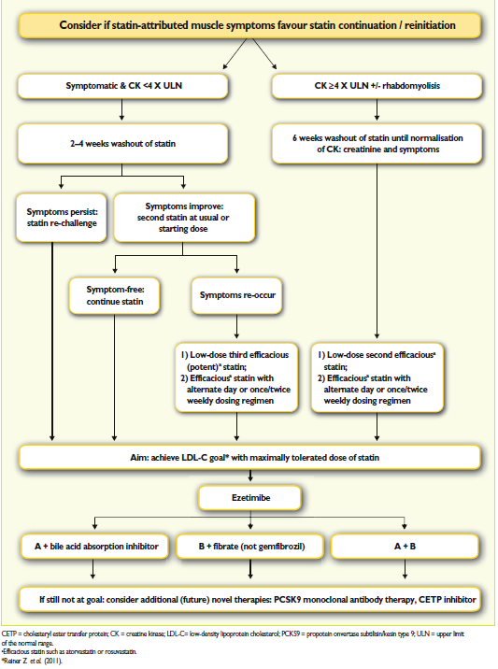
Algorithm for treatment of muscular symptoms during statin treatment
Every effort to keep high risk patients back on statin
Assess & treat possible contributing factors – hypothyroid, Vit D deficiency
Switching statins to water soluble and long acting
(Atorva Rosuva)
Intermittent dosing
Success in 50-60%

Slide 28
Most statin-intolerant patients can be restarted on lipid-lowering drugs
Cleveland Clinic experience
1605 patients of statin intolerance,
1014(72.5%) were successfully rechallenged with rosuvastatin and FUP for a median of 31 months.
Slowly rechallenged – 1/wk, increased to 2/wk, then 3/wk, until they were once again taking a statin daily.
149 patients were restarted on a statin with an intermittent dosing strategy, (that is not taken daily) and showed
    27.7% reduction in LDL-c,
21.3% reduction among patients rechallenged with a daily statin.
Mampuya WM, Frid D, Rocco M, et al. Treatment strategies in patients with statin intolerance:
the Cleveland Clinic experience. Am Heart J 2013; 166: 597-603.

Slide 29
Pitavastatin For Statin Intolerant Patients
In Florida, USA, 152 patients intolerant to > 2 previous statins due to myopathy (average 2.7 statins) were placed on pitavastatin therapy.
Percentage (%) of patients tolerating pitavastatin and achieving NCEP ATP-III LDL-C goal non-HDL-C goal were measured
104 patients (76%) patients tolerated pitavastatin therapy and continued it for > 6 months
87% of patients with intermediate CV risk achieved their NCEP-ATP III LDL-C goals with pitavastatin therapy
Journal of Clinical Lipidology 2012: 6(3) : 274

Slide 30
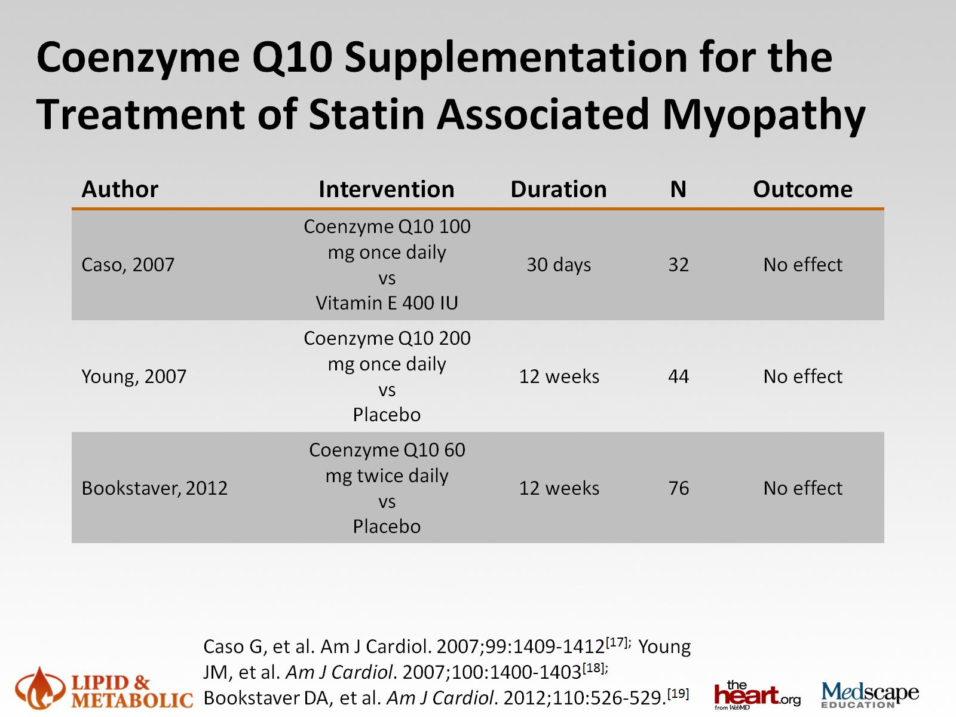
Coenzyme Q10 Supplementation for the Treatment of Statin Associated Myopathy

Slide 31
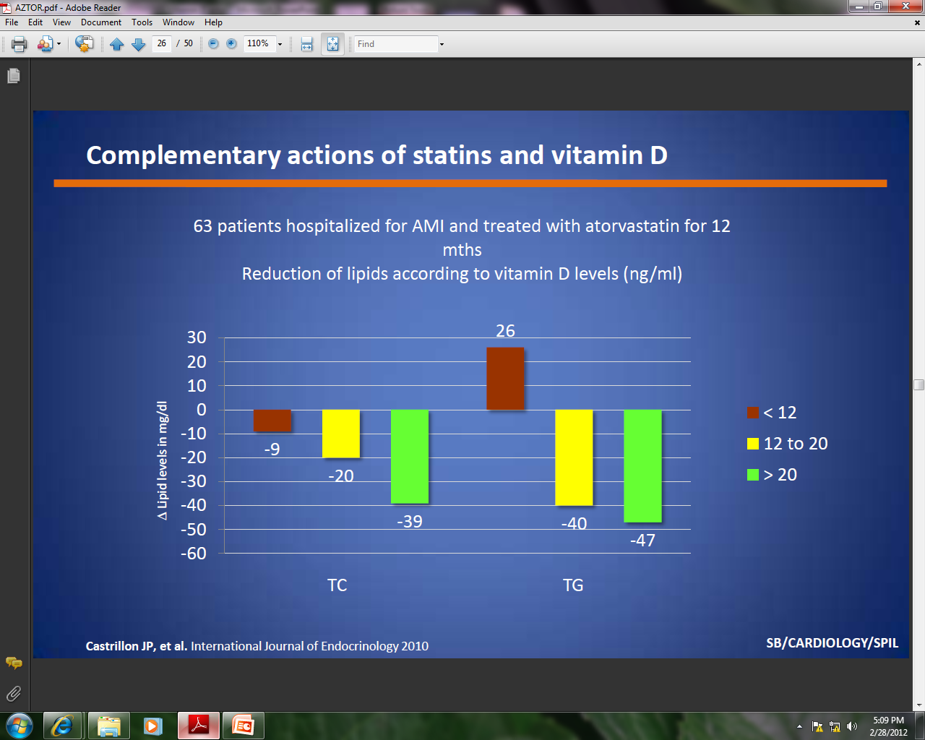
Complementary actions of statins and vitamin D
Castrillon JP, et al. International Journal of Endocrinology 2010

Slide 32
Vitamin D deficiency & Myalgia:
Mechanism
In Vitamin D deficiency, generation of proteins that are needed for repair of the T-tubular system and prevention of sub-sarcollemmal rupture does not occur, Resulting in Myalgia.
Vitamin D levels < 20 ng/mL associated with
4-fold higher rates of myalgias than with
Vitamin D levels >30 ng/mL
Draeger A, Monastyrskaya K, Mohaupt M, et al. Statin therapy induces ultrastructural damage in skeletal muscle in patients without myalgia. J Pathol 2006;210:94–102.
Barton Duell et al; AHA 208 Scientific Sessions.

Slide 33
Proprotein convertase subtilisin/kexin type 9
(PCSK9 inhibitor )
Next block buster Drug

Slide 34
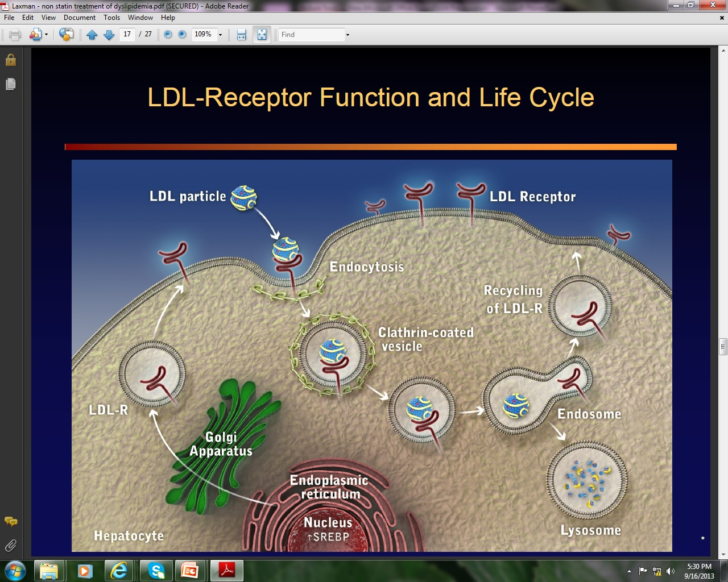
LDL – Receptor Function and Life Cycle
LDL – R play critical role in cellular and circulatory cholesterol by regulating plasma LDL-c

Slide 35
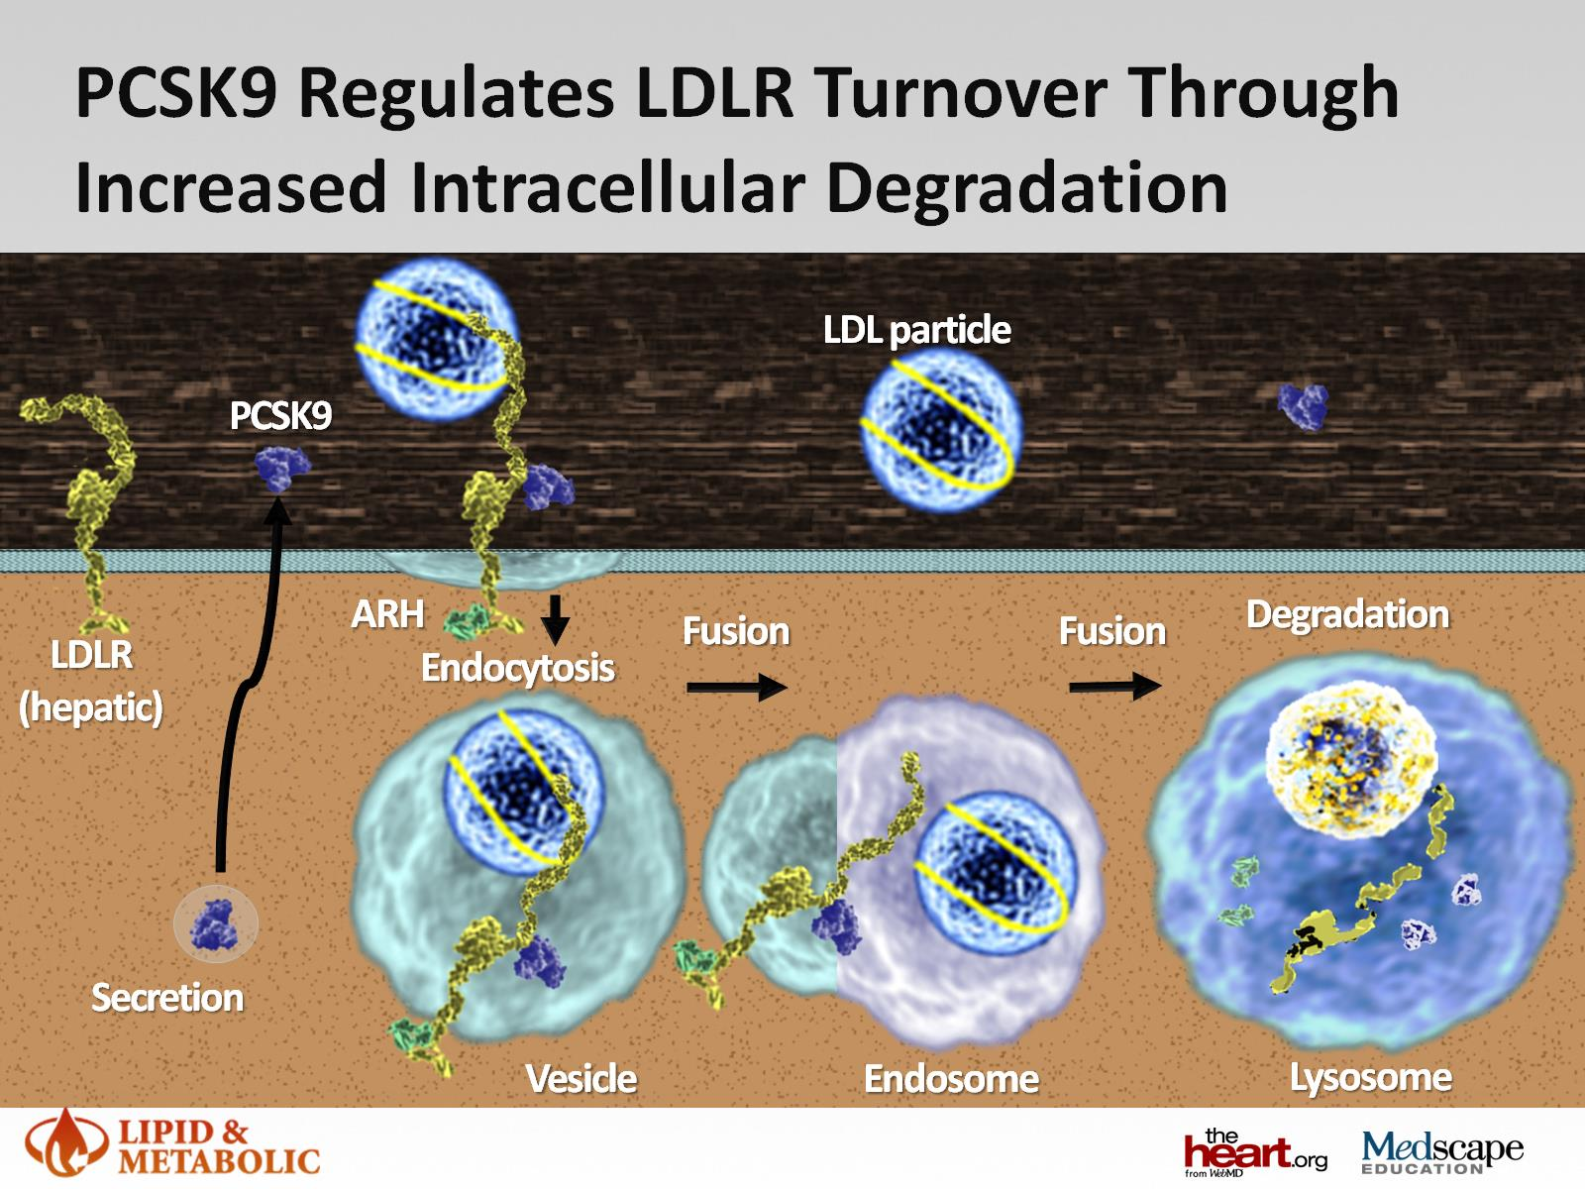
PCSK9 Regulates LDLR Turnover Through Increased Intracellar Degradation
PCSK9 binds to LDL – R causing their degradation thereby reducing the rate at which LDL-C is removed from circulation

Slide 36
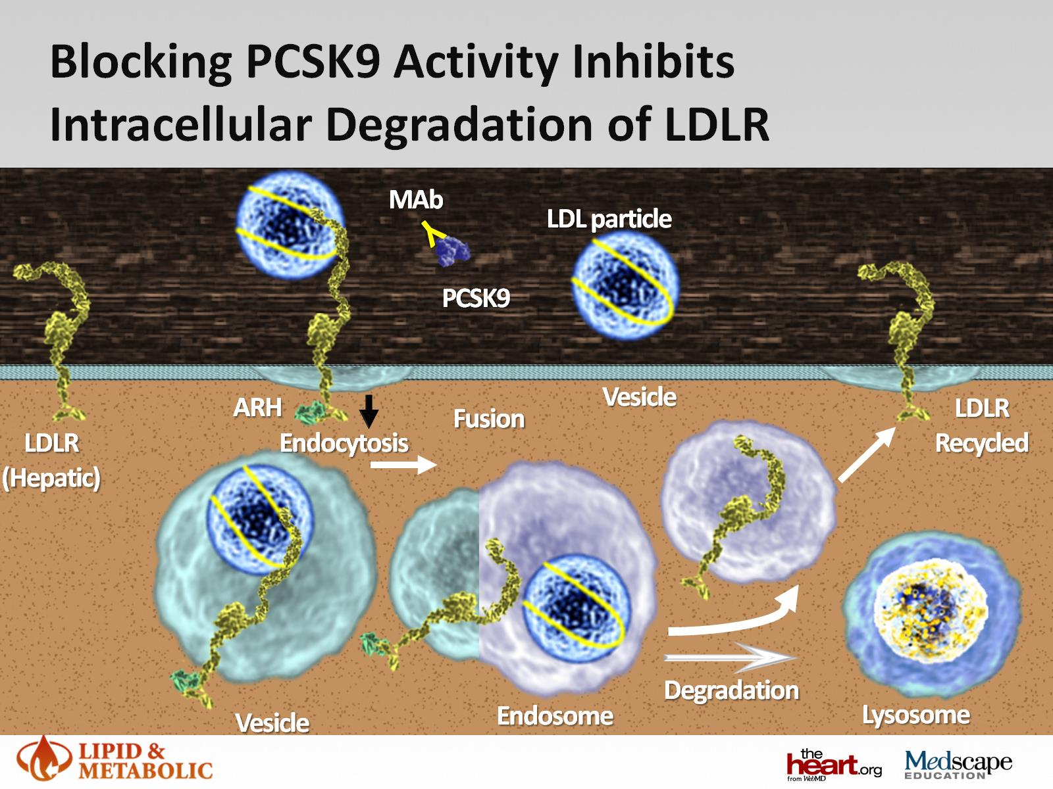

Slide 37
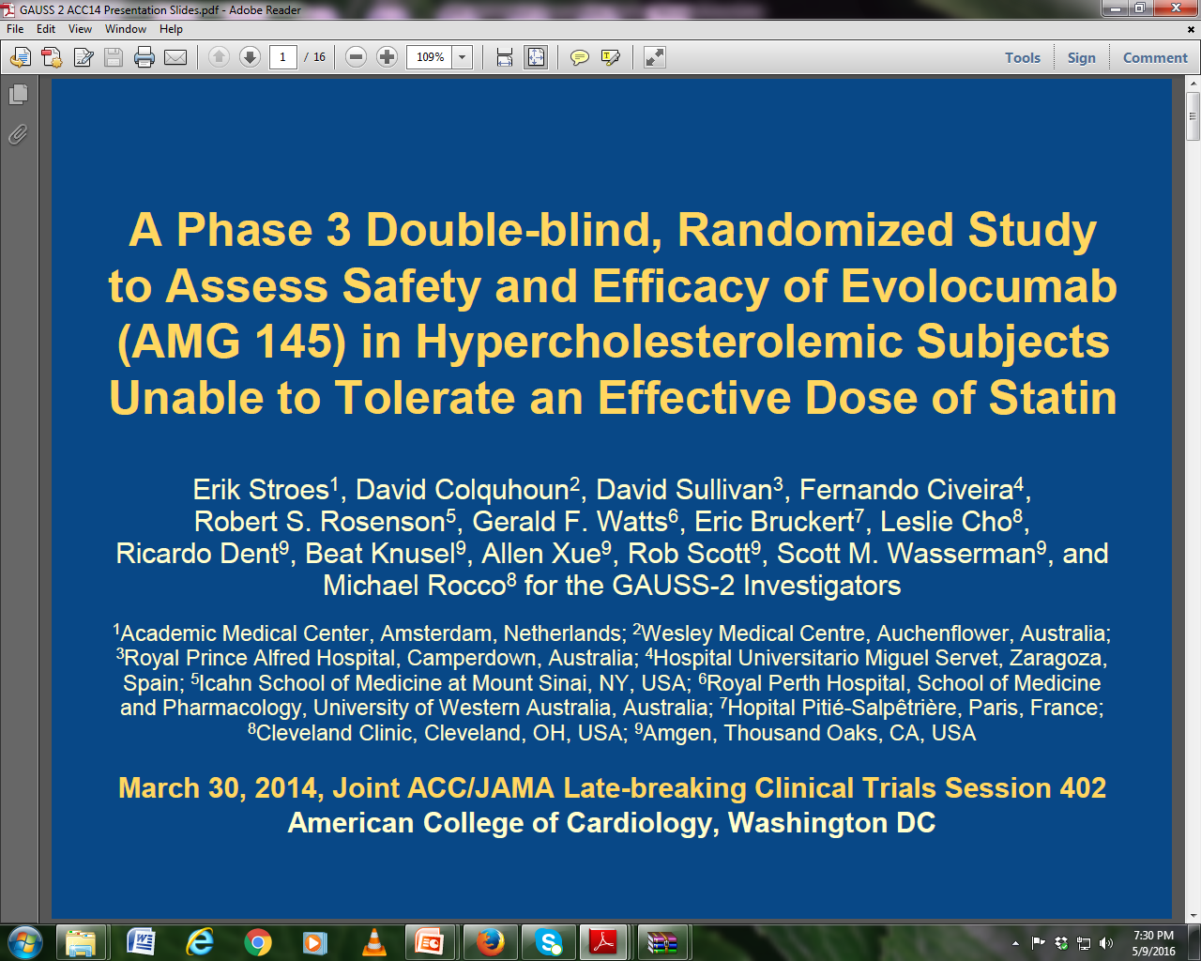

Slide 38
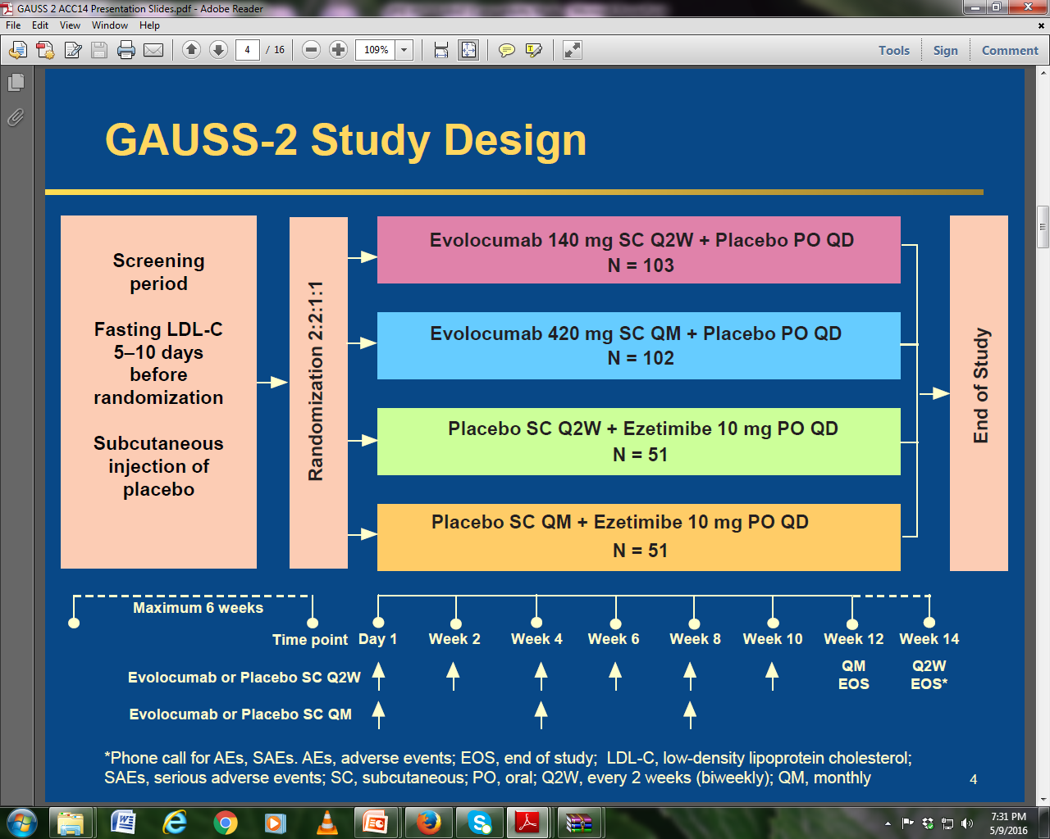
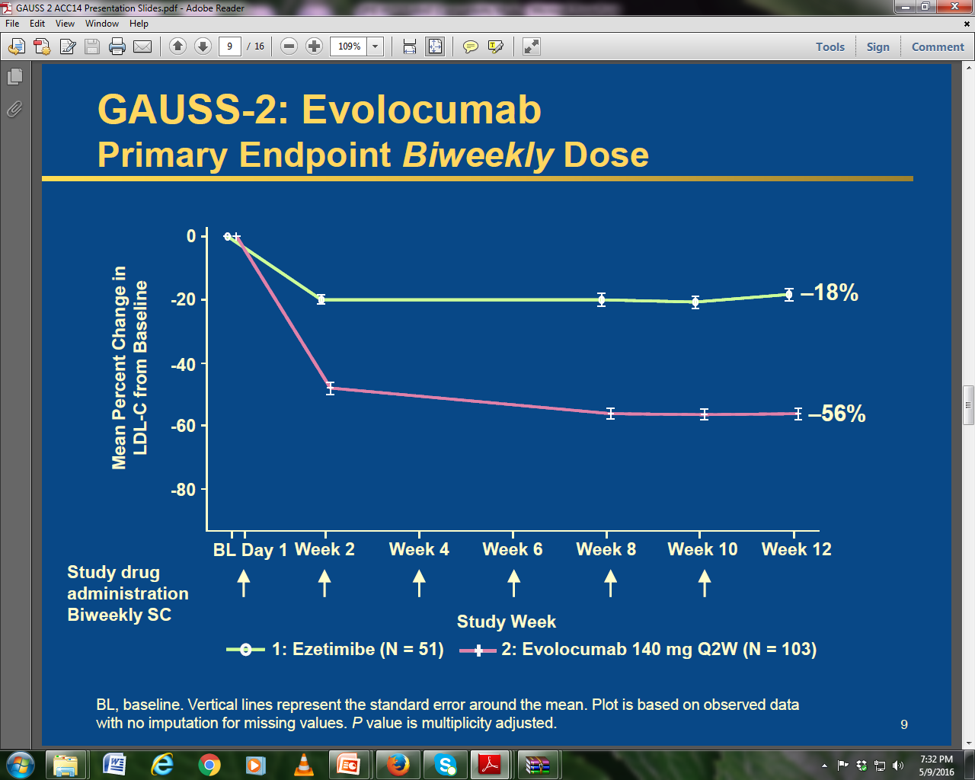
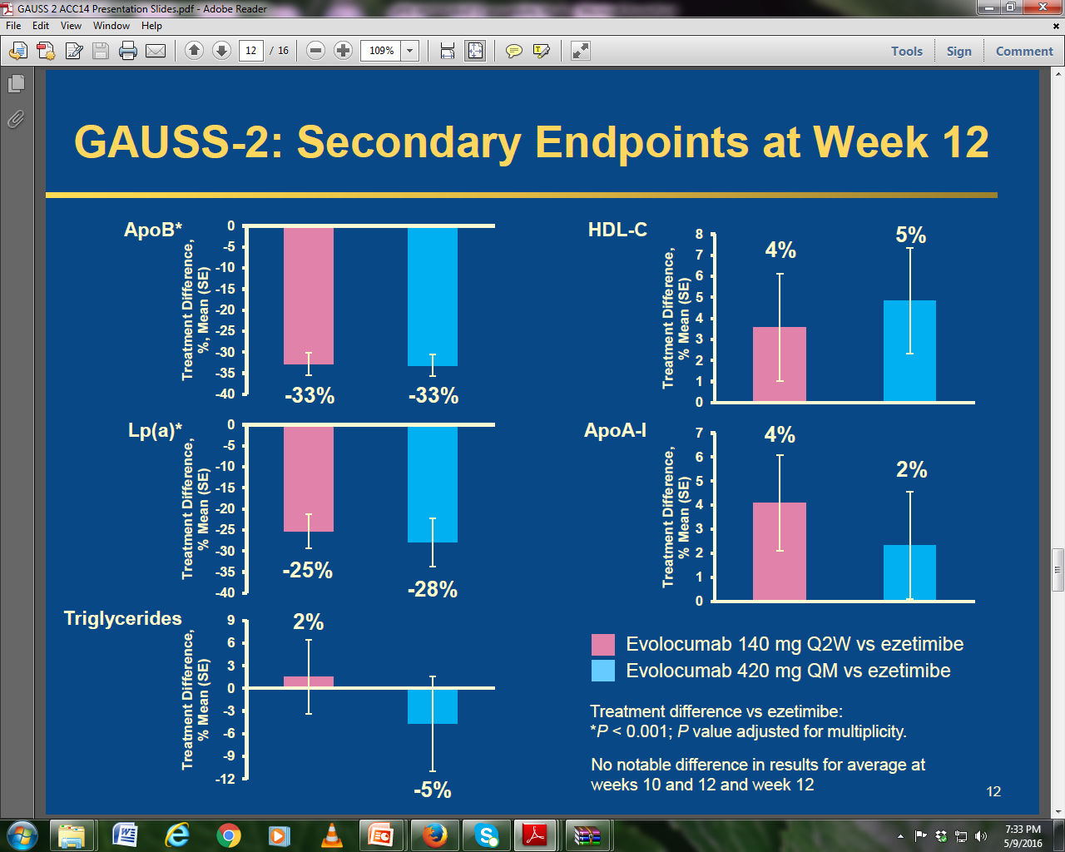
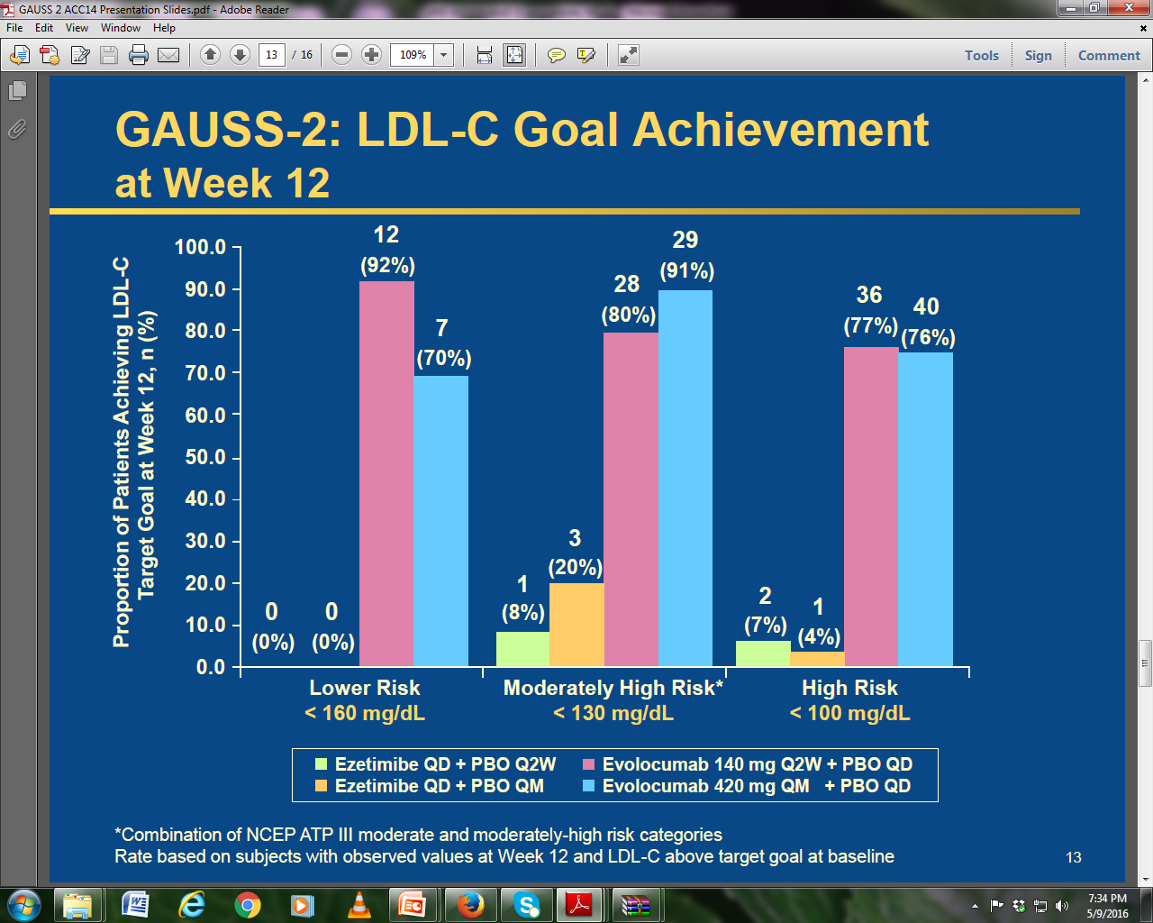

Slide 39
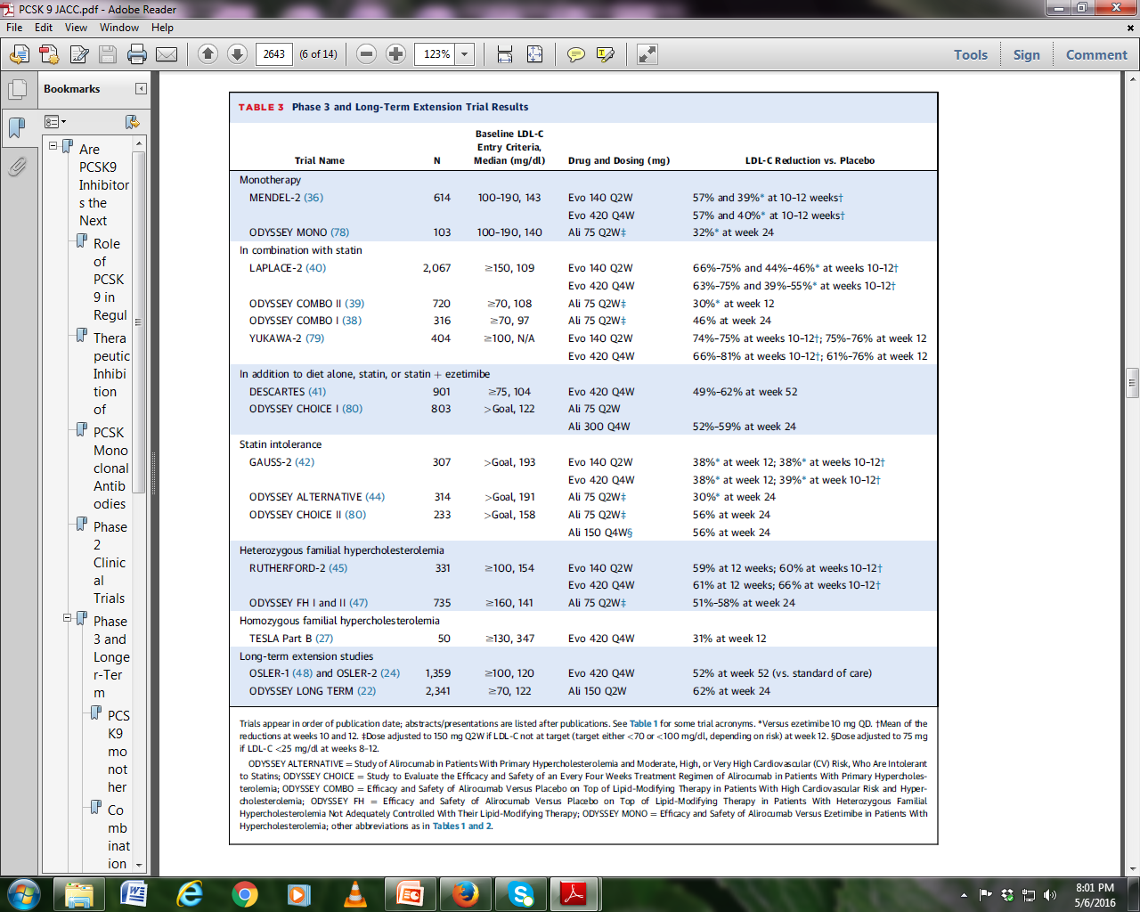
Pcsk9 inhibitors as Monotherapy & combination with Statin ± Ezitemibe

Slide 40
Pcsk9 inhibitors as Monotherapy & combination with Statin ± Ezitemibe in FH & SI

Slide 41
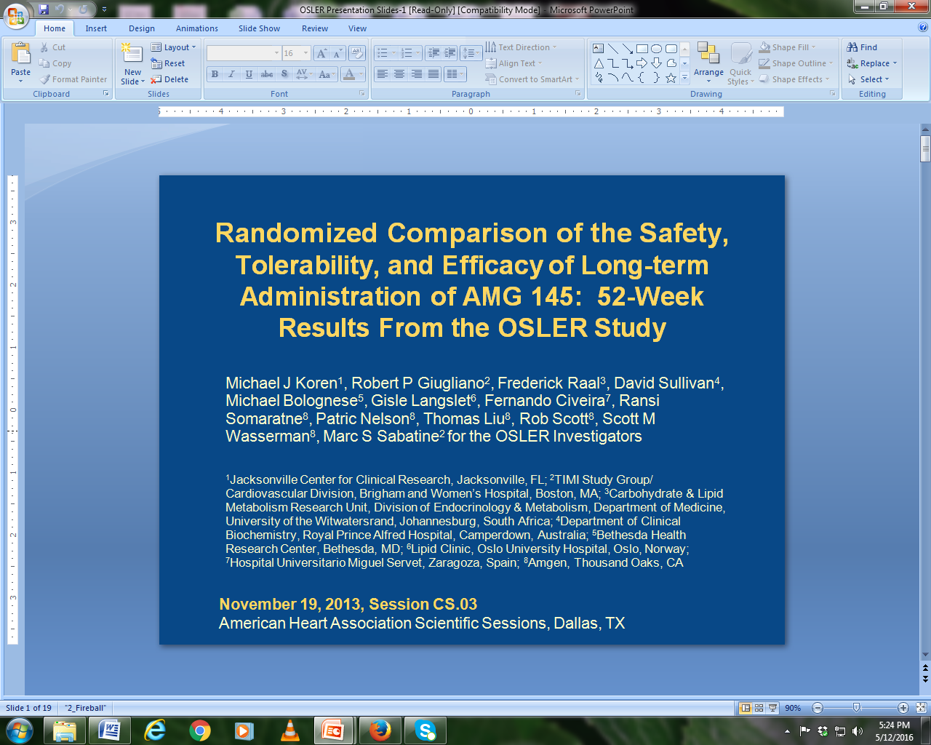
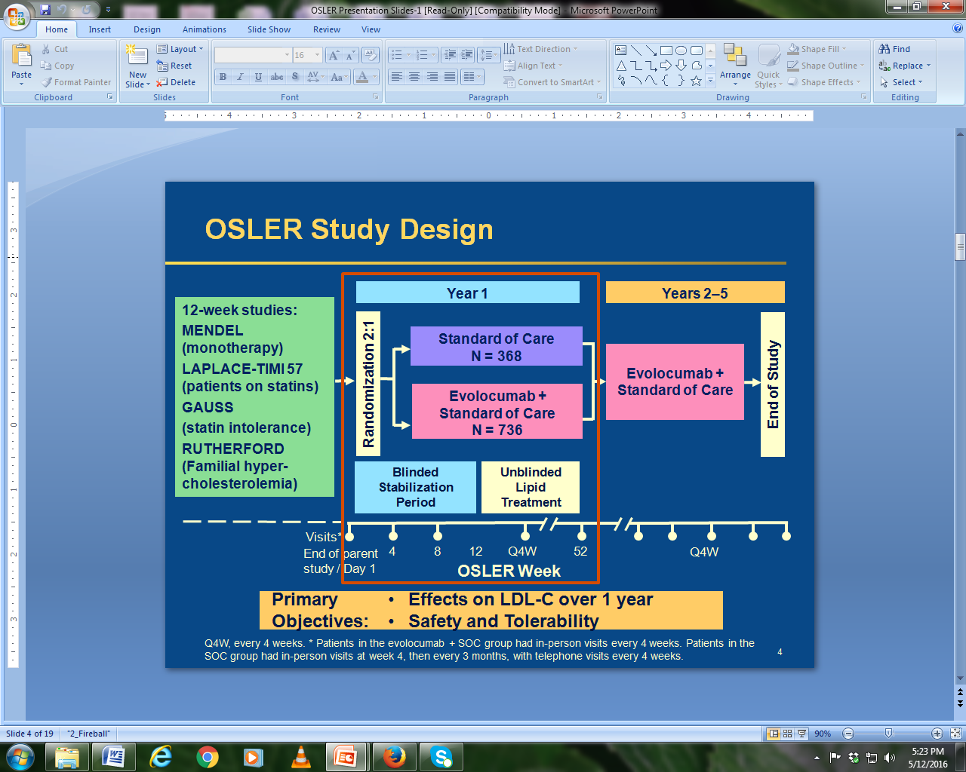
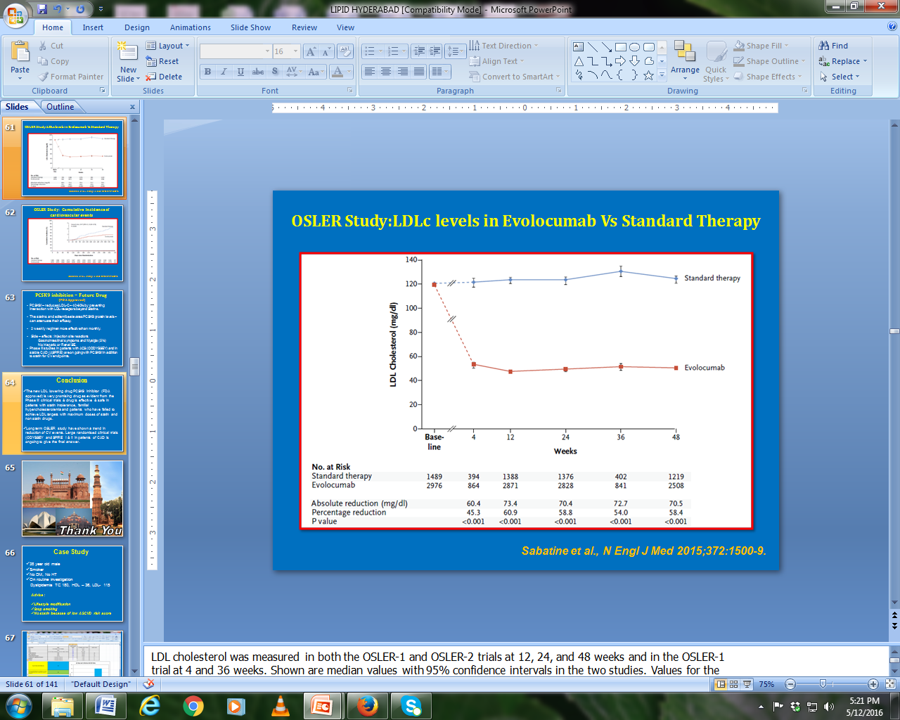
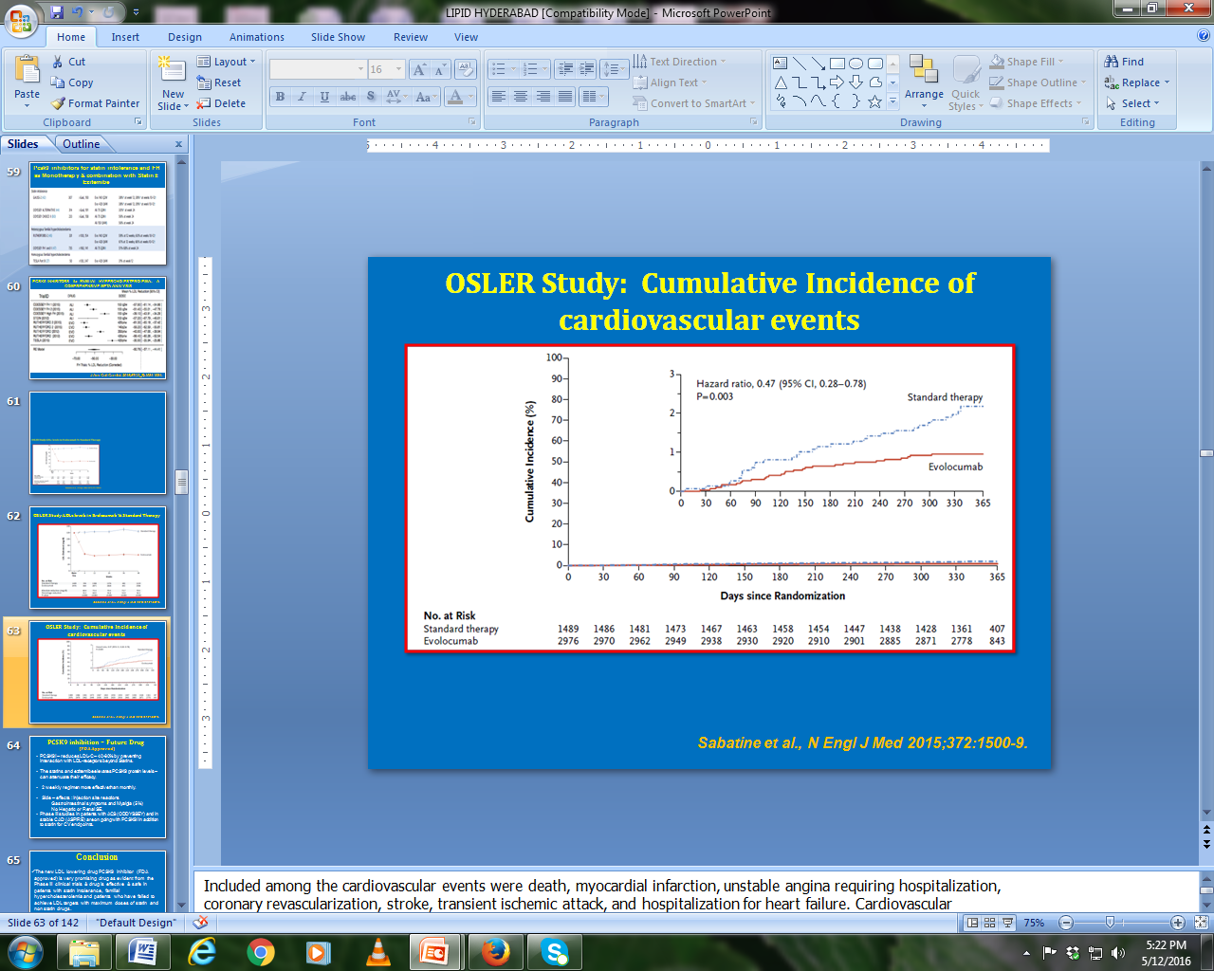

Slide 42
PCSK9 inhibition – Future Drug
(FDA Approved)
PCSK9I – reduces LDL-C – 40-60% by preventing interaction with LDL-receptors beyond Statins.
The statins and ezitemibe elevates PCSK9 protein levels – can attenuate their efficacy.
2 weekly regimen more effective than monthly.
Side – effects : Injection site reactions
Gastrointestinal symptoms and Myalgia (5%)
No Hepatic or Renal SE.
Phase III studies in patients with ACS (ODDYSSEY) and in stable CAD (ASPIRE) are on going with PCSK9I in addition to statin for CV endpoints.

Slide 43
Conclusion
In clinical practice, difficult management of dyslipidemia is not uncommon.
Statin intolerance due to myalgia is the most common cause of discontinuation of statins, thereby causing increased CV events.
Familial heterozygous hypercholesterolemia is a common problem which is grossly under recognized and undertreated. Inspite of maximum doses of statin with or without Ezetimibe majority of patients do not achieve LDL targets.
In both above situations newer LDL lowering drug PCSK9inhibitor has been found to be very effective and safe either alone or in combination with statin in achieving the LDL targets.

Slide 44
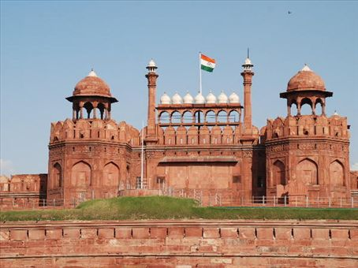
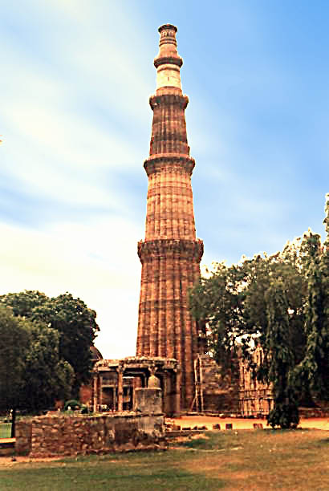


Thank You

Slide 45
IMPROVE-IT: Baseline Characteristics
 | Simvastatin (N=9077) % | EZ/Simva (N=9067) %
Age (years) | 64 | 64
Female | 24 | 25
Diabetes | 27 | 27
MI prior to index ACS | 21 | 21
STEMI / NSTEMI / UA | 29 / 47 / 24 | 29 / 47 / 24
Days post ACS to rand (IQR) | 5 (3, 8) | 5 (3, 8)
Cath / PCI for ACS event | 88 / 70 | 88 / 70
Prior lipid Rx | 35 | 36
LDL-C at ACS event (mg/dL, IQR) | 94 (79, 110) | 94 (79,110)
Cannon CP, N Engl J Med. 2015;372:2387
Notes:
Waters DD, et al.2009:31, A2, and 33, B3

Slide 46
IMPROVE-IT: Safety – ITT
No statistically significant differences in cancer or muscle- or gallbladder-related events (percent)
 | Simva n=9077 | EZ/Simva n=9067 | p
ALT and/or AST≥3x ULN | 2.3 | 2.5 | 0.43
Cholecystectomy | 1.5 | 1.5 | 0.96
Gallbladder-related AEs | 3.5 | 3.1 | 0.10
Rhabdomyolysis* | 0.2 | 0.1 | 0.37
Myopathy* | 0.1 | 0.2 | 0.32
Rhabdo, myopathy, myalgia with CK elevation* | 0.6 | 0.6 | 0.64
Cancer* (7-yr KM %) | 10.2 | 10.2 | 0.57
Cannon CP, N Engl J Med. 2015;372:2387
Notes:
Waters DD, et al.2009:31, A2, and 33, B3

Slide 47
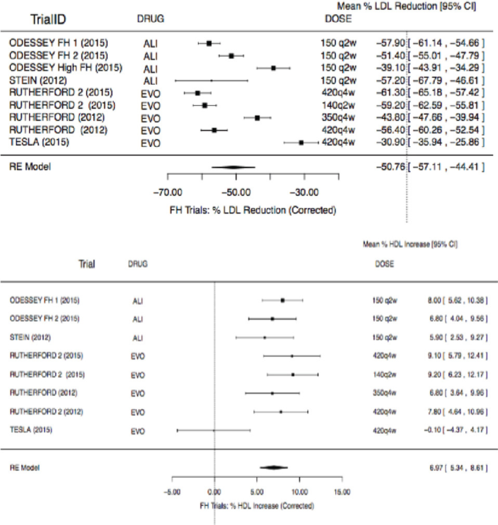
PCSK9 INHIBITORS for FAMILIAL HYPERCHOLESTEROLEMIA: A COMPREHENSIVE META-ANALYSIS
J Am Coll Cardiol. 2016;67(13_S):1984-1984.

Slide 48
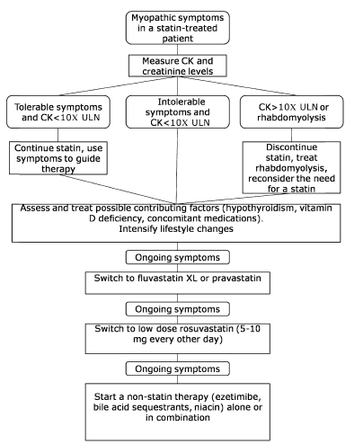
Proposed algorithm for the management of statin-associated myopathy.
Every effort to keep high risk patients back on statin
Switching statins to water soluble and long acting
(Atorva → Rosuva)
(Rosuva → Pitava)
Intermittent dosing
Success in 50-60%
DIABETES CARE, VOLUME 36, SUPPLEMENT 2, AUGUST 2013

Slide 49
Moderate intensity statins for all Indians ?
>50% of LDL as desired by guidelines
Better tolerated – less myalgia and transaminitis
Less incidence of new DM ( 0.1/100 vs. 0.3/100)
Cost effective
Safe to add Non statin lipid lowering drug
Indian consensus recommendation suggest high intensity statin in ACS patient for at least 3 months.

Slide 50
Are These guidelines relevant to Indian population?
Guidelines for dyslipidemia management and treatment have largely been derived from clinical trials comprised of mostly NHW populations, which have often under-represented Asian population.
Atherogenic triad is common and associated with high CVD risk - High TG, Low HDL and small dense LDL – Need of Non statin drugs
Early age of CVD, probably because of high prevalence of Metabolic Syndrome – shall we start statin in early age ?

Slide 51
Are These guidelines relevant to Indian population?
Underestimation of cardiovascular risk by ASCVD risk calculator, hence underutilization of Statin.
Doses of Statin – possibly Asian population respond to modest doses of statin( > 50% LDL reduction). High dose Statin – increase SE ( Myalgia and Transaminitis).
High incidence and prevalence of IGT & MeTS. Concerns - Statin induced risk of DM.
LDL targets may be useful

Slide 52
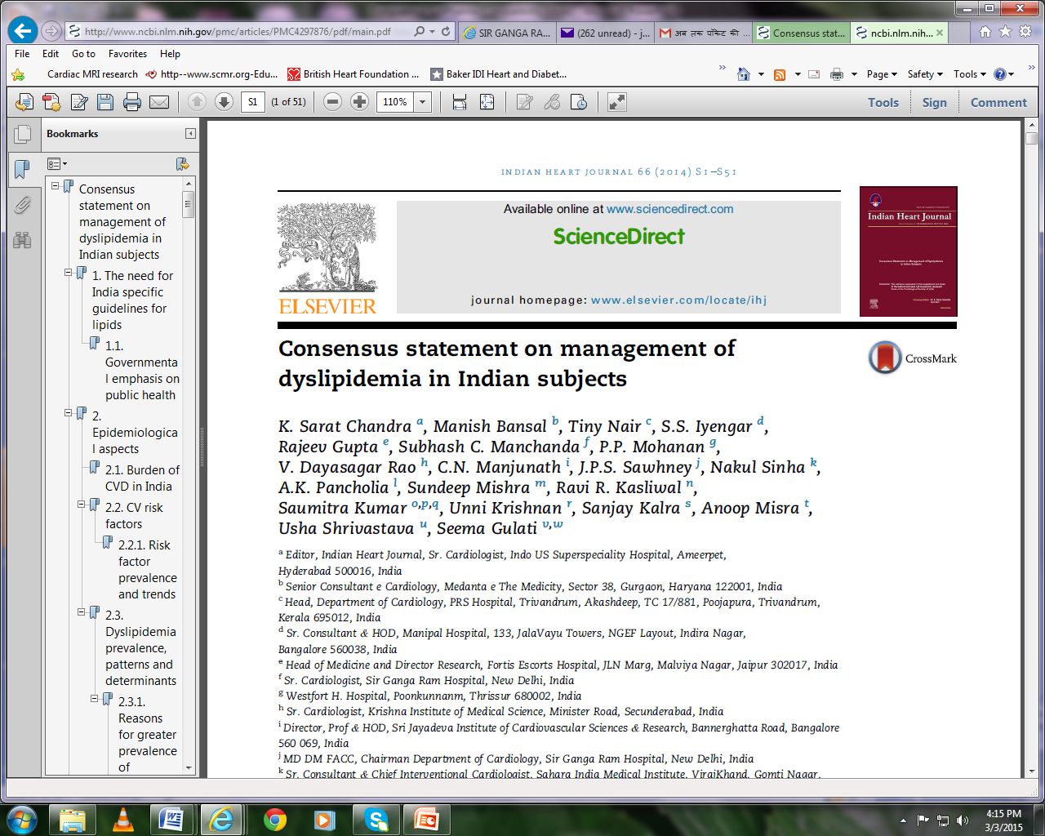

Slide 53
Nine Important Risk Factors for Heart Attack
Inter Heart Study
- 90% prediction of risk
Risk of HA (Times)
- Dr. Salim Yusuf sep. 2004
Lipid Disorder
Diabetes
Smoking
High Blood Pressure
Psychosocial Stress
Central Obesity
X 4
X 3
X 3
X 2.5
X 2.5
X 2.5
29000 subjects,262 sites across 52 countries
Inter Heart included 14820 sub.
& 15152 first MI pts.
Europe - 25%
China - 25%
South Asia - 20%
Middle East - 13%
S. America - 12%
Africa - 5%
Lack of Exercise
Lack of intake of fruits & vegetables
Lack of intake of moderate qt. of alcohol
20-30% in HA

Slide 54
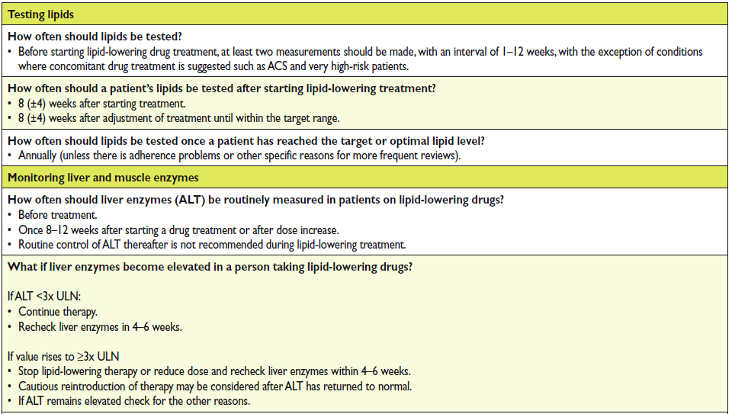

Slide 55
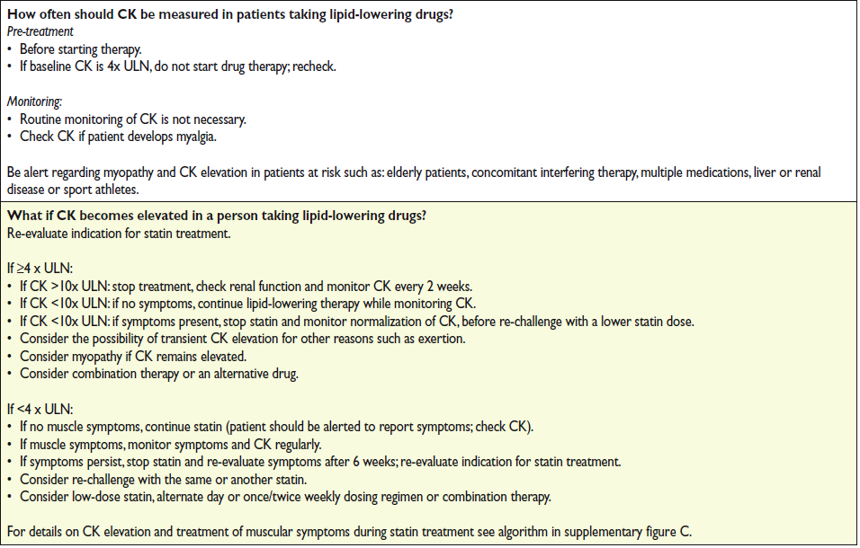

Slide 56
PCSK9 inhibition – Future Drug
PCSK Mabs – reduces LDL-C – 40-60% by preventing interaction with LDL-receptors beyond Statins.
The statins and ezetamibe elevates PCSK9 protein levels – can attenuate their efficacy.
2 weekly regimen more effective
Side – effects : Injection site reactions
Gastrointestinal symptoms and Myalgia (5%)
No Hepatic or Renal SE.
Phase III trials are undergoing with statins or with Ezetamibe for Familial Hypercholesterolemia and refractory hypercholesterolemia at high risk of CAD

Slide 57
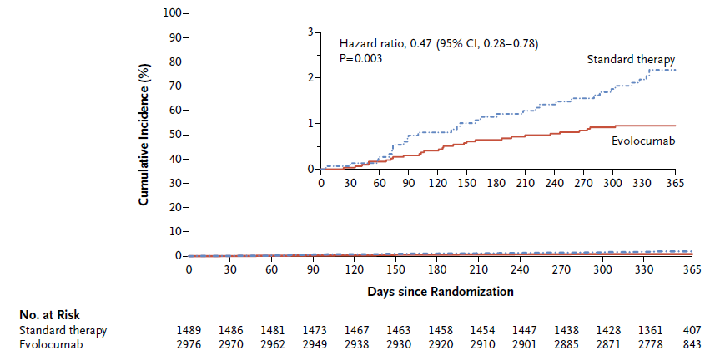
OSLER Study: Cumulative Incidence of cardiovascular events
Sabatine et al., N Engl J Med 2015;372:1500-9.
Notes:
Included among the cardiovascular events were death, myocardial infarction, unstable angina requiring hospitalization,
coronary revascularization, stroke, transient ischemic attack, and hospitalization for heart failure. Cardiovascular
events were reported in 29 of 2976 patients in the evolocumab group (Kaplan–Meier 1-year event rate, 0.95%)
and in 31 of 1489 patients in the standard-therapy group (Kaplan–Meier 1-year event rate, 2.18%). The inset shows
the same data on an expanded y axis. The P value was calculated with the use of a log-rank test.

Slide 58
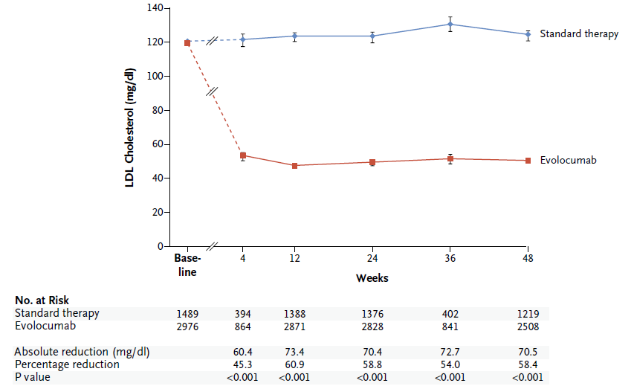
OSLER Study:LDLc levels in Evolocumab Vs Standard Therapy
Sabatine et al., N Engl J Med 2015;372:1500-9.
Notes:
LDL cholesterol was measured in both the OSLER-1 and OSLER-2 trials at 12, 24, and 48 weeks and in the OSLER-1
trial at 4 and 36 weeks. Shown are median values with 95% confidence intervals in the two studies. Values for the
baseline measurement were obtained before randomization into a parent study. The dashed lines indicate that patients
were receiving either evolocumab or placebo during the period from baseline to enrollment into OSLER. In
the chart below the graph, the absolute and percentage reductions in the LDL level in the evolocumab group are
compared with those in the standard-therapy group and are presented as means.

Slide 59
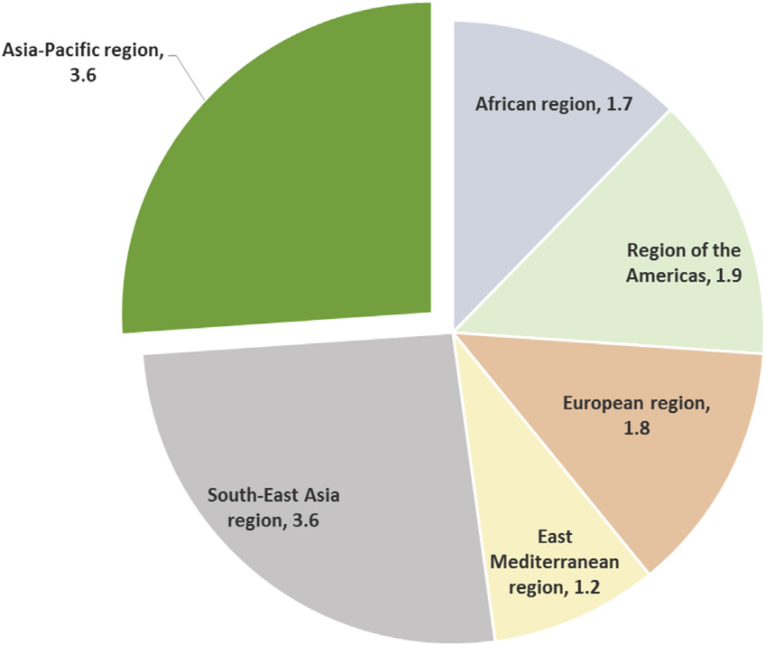
Familial Hypercholesterolemia
Inherited disorder of lipid metabolism
Prevalence - 1 in 300- 500
Frequency is much higher in certain populations (Afrikaners, Ashkenazi Jews, French Canadians, Lebanese)
According to study done on 2500 school children in Delhi & estimated frequency of 1:375, India would have 3.2 million individuals with FH
Adapted from Watts et al Journal of Clinical Lipidology (2015) 9, 42–48
Notes:
Higher Founder effect
59

Slide 60
2013 ACC/AHA Guideline -
Statin Treatment Recommendations
ASCVD Statin Benefit Groups:
Age <75 y, High-intensity statin
(Moderate-intensity statin if not
candidate for high-intensity statin)
Clinical ASCVD
(Adults age >21 y and a candidate for statin therapy)
A
Yes
Age >75 y OR if not candidate for
high-intensity statin,
Moderate-intensity statin
No
Yes
LDL–C ≥190 mg/dL
High-intensity statin
(Moderate-intensity statin if not
candidate for high-intensity statin)
No
Moderate-intensity statin
Diabetes Type 1 or 2, age 40-75 years
Yes
A
No
Estimated 10-y ASCVD risk ≥7.5%*, High-intensity statin
7.5% estimated 10-y ASCVD risk and age 40-75
Yes
Moderate-to-high intensity statin
A
Journal of the American College of Cardiology (2013), doi: 10.1016/j.jacc.2013.11.002.
A – Evidence A, strongly recommended

Slide 61
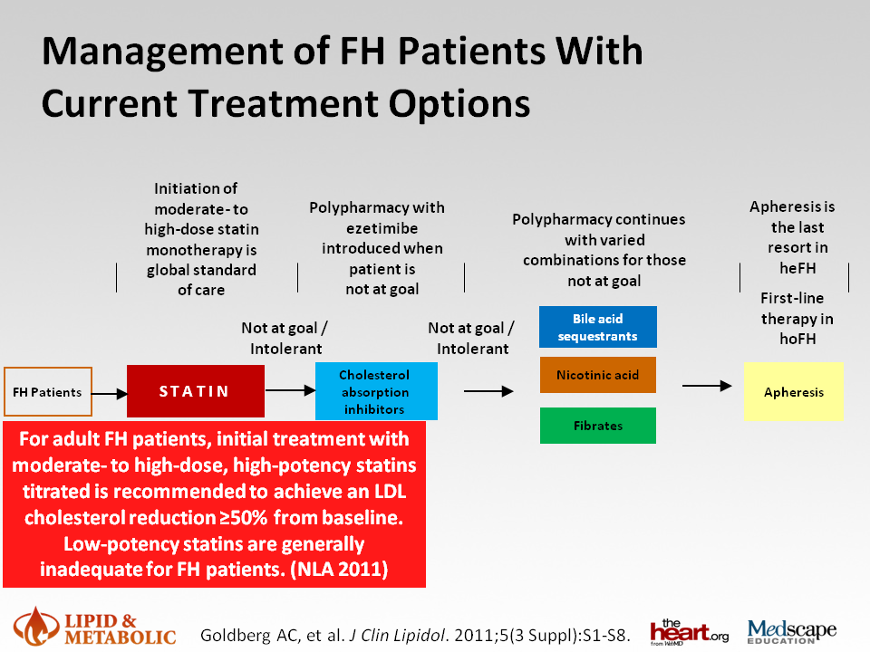

Slide 62
From: EFFICACY AND SAFETY OF PROPROTEIN CONVERTASE SUBTILISIN/KEXIN TYPE 9 INHIBITORS TREATMENT IN FAMILIAL HYPERCHOLESTEROLEMIA: A COMPREHENSIVE META-ANALYSIS OF ALL RANDOMIZED CLINICAL TRIALS27
J Am Coll Cardiol. 2016;67(13_S):1984-1984. doi:10.1016/S0735-1097(16)31985-4
Date of download: 4/29/2016
Copyright © The American College of Cardiology. All rights reserved.

Slide 63
The LAPLACE-2 Trial: A Phase 3, Double-blind, Randomized, Placebo and Ezetimibe Controlled, Multicenter Study to Evaluate Safety, Tolerability and Efficacy of Evolocumab (AMG 145) in Combination With Statin Therapy in Subjects With Primary Hypercholesterolemia and Mixed Dyslipidemia
Jennifer G. Robinson,¹ Bettina S. Nedergaard,² William J. Rogers,³ Jonathan Fialkow,⁴ Joel M. Neutel,⁵ David Ramstad,⁶ Ransi Somaratne,⁷ Jason C. Legg,⁷ Patric Nelson,⁷ Robert Scott,⁷ Scott M. Wasserman,⁷ and Robert Weiss,⁸ for the LAPLACE-2 Investigators
¹College of Public Health, University of Iowa, Iowa City, IA, USA; ²Center for Clinical and Basic Research, Aalborg, Denmark; ³University of Alabama Medical Center, Birmingham, AL, USA; ⁴Herbert Wertheim College of Medicine, Florida International University, Miami, FL, USA; ⁵Orange County Research Center, Tustin, CA, USA; ⁶Hampton Roads Center for Clinical Research, Suffolk, VA, USA; ⁷Amgen Inc., Thousand Oaks, CA, USA; ⁸Maine Research Associates, Auburn, ME, USA
March 30, 2014, Late-Breaking Clinical Trials Session 402
American College of Cardiology, Washington DC

Slide 64
Proposed algorithm for the management of statin-associated myopathy.
Every effort to keep high risk patients back on statin
Switching statins to water soluble and long acting
Intermittent dosing
DIABETES CARE, VOLUME 36, SUPPLEMENT 2, AUGUST 2013

Slide 65
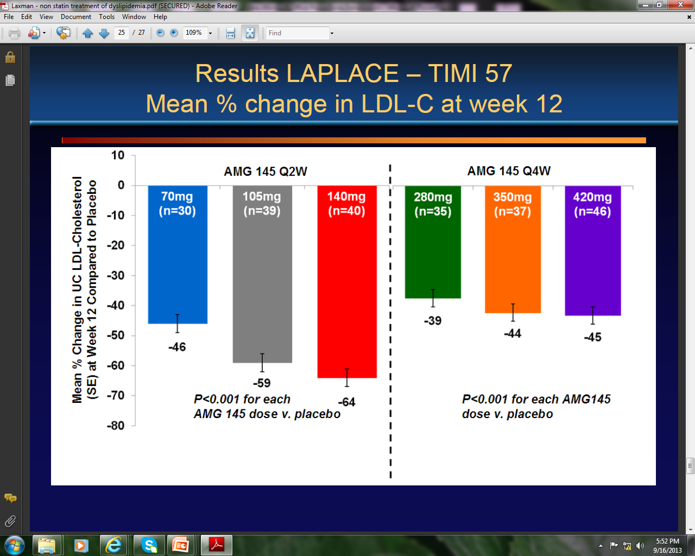
Results LAPLACE – TIMI 57
Mean% change in LDL-C at week 12

Slide 68
Thank you

Slide 69
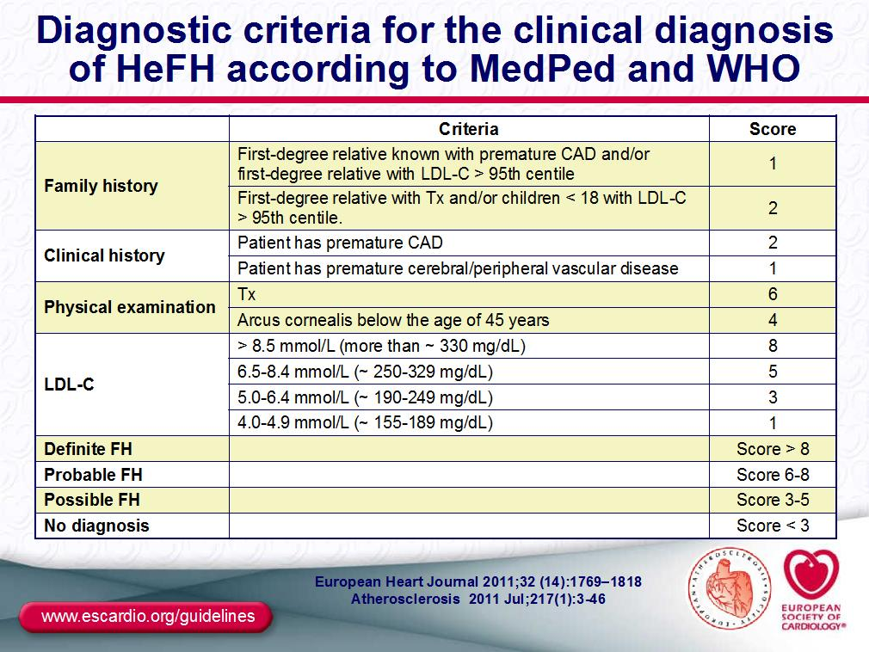

Slide 70
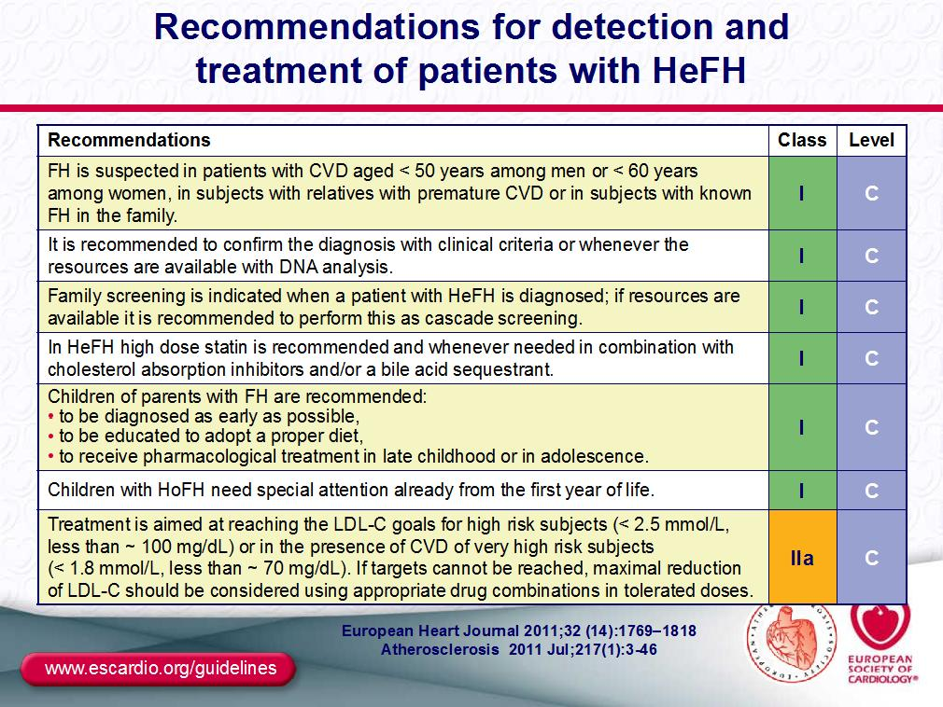

Slide 71
Key points
Treating to LDL -C targets is no longer recommended
Patients are divided in 4 groups which are eligible for moderate or high dose statin therapy
Individuals with clinical ASCVD:(Atherosclerotic CVD includes coronary heart disease (CHD), stroke, and peripheral arterial disease): high-intensity statin therapy should be used to achieve at least a 50% reduction in LDL - C unless otherwise contraindicatedFor those
  Age > 75 yrs, moderate dose statin may be used
Individuals with primary elevations of LDL–C ≥190 mg/dL: high-intensity statin therapy should be used to achieve at least a 50% reduction in LDL -C unless otherwise contraindicated
Stone NJ, et al. 2013 ACC/AHA Blood Cholesterol Guideline
published online November 12, 2013 Circulation
JACC, Nov 12, 2013

Slide 72
Despite Recommendations for LDL-C Lowering, Many Adults with high LDL-C Were Not Treated or Not Able to Achieve Their Goal
Prevalence, Treatment, and Control of LDL-C Based on NHANES 2005–2008ª
US Adult Population
US Adults With High LDL-C
23 million were treated and at goal^{c}
37 million
were untreated
11 million were treated, but not at goal^{c}
NHANES = National Health and Nutrition Examination Survey
ªExtrapolated from data from 3,996 adults with high LDL-C aged ≥ 20 years in the NHANES 2005–2008.
^{b}High LDL-C defined as > 160 mg/dL for low-risk adults; > 130 mg/dL for moderate-risk adults; and > 100 mg/dL for high-risk adults or the use of cholesterol-lowering medication.
^{c}Adult Treatment Panel III LDL-C goals: < 160 mg/dL for low-risk adults; < 130 mg/dL for moderate-risk adults; and < 100 mg/dL for high-risk adults.
1. Kuklina EV, et al. Morb Mortal Wkly Rep. 2011;60:109-114.

Slide 73
Key points
Individuals 40 to 75 years of age with diabetes & without clinical ASCVD with LDL-C 70-189 mg/dL:
  A moderate-intensity statin- that lowers LDL-C 30% to 49%
  High-intensity statin is a reasonable choice if the pt. also has a 10-year risk of atherosclerotic cardiovascular disease exceeding 7.5%
  Diabetes patients <40 years of age: In adults with diabetes mellitus, who are <40 or >75 years of age, it is reasonable to evaluate the potential for ASCVD benefits and for adverse effects, for drug-drug interactions, and to consider patient preferences when deciding to initiate, continue, or intensify statin therapy.
Individuals without clinical ASCVD or diabetes who are 40 to 75 years of age with LDL-C 70-189 mg/dL and an estimated 10-year ASCVD risk of 7.5% or higher: a moderate- or high-intensity statin
Stone NJ, et al. 2013 ACC/AHA Blood Cholesterol Guideline
published online November 12, 2013 Circulation
JACC, Nov 12, 2013

Slide 75
Are These guidelines relevant to Indian population?
Guidelines for dyslipidemia management and treatment have largely been derived from clinical trials comprised of mostly NHW populations, which have often under-represented Asian population.
Atherogenic triad is common and associated with high CVD risk - High TG, Low HDL and small dense LDL – Need of Non statin drugs
Early age of CVD, probably because of high prevalence of Metabolic Syndrome – shall we start statin in early age ?

Slide 76
Are These guidelines relevant to Indian population?
Underestimation of cardiovascular risk by ASCVD risk calculator, hence underutilization of Statin.
Doses of Statin – possibly Asian population respond to modest doses of statin( > 50% LDL reduction). High dose Statin – increase SE ( Myalgia and Transaminitis).
High incidence and prevalence of IGT & MeTS. Concerns - Statin induced risk of DM.
LDL targets may be useful

Slide 77
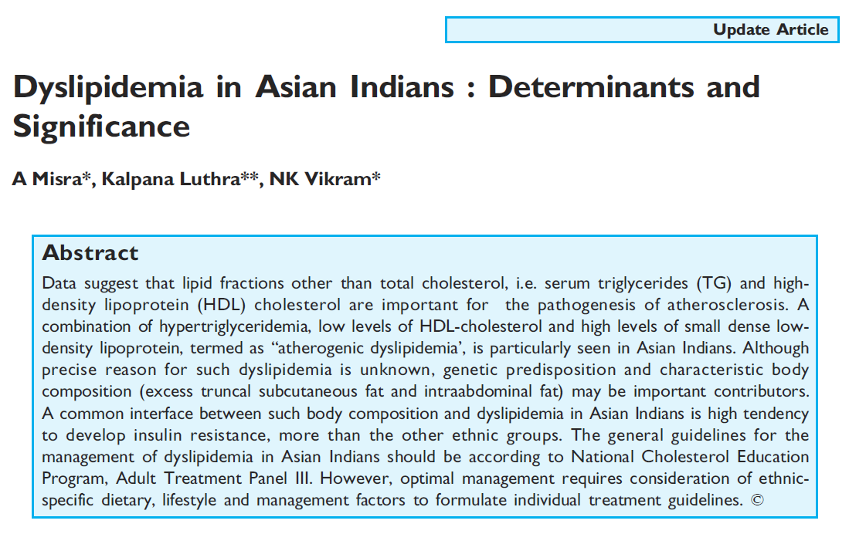
1) Atherogenic Dyslipidemia
Asian Indians have abnormal lipid ratios, lower HDL values and have abnormal triglycerides and triglyceride-rich lipoproteins.
Diabetic patients are known to have high levels of serum triglyceride (TG) and low levels of high-density lipoproteins (HDL)
TG-rich LPs
Chylos, VLDL
+ Remnants
- Fasting
- Nonfasting
Chronic Inflammation,
Premature Atherosclerosis
and CHD
HDL-C
Apo AI
Small
Dense LDL
Apo B

Slide 78
Role of non statins
Fibrates are more effective than statins in reducing serum triglyceride levels and increasing HDL-cholesterol levels.
Atherogenic dyslipidemia in Asian Indians may be well managed by the use of fibrates, although the combination may have more adverse effects BUT recent evidence indicates that combination is well tolerated by our population with modest doses of statin.

Slide 79
When to add Fibrates ?

Slide 80
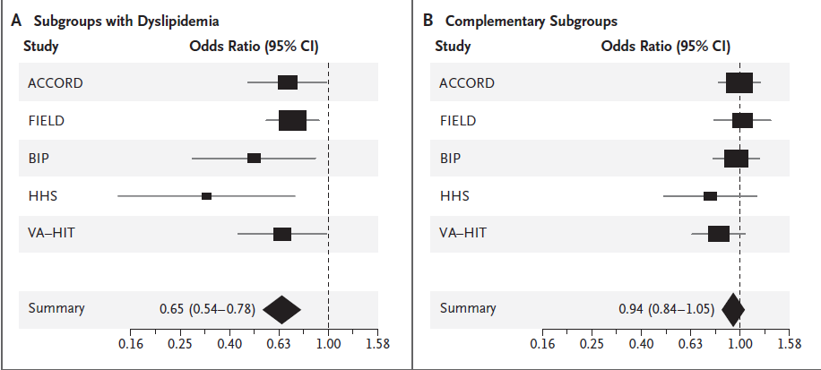
Fibrates And CVD Risk Reduction Among Those With Atherogenic Dyslipidemia
TG>1.7mmol/L And HDL <1mmol/L
Target Non HDL Cholesterol
Sacks et al NEJM 2010

Slide 81
Fibrate meta-analysis of 45, 058 participants
Jun et al lancet 2010

Slide 82
2) Underestimation of CV Risk
ACC/AHA provided a CV Risk calculator for estimation of 10-year risk for ASCVD in men and women 40 through 79 years of age.
But the guidelines also state that,
  ‘These estimates may underestimate the risk for persons from some race/ethnic groups, especially American Indians, some Asian Americans (e.g., of south Asian ancestry), and some Hispanics (e.g., Puerto Ricans)’
Therefore, usage of same CV Risk calculator may underestimate ASCVD risk in Indian population.

Slide 83
Case Study
38 year old male
Smoker
No DM, No HT
On routine investigation
Dyslipidemia TC 180, HDL – 36, LDL- 115
Advice :
Lifestyle modification
Stop smoking
No statin because of low ASCVD risk score

Slide 84
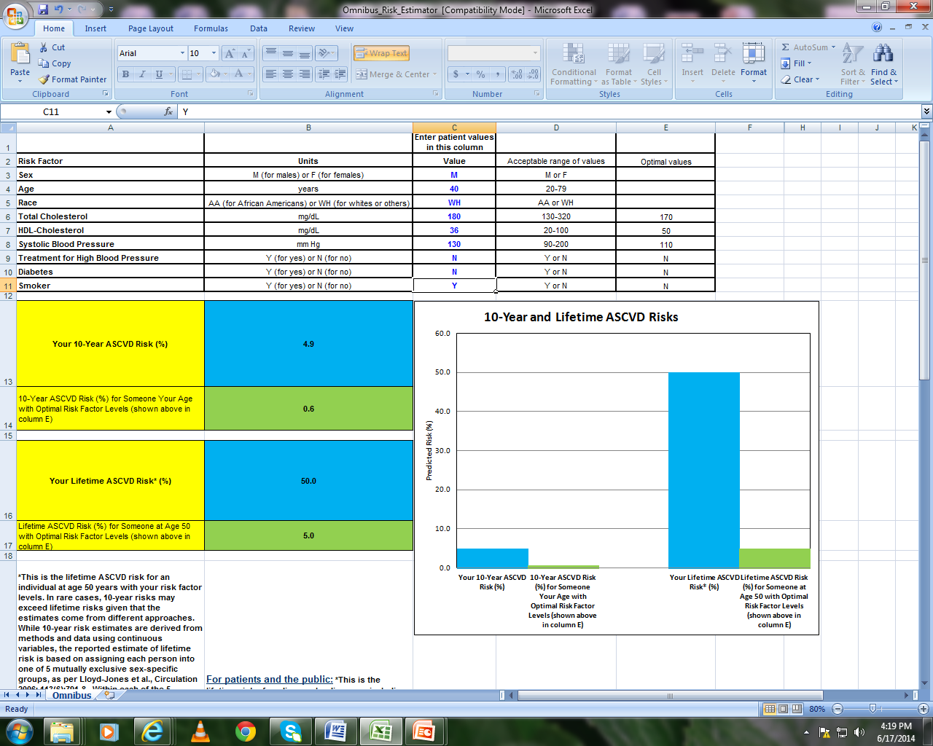
10 year ASCVD Risk score 4.9% - NO STATIN

Slide 85

After 3 months, patient presented with chest discomfort with bilateral arm pain
ECG – Anterior wall MI , PTCA to LAD done

Slide 86
Underutilization of Statin therapy
Once you underestimate the ASCVD risk in any patient, following the guidelines based on the ASCVD risk will lead to underutilization of Statin therapy.
The high prevalence of CHD in early age in Indian population further necessitates the usage of statin therapy earlier & more aggressively.

Slide 87
3) Intensity of Statin
Additional characteristics that may modify the decision to use higher statin intensities may include, but are not limited to:
  History of hemorrhagic stroke.
  Asian ancestry.

Slide 88


Slide 89

IRIS Study – efficacy of low and moderate doses of statins
The heightened statin response in Asians – May increase side effects in higher doses : 1) Lower BMI
2) Slower Statin metabolism
J Clin Pharmacol. 2004;44:1083e1105

Slide 90
Moderate intensity statins for all Indians ?
>50% of LDL as desired by guidelines
Better tolerated – less myalgia and transaminitis
Less incidence of new DM ( 0.1/100 vs. 0.3/100)
Cost effective
Safe to add Non statin lipid lowering drug
Indian consensus recommendation suggest high intensity statin in ACS patient for at least 3 months.

Slide 91

Indian perspective
Docs: Not US’s, Indian norms needed to check cholesterol
Times of India, 16 Feb’2014

