Slide 1
Optimal Duration of Dual Antipletlet Treatment (DAPT)
Subhash Chandra MD,DM,FACC,FCSI
Chairman,Cardiac Sciences,
BLK Super Speciality Hospital,
New Delhi
Annual API Delhi 15th Oct 2016

Slide 21
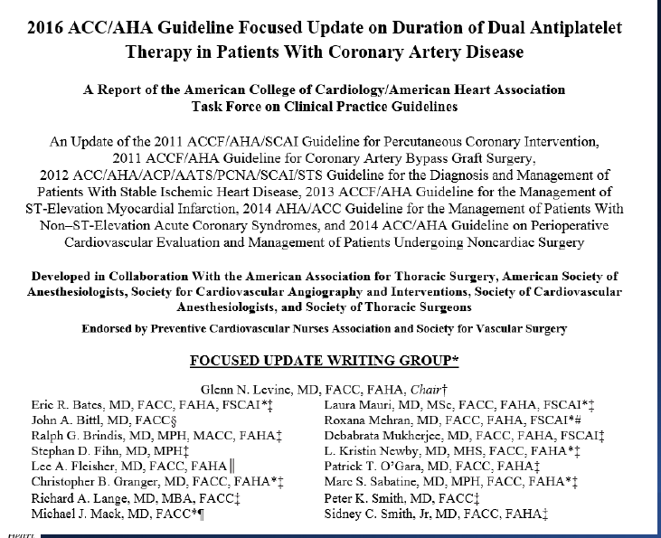

Slide 24
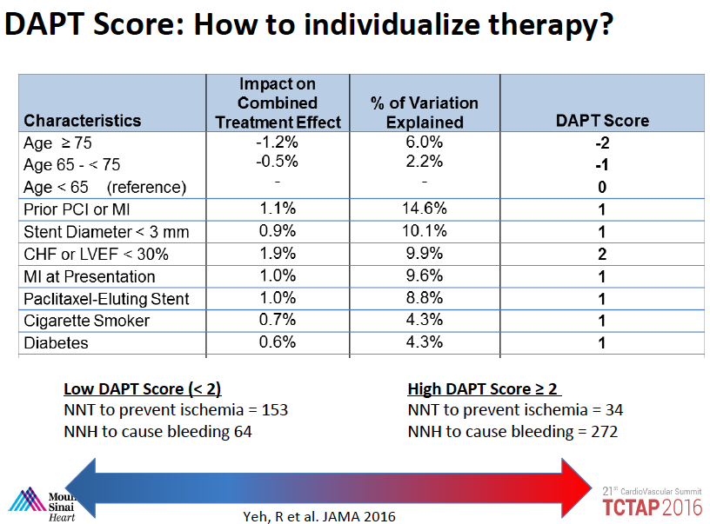

Slide 26
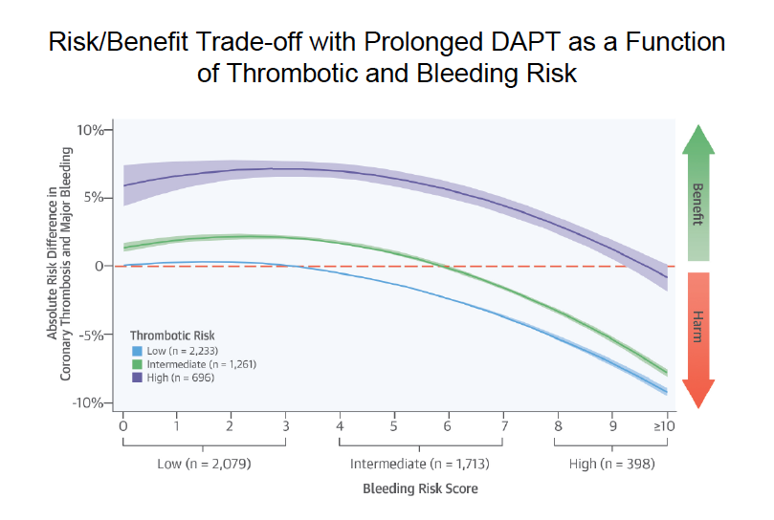

Slide 31
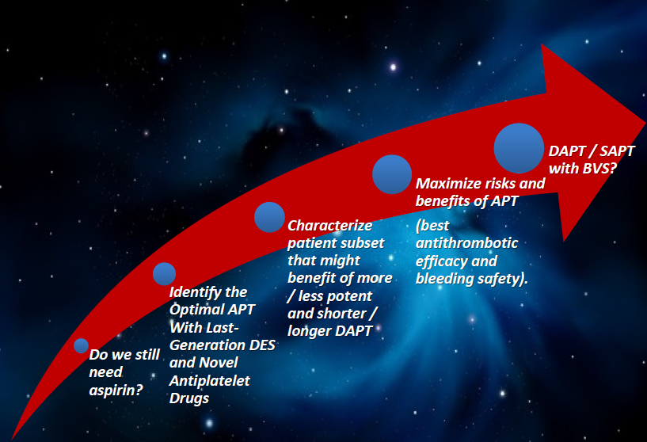

Slide 32
Duration of DAPT in Patients With SIHD Treated With PCI
COR | LOE | Recommendations
I | A | In patients with SIHD treated with DAPT after BMS implantation, P2Y₁₂ inhibitor therapy (clopidogrel) should be given for a minimum of 1 month.
I | B-R ^{SR} | In patients with SIHD treated with DAPT after DES implantation, P2Y₁₂ inhibitor therapy (clopidogrel) should be given for at least 6 months.
I | B-NR | In patients treated with DAPT, a daily aspirin dose of 81 mg (range, 75 mg to 100 mg) is recommended.
SR indicates systematic review.

Slide 33
Recommendations for Duration of DAPT in Patients with SIHD 2016 Focused Update
COR | LOE | Recommendations
I | A | In patients with SIHD treated with DAPT after BMS implantation, P2Y₁₂ inhibitor therapy (clopidogrel) should be given for a minimum of 1 month.
I | B-R ^{SR} | In patients with SIHD treated with DAPT after DES implantation, P2Y₁₂ inhibitor therapy (clopidogrel) should be given for at least 6 months.
I | B-NR | In patients treated with DAPT, a daily aspirin dose of 81 mg (range, 75 mg to 100 mg) is recommended.
IIb | A ^{SR} | In patients with SIHD being treated with DAPT for an MI that occurred 1 to 3 years earlier who have tolerated DAPT without a bleeding complication and who are not at high bleeding risk (e.g., prior bleeding on DAPT, coagulopathy, oral anticoagulant use), further continuation of DAPT may be reasonable.
SR indicates systematic review.

Slide 34
Duration of DAPT in Patients With ACS Treated With PCI
COR | LOE | Recommendations
I | B-R | In patients with ACS (NSTE-ACS or STEMI) treated with DAPT after BMS or DES implantation, P2Y₁₂ inhibitor therapy (clopidogrel, prasugrel, or ticagrelor) should be given for at least 12 months.
I | B-NR | In patients treated with DAPT, a daily aspirin dose of 81 mg (range, 75 mg to 100 mg) is recommended.
IIa | B-R | In patients with ACS (NSTE-ACS or STEMI) treated with DAPT after coronary stent implantation, it is reasonable to use ticagrelor in preference to clopidogrel for maintenance P2Y₁₂ inhibitor therapy.
IIa | B-R | In patients with ACS (NSTE-ACS or STEMI) treated with DAPT after coronary stent implantation who are not at high risk for bleeding complications and who do not have a history of stroke or TIA, it is reasonable to choose prasugrel over clopidogrel for maintenance P2Y₁₂ inhibitor therapy.

Slide 35
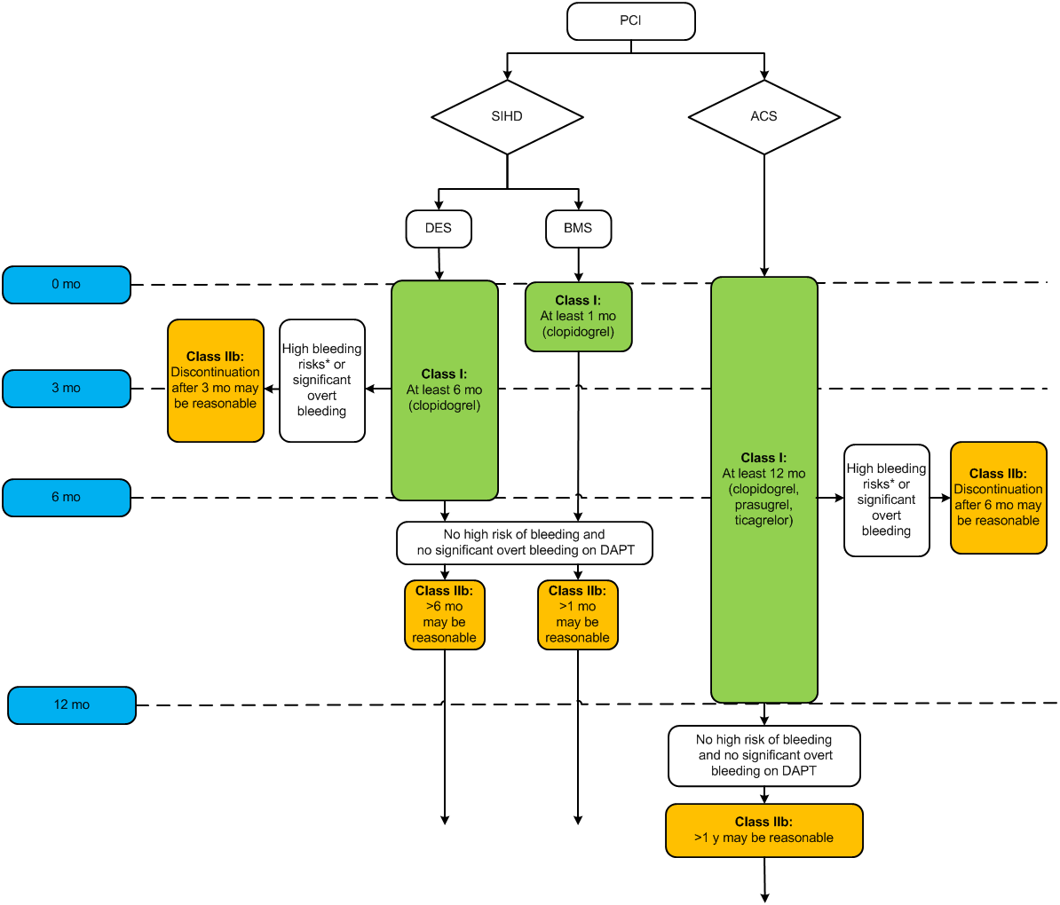
Treatment Algorithm for Duration of P2Y₁₂ Inhibitor Therapy in Patients Treated With PCI

Slide 36
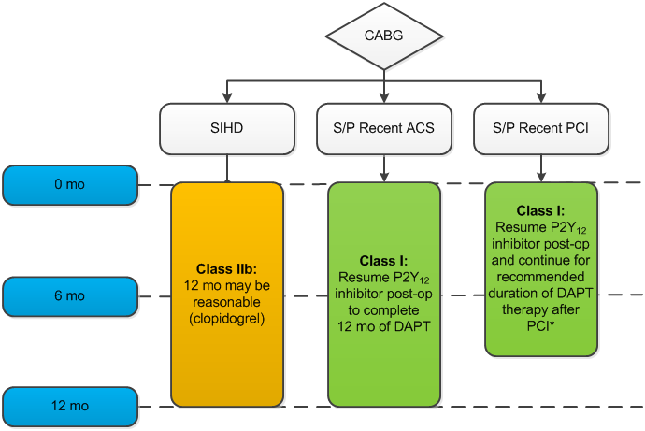
Treatment Algorithm for Management and Duration of P2Y₁₂ Inhibitor Therapy in Patients Undergoing CABG

Slide 37
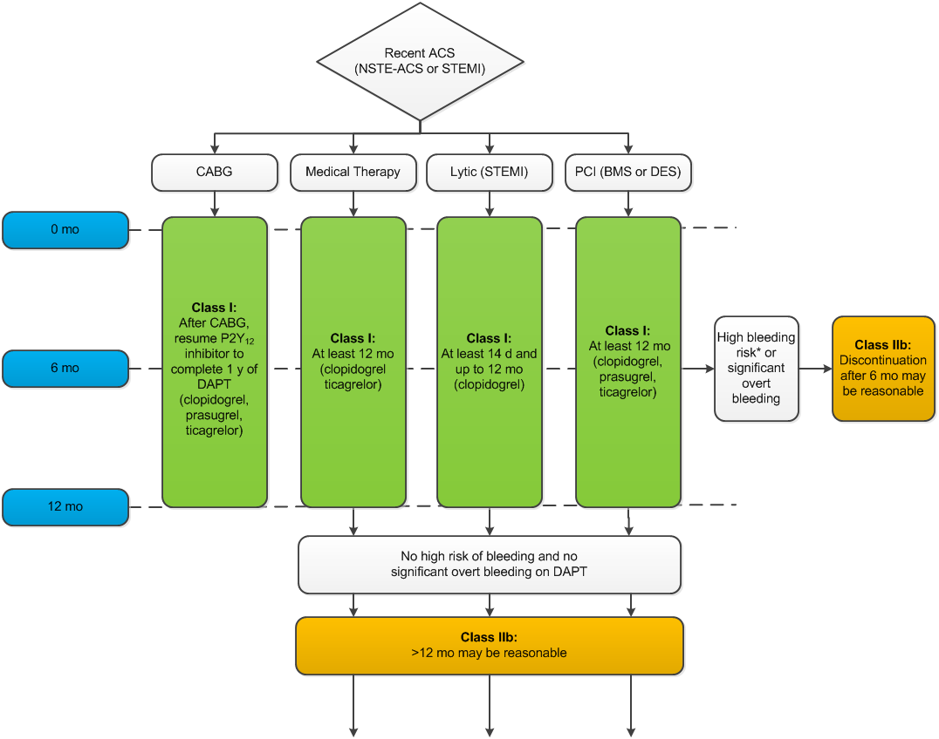
2016 update Treatment Algorithm for Duration of P2Y₁₂ Inhibitor Therapy in Patient With Recent ACS (NSTE-ACS or STEMI)

Slide 38
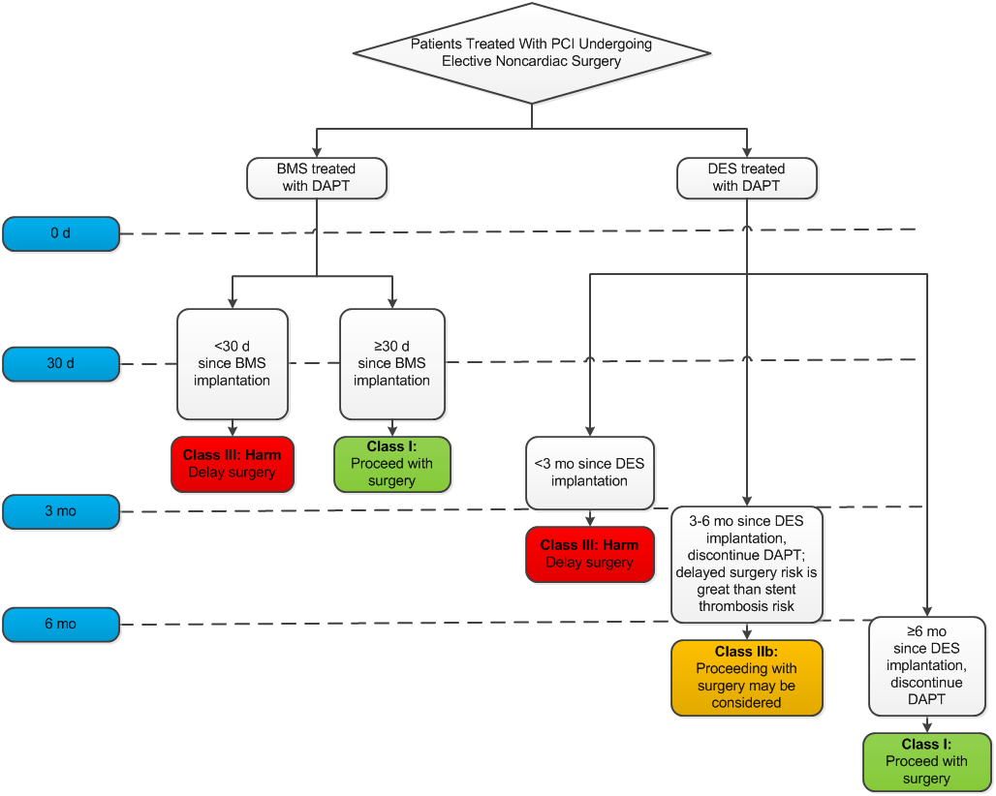
Treatment Algorithm for the Timing of Elective Noncardiac Surgery in Patients With Coronary Stents

Slide 39
DAPT Duration: Conclusions
“One size shoe” approach for DAPT duration is unlikely to fit all patients
ACS
Diabetes
CABG-SVG / ISR
We treat symptomatic patients and non-target lesions with objective to reduce events (D/MI/CVA) which may not be stent (target lesion) related
Stent platforms differ with respect to risk for early , late and/or very late stent thrombosis events (“All DES not created equal”)
Conclusions regarding “optimal” DAPT duration should be based on adequately powered RCCT

Slide 42
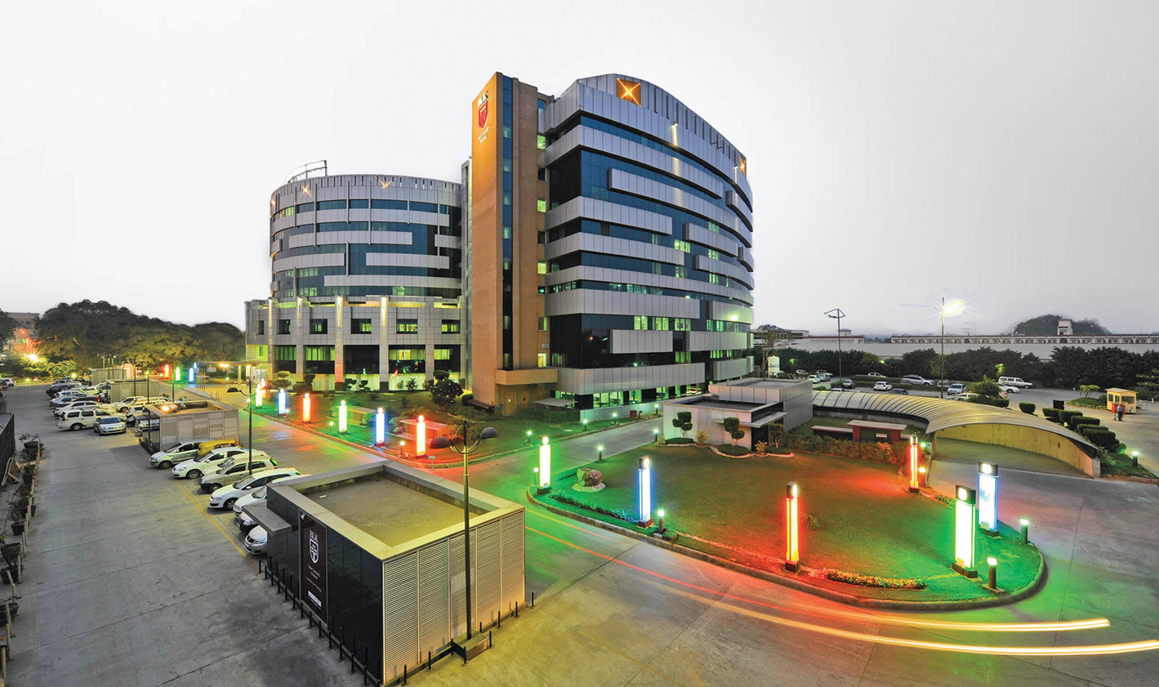
Thanks for kind attention Subhash.Chandra@blkhospital.com

