Slide 1
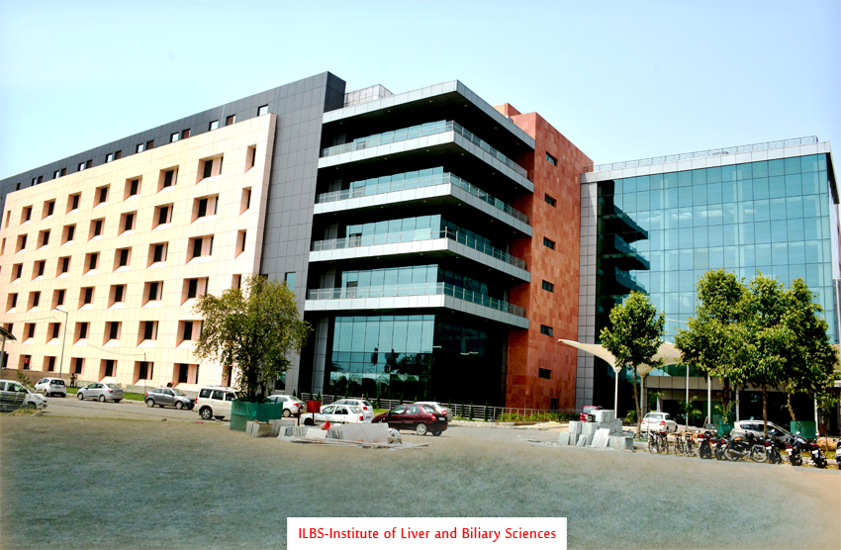


ASSOCIATION OF PHYSICIANS OF INDIA
Delhi State Chapter
Institute of Liver & Biliary Sciences
Dedicated to Excellence in Patient Care,
Teaching & Research in Liver & Biliary Diseases
Management of Hepatitis B in 2016
Institute of Liver & Biliary Sciences A Deemed Liver University
Dr. S K Sarin
sksarin@ilbs.in
New Delhi, India
www.ilbs.in

Slide 2

Disclosure
I have no conflict of Interest or disclosures to make
Notes:
The authors do not have any conflict of Interest or disclosures

Slide 3

ILBS : Residents
2015 = 87,000 patients, Nearly 12,000 Emergencies
980 new OPD HBV patients

Slide 4

ILBS : Faculty
2015 = 87,000 patients, Nearly 12,000 Emergencies
980 new OPD HBV patients

Slide 5
Outline
HBV
How to Treat: Regimens
Indications
Contraindications
Duration
New Therapies

Slide 6
Schematic representation of HBV
HBV-DNA
DNA-polymerase
Outer lipid envelope containing
HB surface antigen)
Inner protein core (HBcAg)
HBeAg
HBsAg

Slide 7
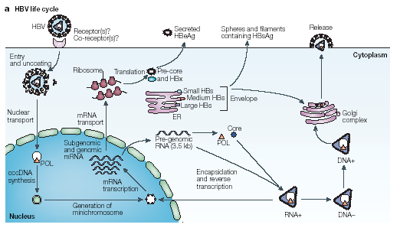
Liver Cell
Nature Reviews
Immunol, 2005

Slide 8
Liver Cell
Nature Reviews
Immunol, 2005
Once Chronic HBV infection : Always

Slide 9
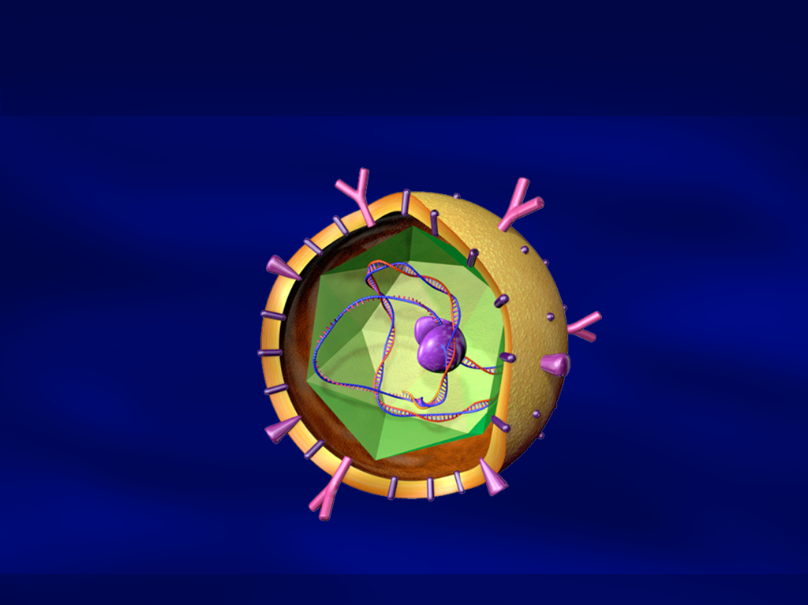

HEPATITIS B VIRUS
cccDNA
Genomic HBV
Anti HBs
HBV DNA
Protection (>10 IU/L)
Genetic material
Replication
Anti HBe
HBsAg
non-replication
Marker of infection
Replication of Virus
Anti HBc,IgG
Past Infection
HBeAg
Anti HBc,IgM
Acute infection
Marker of replication
SGPT - Injury

Slide 10
Acute HBV
Symptoms
ALT
IgG anti - HBc
HBsAg
IgM anti - HBc
Anti - HBs
HBeAg
Anti - HBe
HBV DNA
0
1
2
3
4
5
6
12
Months after exposure

Slide 11
Chronic HBV
Symptoms
Symptoms
ALT
HBsAg
IgG anti-HBc
ALT
HBeAg/e-
HBV DNA
0
1
2
3
4
5
6
0
1
2
3
4
5
Months after exposure
(years)
Months after reactivation

Slide 12
Reactivation of HBV
Symptoms
Symptoms
ALT
HBsAg
IgG anti-HBc
ALT
IgM anti-HBc
HBeAg/e-
e+, anti-e+
HBV DNA
HBV DNA +
0
1
2
3
4
5
6
0
1
2
3
4
5
Months after exposure
(years)
Months after reactivation

Slide 13
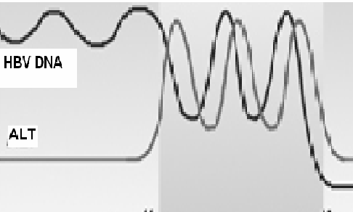
HBV: Natural History in Adult
Depends on Host Immune Response
Vigrous, Immune Response
Weak Immune Response
Acute hepatitis
ALT > 400
Persistent infection – 5% Carrier, Chronic Hepatitis, Cirrhosis, HCC
Fulminant
Hepatitis
ALT Normal
Immune Tolerant
ALT High
Immune Active
95%
Death
Recovery
Kumar and Sarin, Gastroenterology 2008, 2009
Every 4.3 mo.

Slide 14
HBV: Natural History in Adult Depends on Host Immune Response
Infants 95% Chronic
Vigrous, Immune Response
Weak Immune Response
Acute hepatitis
ALT > 400
Persistent infection – 5% Carrier, Chronic Hepatitis, Cirrhosis, HCC
Fulminant
Hepatitis
ALT Normal
Immune Tolerant
ALT High
Immune Active
95%
Death
Recovery
Kumar and Sarin, Gastroenterology 2008, 2009
Every 4.3 mo.

Slide 15
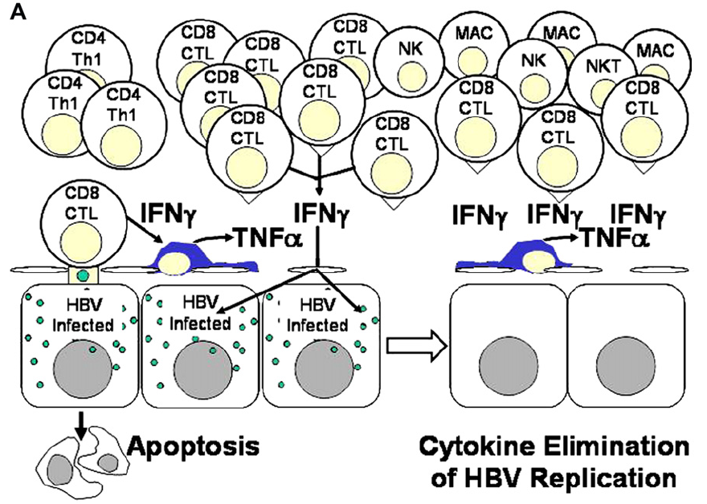
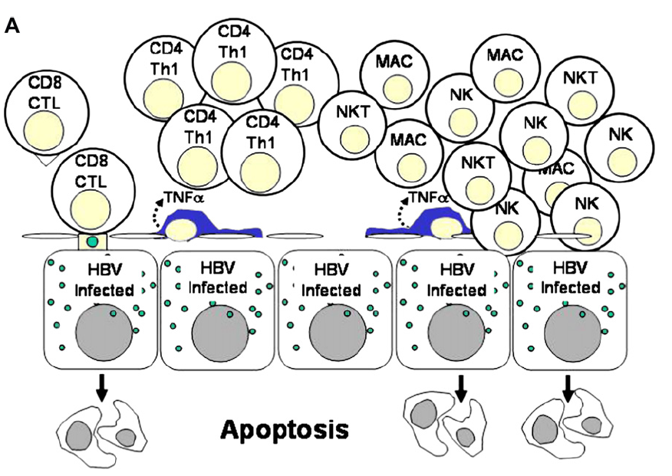
Chronic infection
Impaired Immune Response
Acute infection
Robust Immune Response
T-regs

Slide 16
Chronic infection
Impaired Immune Response
Acute infection
Robust Immune Response
T-regs
Convert Chronic to Acute HBV

Slide 17
Markers of HBV
Acute Infection HBsAg, HBeAg, IgM antiHBc +, HBVDNA +
Chronic HBV HBsAg++, HBeAg/e-, HBV DNA +++
Past Exposure Anti HBc IgG, Anti HBe,
Anti HBs
Occult HBV HBsAg-ve, IgGantiHBc+, HBVDNA +
Protection Anti HBs

Slide 18
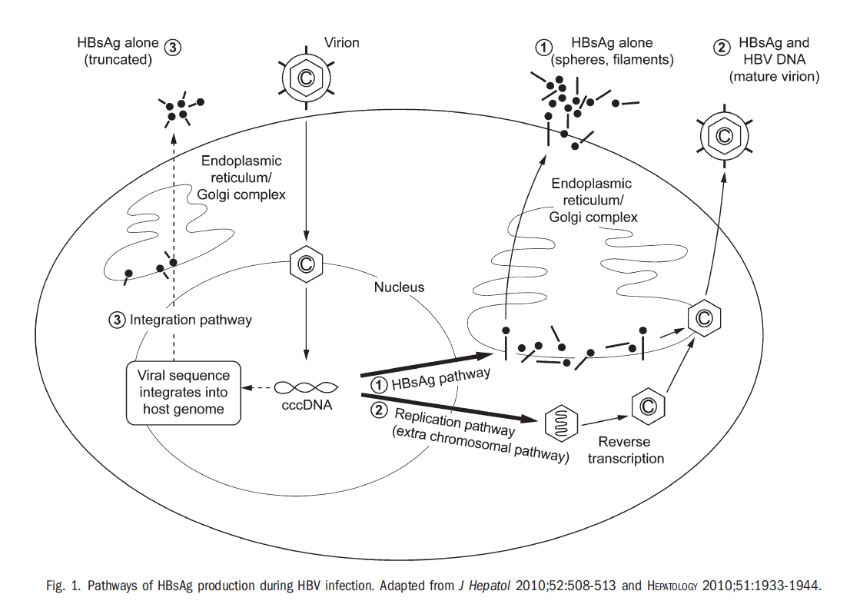
Pathways of HBsAg production

Slide 19
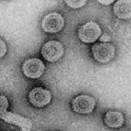
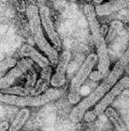
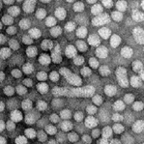
Clinical Significance of HBsAg Level: An Additional Marker of CHB
HBV DNA
(virions)
qHBsAg
virions + defective particles
HBV replication
HBV replication
cccDNA transcription/
mRNA translation
Serum HBV DNA:
a marker of
HBV replication
Serum HBsAg:
a marker of transcriptionally
active cccDNA
Brunetto. J Hepatol 2010

Slide 20

Serum HBsAg quantitation
Elecsys or Cobas e devices (Roche)
Architect system (Abbott)
ILBS Has Both Systems

Slide 21
Whom To Screen !
Family members of HBV+
On regular BT, dialysis,
Pre-chemotherapy

Slide 22
Hepatitis B in India: Mainly Mother baby
116 HBV +ve children
Satapathy SK et al. J Gastroenterol Hepatol 2006

Slide 23
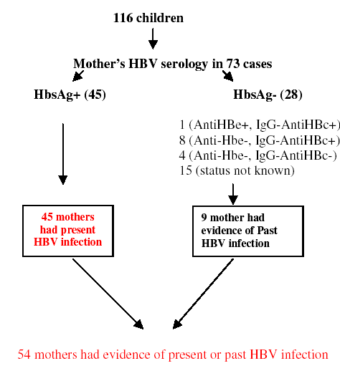
Satapathy SK et al;2006,JGH

Slide 24
Satapathy SK et al;2006,JGH
Test Mother for
HBsAg,
AntiHBc (T)
Anti Hbe
Anti Hbs

Slide 25
Age the Virus !

Slide 26
Healthy Carrier
Is he really healthy ?

Slide 27
Incidentally Detected Asymptomatic HBsAg Positive Subjects: (IDAHS)
Patient characteristics
Persistently N ALT, N=73
Intermittently N ALT, N=117
P
Age(yr)
27.7±15.3
30.8±16.1
0.192
HBVDNA >5 log cp/ml
60.3%
72.1%
0.001
Kumar and Sarin Gastroenterology 2008

Slide 28
40% of asymptomatic Hepatitis B +ve subjects with Normal ALT have hepatic Fibrosis
80
70
66.7
60
50
% of patients
40
37
Normal ALT
30
22.7
25.9
20
11.1
10
3.7
0
F0
F2
F4
HAI>3
F1
F3
Kumar et al. Gastroenterology 2008
Kumar and Sarin Gastroenterology Aug 2009

Slide 29
“Chronic HBV Carrier”
Is a misleading term (X)
Replaced by
“Chronic Hepatitis B Virus Infection”
Ind J. Gastroenterol 1999; 18 : S15, JGH, GE 2001, J Hepatol 2003, Gastroenterology 2008,2009, 2009

Slide 30
How to Write Diagnosis and Monitor a HBV Infected Subject ?
Acute or Chronic HBV or Reactivation of CHB
Incidentally Detected Asymptomatic HBsAg+ve Subject IDAHS : Chronic HBV Infection : NO “Carrier”
Chronic hepatitis B (CHB) -
  e+, (wild) , e- (mutant) -
  ALT - ↑↑ / N - every 4-6 months, >48 IU/ml plan Rx
  Fibrosis 5 / 2, LSM – 8 Treat irrespective of ALT
  HBV DNA - IU/ml
  qHBsAg - IU/ml
  Transmission - Perinatal/ horizontal
  Imaging - US ../ CT …/ Varices
  Treatment- Antiviral
CLD-B – e+, e- …….Compensated, decompensated, CPT
CLD- B with HCC

Slide 31
Treatment of HBV in 2016 !
Whom, Treat all or select !
How to treat !
  Regimens
  Indications
  Contraindications
  Duration
New Options

Slide 32


Slide 33
ASSESMENT OF PERSONS WITH CHRONIC HBV INFECTION
Perinatal/horizontal, signs, LFT, US [A1].
qHBV DNA: diagnosis, start, monitor Rx [A1].
Fibrosis stage: Identify whom to treat ! [AI]

Slide 34
ASSESMENT OF PERSONS WITH CHRONIC HBV INFECTION
Liver biopsy: stage fibrosis/ grade activity, high viral load, N or minimally raised ALT, no cirrhosis. (AI)
Fibroscan >8 KPa
Risk calculators to assess HCC risk on Rx [B2]

Slide 35
Treatment of HBV: Basis
Virus – qHBV DNA
Hepatic inflammation - ALT
Fibrosis/disease – Liver Bx/ LSM

Slide 36

Goal of Therapy : HBV Cure?
Parameter | Absolute cure (eradication) | Clinical or Functional cure
Viral load | Undetectable | Undetectable
HBsAg | Undetectable | Undetectable
Anti-HBs | Present | Variable
cccDNA | Undetectable | Undetectable or repressed
Risk of HCC development | Maybe negligible | Maybe still exist
Risk of HBV reactivation | Maybe negligible | Maybe still exist
Risk of death from liver diseases | Same as person who was never infected | Same as person with naturally resolved infection
Treatment cessation | Off-drug possible | Off-drug possible
Zoulim F et al. Cold Spring Harb Perspect Med 2015

Slide 37
Comments !

Slide 38
Hypothesis
Convert Chronic to Acute !!
TREATMENT OF CHRONIC HEPATITIS B
Virus is cleared when immunity is High ALT ⬆
DNA is Low as in Acute Hepatitis
Normal ALT: Antiviral Drugs less effective

Slide 39
Indications of Rx
APASL HBV Guidelines 2015
CHB HBeAg+ve
HBV DNA
<2000IU/mL
HBV DNA 2000-20,000IU/mL
HBV DNA>20,000 IU/mL
ALT<ULN
ALT>ULN
ALT1-2x ULN
ALT>2x ULN
Monitor 3-6 mo
Assess – Fibrosis
Treat - Fibrosis≥2, moderate- severe inflammation
Monitor 3-6 mo*
Assess fibrosis /Bx
Treat :
  ALT persist 1-2 Age>35
Family H/o HCC, cirrhosis
Treat
Monitor
Fibrosis≥2
Moderate to severe inflammation on liver biopsy : HAI >3/18, METAVIR activity score A2 or A3; Significant fibrosis: F≥2 by METAVIR or Ishak F≥ 3
Non-invasive – Fibroscan : LSM value of ≥ 8* , APRI

Slide 40
Indications of Rx
APASL HBV Guidelines 2015
CHB HBeAg -ve
HBV DNA 2000-20,000 IU/mL
HBV DNA>20,000 IU/mL
ALT>2xULN
HBV DNA<2000 IU/mL,
ALT<ULN
ALT1-2x ULN
ALT>2x ULN
ALT 1-2x ULN
ALT>2x ULN
ALT<ULN
Monitor
Treat
Fibrosis≥2
Treat
Monitor ALT , HBV DNA,
1-3 mo
Assess Fibrosis Bx if ≥ 35 yr
TreatFibrosis≥2
Treat
Assess Fibrosis
Treat
Liver biopsy optional
Assess Fibrosis
2 consecutive tests conducted 3 months apart.
Offer antiviral treatment
If Age > 35 years
- if age <35 years, >F2 metavir / Ishak > F3 fibrosis
Non-invasive – Fibroscan : LSM value of ≥ 8* ,

Slide 41
INDICATIONS OF THERAPY
APASL HBV Guidelines 2015
HBsAg +ve | HBV DNA (IU/mL) | ALT | Treatment
Decompensated Cirrhosis | Detectable | Any | Treat immediately Histology not needed. Consider LT if no stabilization. [A1]
Compensated Cirrhosis | >2000 | Any | Treat. [A1] Assess fibrosis - histology or noninvasive
Severe reactivation of chronic HBV | HBV DNA >2x10(4) | Flare, ALT>>5 time | Treat immediately [B1]

Slide 42
Comments !

Slide 43
DRUGS: Nucleos(t)ide Analogues
Tenofovir or Enteacvir are first line [A1].
Monitoring: HBeAg, anti-HBe, ALT every 3 mo. [A1]
HBV DNA : mo. 3, 6 of therapy, then every 3-6 mo. [A1]

Slide 44
END POINTS OF THERAPY
Sustained off-therapy: HBeAg +ve ➔ anti-Hbe [A1].
If unachievable, maintain undetectable HBV DNA [A1].

Slide 45
DRUGS: Nucleos(t)ide Analogues
Monitoring
Renal function, bone profile every 3 mo if TDF [A1].
Muscle symptoms and weakness on Telbivudine or Clevudine therapy [A1]
[

Slide 46
DRUGS: Nucleos(t)ide Analogues
3.6. STOPPING RULES ON THERAPY IN CHB INFECTION
3.6.1
Duration:
HBeAg+ve : Unknown, stop at 1 yr [A1] better 3 yr [C1] after anti HBe, undetectable HBV DNA, N ALT
HBeAg-ve: Unknown. Withdraw after HBsAg loss, anti-HBs seroconversion [B1].
Continue indefinitely in cirrhosis [B1].

Slide 47
DRUGS: Interferons
Peg-IFN most appropriate 1st line treatment
To Whom: Treatment naïve, ALT >80 [A1].
Duration: 48 wk for HBeAg +ve/-ve (A1).
HBV genotype: A and D [A1].
[

Slide 48
STOPPING RULES DURING THERAPY
Interferons
HBeAg +ve: If qHBsAg >20,000 IU/ml by wk. 24 stop (B2).
HBeAg-ve: Geno D, without decline in qHBsAg, >2 log in DNA by mo. 3, stop (B2).
[

Slide 49

Decision Making
Acute Hepatitis
OR
Reactivation of HBV ?

Slide 50
AVH – B versus Reactivation of CHB
HBV DNA quantification
If DNA > 10(5) cp/ml- 98 % PPV for ECHB.
TREAT
Evaluate for underlying CLD
Kumar and Sarin Am J GE 2005
Jindal et al Liv Int 2013

Slide 51
ACLF
Reactivation of HBV presenting as ACLF
Need to assess reversibility
Acute = HBV Reactivation
Liver failure
Bil >5
INR >1.5
Chronic Liver Disease HBV
Sarin et al Hep Int 2009

Slide 52
Drugs and Degree of HBVr

Slide 53
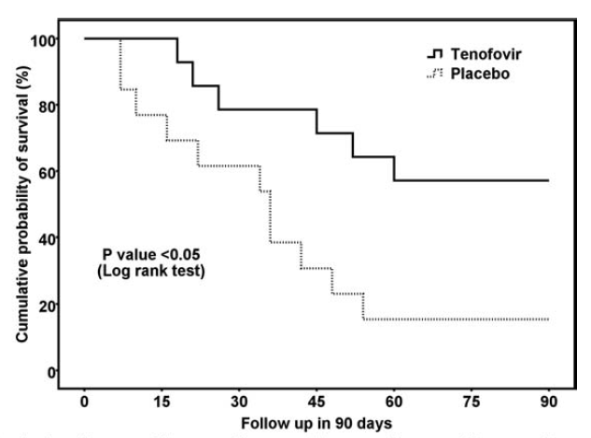
HBV ACLF:
Antiviral vs. no antiviral: Tenofovir: Yes
  Randomized trial
  Tenofovir (n=14) vs. placebo (n=13)
HBV DNA reduction at D15 after tenofovir
> 2 logs 9 patients (8, 90% survived)
< 2 logs 5 patients (0, 0% survived)
Garg H et al., Hepatology 2011

Slide 54
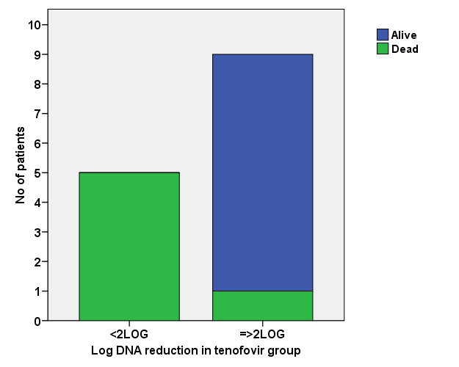
Reduction in HBV DNA with Tenofovir at 2 weeks predicts survival
P = 0.003
Alive = 0
Garg H, Sarin SK et al. Hepatology 2011;53:774-80
Alive=8 (89%)
Died= 5 (100%)
Died= 1 (11%)
Telbuvidine improves GFR

Slide 55

Liver Transplants
Bilirubin > 10, INR >1.5 : Prepare, Bil >20 - Transplant
Liver Transplant@ILBS
TOTAL | 353
HBV | 10 HBIG in 1
Cost 11.5 Lacs only
Last 50 Tx 90% survival

Slide 56
Combination of IFN and NAs

Slide 57
Lead in period
(week 1- week 12)
Sequential therapy
(week 12 to week 36)
Follow up period
(week 36 to week 72)
Sequential Therapy: Protocol
Tenofovir 300 mg OD (n=53)
Tenofovir 300 mg OD
Tenofovir 300 mg OD
Tenofovir 300 mg OD (n=53)
PEG-IFN α2b 1.5 mcg/kg s/c weekly plus
Tenofovir 300 mg OD
Tenofovir 300 mg OD
Week 0 12 24 36 48 60 72

Slide 58
Rate of combined response at week 72 in treatment groups
Combined response – ALT N + HBeAg loss + HBV DNA < 2000 IU/ml
6/53
11/53

Slide 59
Emerging Therapies for HBV
Potent NA
Prevent viral spread and cccDNA re-amplification
+
Immune
modulator
Activate specific antiviral immunity
+
cccDNA
inhibitor
Reduce or silence cccDNA
+
HBV antigen
inhibition
Inhibit components HBV life cycle
(entry, cell-spread, capsid assembly, HBx, HBeAg, HBsAg)
Notes:
Then, what will the future HBV curative regimen would look like?
Although potent nucleos(t)ide analogues are available right now, a combination of new drugs will be needed to “cure” the disease.
*CLICK*
And these will include immune modulators, cccDNA inhibitors, and HBV antigen inhibitors.

Slide 60
Emerging Drugs Against HBV
Direct-acting antiviral agents (DAAs)
Host-targeting antiviral agents (HTAs)
Notes:
Now, let’s have a look at what kinds of DAAs are in development.

Slide 61
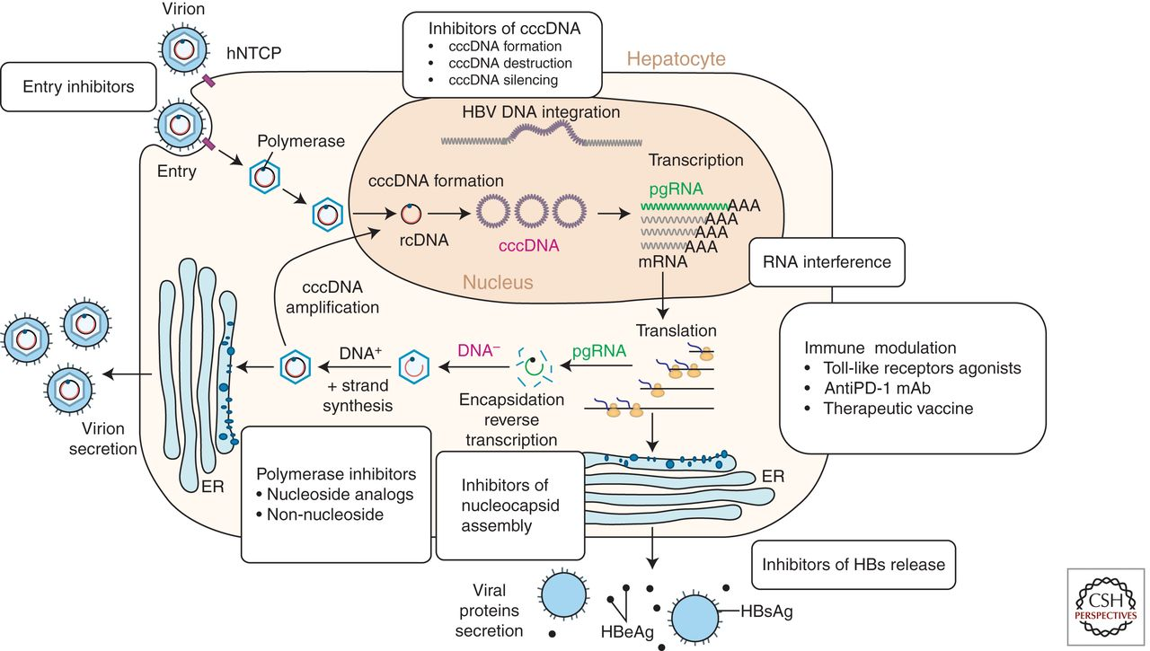
New Drugs for HBV infection
Direct-acting antivirals
(DAAs)
⬇
⬇
Host-targeting antivirals
(HTAs)
⬇
⬇
⬇
⬇
⬇
Zeisel MB et al. Gut 2015, Zoulim F et al. Cold Spring Harb Perspect Med 2015
Notes:
This is a schematic representation of HBV life cycle. Since NA cannot eliminate cccDNA, persisting in the nucleus of hepatocyte, HBV infection cannot be cured.
Currently, there are many compounds in development for chronic hepatitis B, and they can be categorized into two groups.
*CLICK* The direct-acting antiviral agents (DAAs) and..
*CLICK* the host-targeting antiviral agents (HTAs).

Slide 62
New HBV Receptor
Baumart T et al., Hepatology 2016, Hep Int 2016

Slide 63
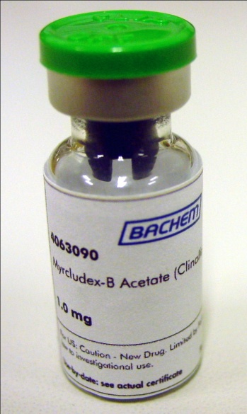
Entry inhibitor: Myrcludex-B
Phase IIa clinical trial
HBV DNA decline > 1 log₁₀ at Wk 12: 6/8 (75%) patients receiving 10 mg Myrcludex-B
HBV Has Other Receptors
Urban S et al. AASLD 2014 (LB-20)
Notes:
In a recent Phase IIa study, with daily SC injection of Myrcludex-B, was shown to be very well tolerated with a few adverse events.

Slide 64
HBV life cycle : New Polymerase inhibitors
Zeisel MB et al. Gut 2015
Notes:
The final group among DAAs is the polymerase inhibitor.

Slide 65
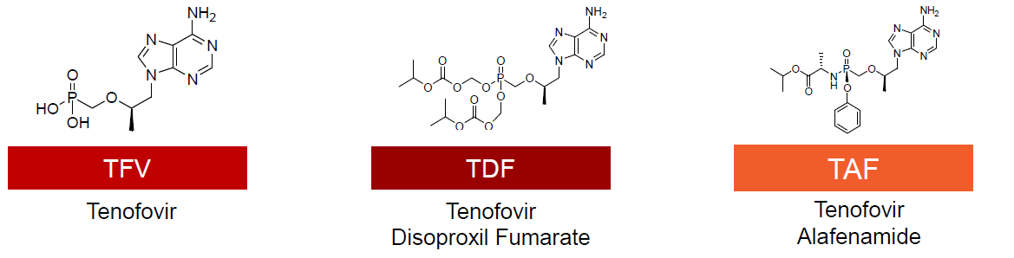

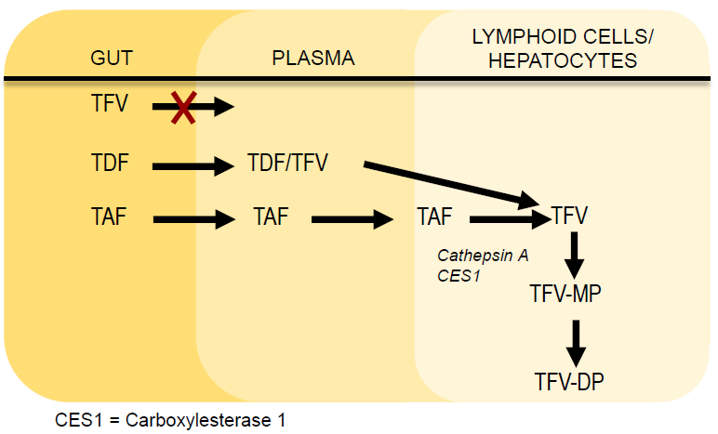
Tenofovir alafenamide (TAF)
↑ stability in plasma
↑ delivery to hepatocytes
↓ doses with TAF
↓ systemic exposures of TFV
Argarwal K et al. AASLD 2013
Notes:
Currently, Viread, or TDF, is one of the most potent antiviral drugs for HBV. TAF is similar drug also developed by Gilead, and through modification of its structure, its stability in the plasma is increased, hence the delivery of effector molecule to the target cells is enhanced.
Because it requires less dose compared with TDF, it is considered safer in terms of systemic exposures of TFV.

Slide 66
How many of you are Immunized against Hepatitis B !

Slide 67
Vaccination is
NOT
Equivalent to Immunization
(Protection)
Antibody, Anti-HBs > 10 IU/L,
better >100 IU/L
Non-response in doctors = 7%
HEPATITIS B IS DECREASING

Slide 68
COUNSELING AND PREVENTION OF TRANSMISSION OF HBV
Chronic HBV Infected subjects should not be discriminated and stigmatized.

Slide 69
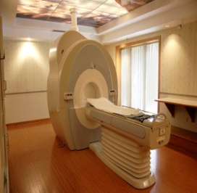
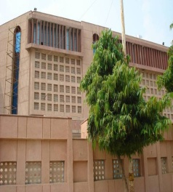
Carry Home Messages:
HBV Therapy 2016
ILBS
Screen Family members
Carrier - X, Chronic HBV Infection, IDAHS – Incidentally Detected Asymptomatic HBsAg Positive Subject
Whom: ≥F2, LSM >8, cirrhosis
ALT >48 IU/ml, Monitor 4-6 mo.
Reactivation vs. AVH B, High DNA
What: Tenofovir, entecavir, Peg IFN
On Rx, Monitor DNA, then qHBsAg,
Convert Chronic to Acute HBV
Viral load ↓ - immune restoration, Sequential Rx
Stop : 3 yr after eAb, and e-ve, after HBsAg loss
APASL
15-18 March, 2018
shivsarin@gmail.com

Slide 70


