Slide 1
Dr Piyush Jain
Associate Professor,
Department of Medicine,
PGIMER, Dr RML Hospital
Graduate and Post graduate from prestigious University College of Medical sciences (UCMS), Delhi
Post graduate program in Rheumatology from John Hopkins school of Medicine
Awarded Dr Madhu Saxena Award for Best Outgoing Post Graduate in Medicine , 2010
Awarded ICMR International travel grant for ESH 2013, Milan.
Member, Board of Management, Delhi Diabetic Forum
Rheumatology clinics at RML hospital.
Various publications in national and international journals & textbooks.
Reviewer for national journals.

Slide 2
Lupus Nepritis – What is new in 2016
Dr Piyush Jain
Associate Professor,
Department of Medicine,
PGIMER, Dr RML Hospital

Slide 3
Contents
Introduction
Diagnosis of lupus nephritis
Classification
Management of LN
Recent trials

Slide 4
Systemic Lupus Erythematosus
Inflammatory multisystem disease
1.5 million cases
Women>Men- 9:1 ratio (90% cases are women)
African Americans>Whites
Onset usually between ages 15 and 45 years, but can occur in childhood or later in life
Highly variable course and prognosis, ranges from mild to life threatening
Characterized by flares and remissions
Associated with characteristic autoantibodies

Slide 5
Lupus history
Lupus is the Latin word for wolf
1st used medically in the 10th century
Described clinically in the 19th century
Butterfly rash in 1845
Arthritis in 1892
Nephritis in 1895 by Osler
Serologic tests become available in the 20th century
LE cell in 1948
Lupus anticoagulant in 1952
ANA in 1954
From Dubois
Notes:
Lupus (wolf) is an ancient Roman family name; a St. Lupus lived in central France in 600 AD. How this name became associated with a disease is obscure. The eariliest medical use of lupus was in a 10th century biography of St. Martin who lived in the 4th century and used it in reference to a skin disease. The first defined descriptions of the disease were in the 19th century (report by Osler in 1895).

Slide 6
What are the symptoms of lupus?
Sensitivity to the sun
Mouth Sores
Hair loss
Pale or purple fingers or toes from cold
Swollen glands
Headache and/or Depression
Chest pain with deep breathing
Low blood count
Painful swollen joints
Unexplained fever
Extreme fatigue
Rashes
Notes:
Symptoms can mimic other less serious illnesses. Although lupus can affect almost any part of the body, most people experience symptoms in only a few organs.

Slide 7
Other problems
Repeated Miscarriages
Disease in organs
Kidney
Heart
Lungs
Brain and nerves

Slide 8
Lupus presenting symptoms

Slide 9
How do we diagnose lupus?
Skin criteria Systemic criteria
1. Malar rash 5. Arthritis
2. Discoid Rash 6. Serositis
3. Photosensitivity 7. Kidney
4. Oral Ulcers 8. Neurologic
Lab criteria
9. Anti-nuclear antibody
10. Immunologic
11. Hematologic
*4 criteria simultaneously or serially for diagnosis

Slide 10
LUPUS NEPHRITIS
35% of adults with SLE have clinical evidence of nephritis at the time of diagnosis.
50–60% develop nephritis during the first 10 years of disease.
Higher in men than in women.

Slide 11
Case definition
Persistent proteinuria 0.5 gm per day
Or greater than 3+ by dipstick
And/or
Cellular casts including red blood cells, granular, tubular, or mixed

Slide 12
Active Urinary Sediment:
>5 RBCs/hpf
>5WBCs/hpf in the absence of infection
cellular casts limited to RBC or WBC casts

Slide 13
Renal Biopsy
All patients with clinical evidence of active LN, previously untreated, undergo renal biopsy (unless strongly contraindicated) so that glomerular disease can be classified by current ISN/RPS classification
Evaluated for activity and chronicity and for tubular and vascular changes

Slide 15
Investigations
Urine Protein creatinine ratio
24 hrs urinary protein
Creatinine clearance
ds DNA
Complement level

Slide 16
Non Invasive Biomarkers

Slide 17
Non Invasive Biomarkers
Novel biomarkers must be judged against an activity measurement that is superior to the kidney biopsy.
More importantly, these putative biomarkers are now being tested to determine whether they predict the course of lupus nephritis, such as impending flare, or future outcome.

Slide 18
All SLE patients should be on Hydroxchloroquine (HCQ)
Rationale:
Lower rates of Flare
Reduced renal damage
Less clotting events
Improvement in arthralgias/arthritis
Skin rash

Slide 19
LN patients with proteinuria >0.5 gm per 24 hours should have blockade of the renin–angiotensin system, with ACE inhibitors or ARBs.
Rationale:
Reduces proteinuria by 30%, and
Significantly delays doubling of serum creatinine
Delays progression to end-stage renal disease

Slide 20
Control of hypertension, with a target of <130/80 mm Hg
Statin therapy be introduced in patients with low-density lipoprotein cholesterol >100 mg/dl

Slide 21
Principles of treatment
Class I and Class II- do not require immunosuppressive treatment.
Class III And Class IV aggressive therapy with glucocorticoids and immunosuppressive agents
Class V when combined with class III or IV should be treated in the same manner as class III or IV
Class VI requires preparation for renal replacement therapy rather than immunosuppression

Slide 22
Class I LN (minimal-mesangial LN)
Treatment as dictated by the extrarenal clinical manifestations of lupus
RATIONALE:
Class I LN has no clinical kidney manifestations.
Class I LN is not associated with long-term impairment of kidney function
Nephrotic syndrome due to concomitant podocytopathy would warrant treatment with corticosteroids.

Slide 23
Class II LN (mesangial-proliferative LN)
Treat patients with class II LN and proteinuria <1 g/d as dictated by the extrarenal clinical manifestations of lupus.
Class II LN with persitent proteinuria >1 g/d be treated with low dose corticosteroids with or without AZA.
RATIONALE:
There are no evidence-based data on the treatment of class II LN.

Slide 24
Class III LN (focal LN) and class IV LN (diffuse LN)
Initial therapy with corticosteroids , combined with either cyclophosphamide or MMF
if patients have worsening LN (rising SCr, worsening proteinuria) during the first 3 months of treatment, a change be made to an alternative recommended initial therapy, or a repeat kidney biopsy be performed to guide further treatment.
KDIGO suggest treatment change over after 3 months.
ACR- EULAR after 6 months.

Slide 25
Response Definition

Slide 26
Management Goals
Recognize serious lesions early so that aggressive treatment regimens can be initiated before irreversible changes have occurred
Attempt to induce remissions (complete or partial) with the safest, most effective regimen
Maintain remission (without relapses) for as long as possible while minimizing adverse drug- related events (especially steroid-related)
Avoid need for RRT; prolong life expectancy; improve quality of life

Slide 27
CYC
Mild FPGN
Or severe
DPGN
Pediatric or adult
Patient received prior CYC
With or without A/E
Rheumatologist or Nephrologist

Slide 28
NIH trial
six pulses of intravenous cyclophosphamide (0.5 to 1 g/m2) on consecutive months, followed by every third month follow-up pulses with low dose corticosteroids.
Effective and prevented relapses better than a shorter regimen limited to six doses alone.

Slide 29
EURO LUPUS NEPRITIS TRIAL
A head-to-head comparison of low-dose to ‘conventional’ high-dose i.v. CYC for active LN.
Ninety patients were randomized to either high dose CYC (six monthly i.v. pulses of 0.5–1 g/m2 followed by two quarterly pulses) or
low-dose CYC (fixed i.v. pulses of 500 mg given every 2 weeks for a total of six doses).
Following CYC, both groups received oral azathioprine (AZA) as maintenance therapy

Slide 30
EURO LUPUS NEPRITIS TRIAL
At 41 months, there were no significant differences in the primary end point,
cumulative probability of treatment failure, between the high- and low-dose treatment arms (20 vs 16%, respectively).
There were also no differences in renal remissions (54 vs 71%, respectively) or
Renal flares (29 vs 27%, respectively).
The shorter regimen had less toxicity with fewer and less severe infections.

Slide 34
MYCOPHENOLATE MOFETIL (MMF)
Inhibitor of the crucial enzyme involved in the de novo synthesis of guanosine nucleotides.
As lymphocytes do not possess a salvage pathway for the generation of these nucleotides, MMF results in selective blockade of B- and T-cell proliferation.
Unlike CYC, MPA has little impact on other tissues with high proliferative activity.
This accounts for less adverse effects.

Slide 35
Chan et al. randomized 42 patients with DPLN to 6 months of induction with MMF (2 g/day) or oral CYC (2.5 mg/kg/day), both with concurrent oral prednisolone.
During the maintenance phase, those in the MMF arm continued the drug at a reduced dose (1 g/day) and those in the CYC arm switched to AZA (1.5 mg/kg/day) for 6 months.
At 12 months, there were no differences in complete remissions (CR), partial remissions (PRs), or relapses.

Slide 37
A larger U.S. induction trial, reported 5 years later in a more diverse population, examined
140 patients with proliferative lupus nephritis or membranous lupus nephritis randomized to intravenous CYC monthly pulses versus oral MMF up to 3 g daily, each in conjunction with a fixed tapering dose of corticosteroids as induction therapy over 6 months.
Although the study was powered as a non inferiority trial, complete remissions and complete plus partial remissions at 6 months were significantly more common in the MMF arm (52%) than the cyclophosphamide arm (30%).
Again, the side effect profile was better in the MMF group, and at 3 years, there were no significant differences in numbers of patients with renal failure, ESRD,or mortality.
Ginzler et al. NEJM 2005

Slide 42
ALMS Maintenance Trial
MMF was superior to azathioprine with respect to the primary end point, time to treatment failure. and with respect to time to renal flare and time to rescue therapy.
Observed rates of treatment failure were 16.4% (19 of 116 patients) in the mycophenolate mofetil group and 32.4% (36 of 111) in the azathioprine group.
rate of withdrawal due to adverse events was higher with AZA than MMF

Slide 43
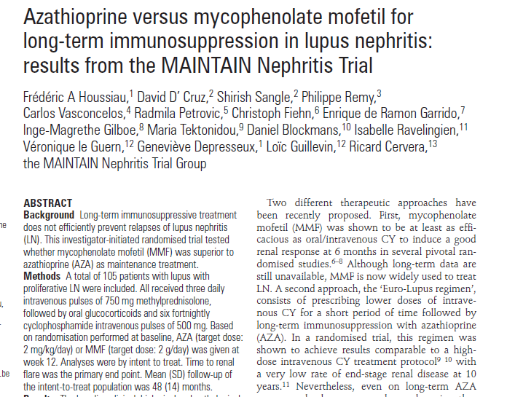

Slide 44
LESS FLARES WITH MMF BUT NS

Slide 45
Maintenance Therapy
MMF
Cardioprotective
AZA can cause some mutations in the genes – potentially carcinogenic. (dose and duration dependent)
AZA
Safe during pregnancy
Cost effective

Slide 46
Rituximab in
Lupus Nephritis

Slide 47
LUNAR Study Design
Rituximab + MMF (n=72)
Screening
Prednisone taper
Placebo + MMF (n=72)
Follow-up Period
Weeks 1 and 2
(Days 1 and 15)
Week
16
Weeks 24 and 26
Week 52
Week 78
(Days 168 and 182)
= Study drug infusion.
= Corticosteroids:
1000 mg IV methlyprednisolone given at days 1 and then days 2, 3, or 4
Oral prednisone initiated at 0.75 mg/kg/day after IV steroids and then tapered to
10 mg/day by day 112

Slide 48
Primary Endpoint:
Renal Response at Week 52
60
54.1
s
P=0.55*
43.0
30.6
30.6
n
26.4
Placebo (N=72) Rituximab (N=72)
15.3
Pr
Colete Renal Response (CRR)
Partial Renal Response (PRR)
No Response (NR)
* Wilcoxon Rank-sum test to compare the proportions of (CRR, PRR, NR) between rituximab and placebo Mean MMF dose: Placebo: 2.4±0.62 g; Rituximab: 2.7±0.41 g

Slide 49
LUNAR-Pre-Specified Analysis
Proportion of Subjects Achieving
Response by Race
70.0
ion
60%
55.0
50.0
52.6
Prop
45.0
47.8
40%
Placebo Rituximab
Resp
20%
10%
9/20 14/20
Black (n=40
11/23 16/29
Hispanic (n=52)
13/26 10/19
Caucasian (n=45)

Slide 50
Rituximab is not currently approved by the FDA for induction of Remission in Lupus Nephritis; with or without concurrent therapy with MMF or CYC

Slide 51
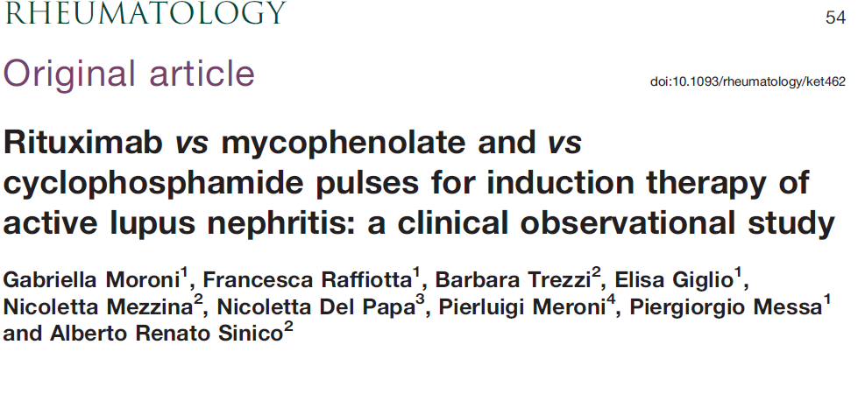

Slide 52
Fifty-four patients with active LN received three methylprednisolone pulses for 3 consecutive days followed by
oral prednisone and RTX 1 g at days 3 and 18 (17 patients)
or MMF 22.5 g/day (17 patients)
or six CYC pulses (0.5 g every fortnight) (20 patients).
At 4 months MMF, AZA or ciclosporin were associated to prednisone as a consolidation/maintenance therapy in all groups.
.

Slide 53
Results
At 3 months, proteinuria was reduced by 50% in 58.8% of patients on RTX, in 64.7% on MMF and in 63.1% on CYC.
At 12 months, complete remission was present in 70.6% of patients on RTX, in 52.9% on MMF, and in 65% on CYC.
Partial remission was reached in 29.4% on RTX, 41.2% on MMF, and 25% on CYC

Slide 54
BELIMUMAB
Inhibits B-cell activating factor (BAFF)
FDA approved agent for treating non renal SLE
Being studied as a potential therapy for Lupus Nephritis.
The Study of Belimumab in Subjects With Systemic Lupus Erythematosus (BLISS)-52 and BLISS-76 trials focused on stable, non severe LN and excluded patients with acute/severe LN.

Slide 55
BELIMUMAB
Although patients receiving belimumab had decreased proteinuria compared with placebo, this difference did not meet clinical significance (median decrease: 48.3/39.1 vs. 75.2%, NS).
Similarly, there was no significant difference in renal flare (2.1/1.1 vs. 3%, NS) and renal remission rates (65.7/70.5 vs. 58.7%, NS) as compared with placebo.

Slide 57
BELIMUMAB
There is a current phase III, double-blinded RCT investigating the effects/safety of standard of care and belimumab 10 mg/kg vs. placebo in patients with LN to address this issue.

Slide 58
ABATACEPT
Abatacept, a selective T-cell co-stimulation modulator.
T-cell activation, a crucial step in the pathogenesis of glomerulonephritis, requires both
binding of the T-cell receptor to the antigen– MHC complex on the antigen presenting cell and
a co stimulatory signal provided by the binding of the CD28 protein (on the T cell) to the B7 protein (on the antigen presenting cell).
Abatacept binds to the B7 protein, preventing this costimulatory signal and, consequently, activation of T cells.

Slide 60
Abatacept and Cyclophosphamide Combination Therapy for Lupus Nephritis
patients with class III/IV ± V LN
intravenous abatacept vs. placebo
Both groups also received glucocorticoids and 500mg intravenous CYC every 2 weeks for six doses, followed by AZA maintenance.
At 24 weeks, there was no difference in CR or overall response rates in the abatacept vs. placebo groups (33 vs. 31% CR, 59 vs. 59% overall response).
Adverse events were comparable in both groups.

Slide 61
Ongoing phase III, double-blind multicenter RCT investigating abatacept vs. placebo with background MMF and glucocorticoids over a 104-week period.

Slide 62
ATACICEPT
Atacicept is a soluble, fully human, recombinant fusion protein, which inhibits both BAFF and a proliferation-inducing ligand (APRIL).
A double-blind RCT of subcutaneous atacicept (four patients) or placebo (two patients) and MMF and prednisone for active class III/IV LN was discontinued early because of severe rapid declines in serum IgG and serious infections in three out of four treated patients.

Slide 63
Ocrelizumab
recombinant humanized antibody, sharing targeting of CD20 with rituximab.
Ocreluzimab (OCR)+ MMF or CYC (Eurolupus protocol) vs Placebo + MMF or CYC underwent a Phase III pivotal trial in LN but the study was stopped prematurely due to excess infection rates in the active drug treated groups.
At the time of discontinuation no difference in efficacy (ITT) between OCR + MMF or CYC and Placebo + MMF or CYC groups.

Slide 64
Anti-TWEAK
The long-term extension trial of BIIB023, a humanized monoclonal antibody against TNF-related weak induced of apoptosis (TWEAK), in class III/IV±V disease was also recently terminated because of inefficacy.

Slide 65
BLISIBIMOD
Blisibimod is a BAFF antagonist (B cell Activating factor)
binds to both soluble and membrane-bound BAFF and inhibits the interaction of BAFF with BAFF receptor, transmembrane activator and Calcium modulating ligand interactor (TACI), and B-cell maturation antigen.

Slide 66
A recent double-blind phase Ia/Ib RCT of 56/64 patients with mild/inactive lupus were randomized to receive either blisibimod at various doses vs. placebo .
The trial found a significant decrease in patient serum B-cell counts with the study drug without an increase in adverse events.
Although this trial excluded patients with active LN, there is a pending phase III, double-blind RCT to evaluate the efficacy and safety of blisibimod in patients with lupus and stable LN.

Slide 67
Mizoribine (MIZ)
Mizoribine (MIZ) is another potential novel treatment for LN.
It is thought to inhibit inosine monophosphate dehydrogenase – the same target as MMF.

Slide 68
Mizoribine (MIZ)
Feng et al. randomized 90 Chinese patients with active class III/IV/V LN to receive MIZ every other day vs. MMF vs. intravenous CYC 500mg every 2 weeks and glucocorticoids over a 24-week period.
All three groups showed an improvement in renal responses at 12 weeks but the CYC group had more early responders compared with MIZ (96.7 vs. 73.3%, P=0.02).
At 24 weeks, CR and overall response rates were similar between all groups (CR – 22.7 MIZ, 24 MMF, and 25% CYC, overall response – 68.2, 72, and 75%).

Slide 69
Anifrolumab
IFN1, including IFNa, have been implicated in the pathogenesis of SLE.
Anifrolumab, a human monoclonal antibody against the INFa receptor 1 , is currently being studied as a potential new therapy for lupus.

Slide 70
LAQUINIMOD (LAQ)
another promising novel therapy for LN.
Mode of action is not fully known but it is thought to behave as an oral immunomodulatory agent by down regulating selected cytokines, including IL-6, IL-12, IL-17, IL-23, and TNFa, whereas increasing IL-10 .
In a phase IIa double-blind RCT of 46 LN patients comparing LAQ 0.5 or 1mg daily vs. placebo and MMF and glucocorticoids , the investigators found that renal responses were higher in the LAQ 1mg compared with the 0.5mg and placebo groups (62.5 vs. 40 vs. 33.3%) at 24 weeks.

Slide 72
Class V Management

Slide 73
CONCLUSIONS
Diagnose early and treat aggressively in case of proliferative lupus nephritis.
Induction therapy with MMF or CYC.
Maintenance with MMF or AZA.
In severe refractory cases RTX may be used.
Prevent relapses and flares.
Follow the patients closely for adverse reactions to drugs.
New drugs are in pipeline and long term trials shall establish their safety and efficacy.

Slide 74
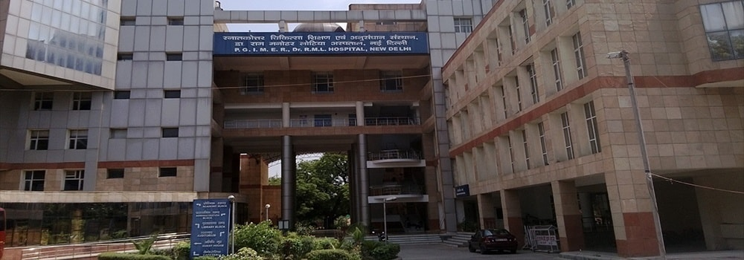
THANK YOU

