Slide 1
CORRELATION OF VITAMIN-D, IGF-1 AND INSULIN RESISTANCE IN PRE-DIABETES AND NEWLY -DIAGNOSED TYPE 2 DIABETES
Presenter : For :
Dr. Dhananjay Gupta API-DSC 2016

Slide 2
I. Introduction
DM – one of the largest global health emergencies
Prediabetes – sub-clinical, asymptomatic stage
IFG IGT
Impaired fasting glucose Impaired glucose tolerance
Prediabetes Overt diabetes
II. Aims, Objectives
III. Methodology
IV. Results
3 – 10 years*
V. Discussion
?? Factors
VI. Conclusions
* Nichols GA, Hillier TA, Brown JB. Progression From Newly Acquired Impai-
red Fasting Glucose to Type 2 Diabetes. Diabetes Care. 2007; 30 (2): 228–233.

Slide 3
I. Introduction
ICMR – INDIAB :
62.4 million diabetics
77.2 million prediabetics
IDF : “world capital” of diabetes
II. Aims, Objectives
III. Methodology
Table -1 : IDF ESTIMATES FOR 2015
1. Diabetes | 1 in 11 adults has diabetes
2. Undiagnosed DM | 1 in 2 adults with diabetes is undiagnosed
5. Incidence | Every 5 seconds a person develops diabetes
6. Mortality | Every 10 seconds a person dies of diabetes
7. Complications | Every 30 seconds a person loses a limb due to DM
IV. Results
V. Discussion
VI. Conclusions

Slide 4
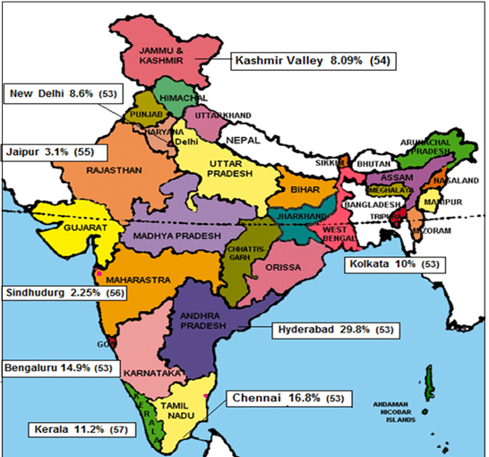
I. Introduction
II. Aims, Objectives
III. Methodology
IV. Results
V. Discussion
VI. Conclusions

Slide 5
I. Introduction
Vitamin- D :
Pleiotropic hormone
Regulates 3% of genome
CVS diseases, cancers, metabolic syndrome
Vitamin-D and Insulin resistance :
Emerging concept
Existing studies have shown contrasting results
II. Aims, Objectives
III. Methodology
IV. Results
V. Discussion
VI. Conclusions

Slide 6
I. Introduction
IGF-1/ Somatomedins :
Insulin homologue – 50%
Glucose lowering + insulin sensitizing effect
IGF-1 and Insulin resistance :
Dys-regulation of IGF system --- IR
Causes dysglycemia related complications
II. Aims, Objectives
III. Methodology
IV. Results
V. Discussion
VI. Conclusions

Slide 7
I. Introduction
Aim:
To study the correlation of vitamin-D, IGF-1 levels with Insulin Resistance (IR)
Objectives:
To measure the vitamin-D and IGF-1 levels in the healthy controls, prediabetics and newly diagnosed diabetics
To calculate Insulin resistance using the HOMA2-IR score
To correlate vitamin-D and IGF-1 levels with IR
II. Aims, Objectives
III. Methodology
IV. Results
V. Discussion
VI. Conclusions

Slide 8
I. Introduction
Methodology
Cross sectional – observation study
1st Nov 2014 – 29th Feb 2016
Dept. of Medicine, RML hospital
enrolled a total of 90 participants
Healthy controls Prediabetics Diabetics (0-12 months)
30 30 30
II. Aims, Objectives
III. Methodology
IV. Results
V. Discussion
VI. Conclusions

Slide 9
I. Introduction
Inclusion criteria
Prediabetics/ diabetics as per *ADA criteria
Exclusion criteria
h/o OCP intake
Steroids / AED intake
Vitamin-D or calcium supplements
Hyper-parathyroidism
Abnormal LFT/ KFT
Any malignancy
II. Aims, Objectives
III. Methodology
IV. Results
V. Discussion
VI. Conclusions

Slide 10
134 Patients were screened
44 excluded
90 Patients were enrolled
FBS <100
RBS <140
HbA1c <5.7
FBS 100-125
RBS = 140-199
HbA1c = 5.7-6.4
Diagnosed within last 12 months
Healthy controls
75 gm OGTT
Newly diagnosed Diabetics
2h PP : 140-199
Prediabetics
1. Serum Vitamin-d, Insulin and IGF-1 levels 2. HOMA-2-IR score

Slide 11
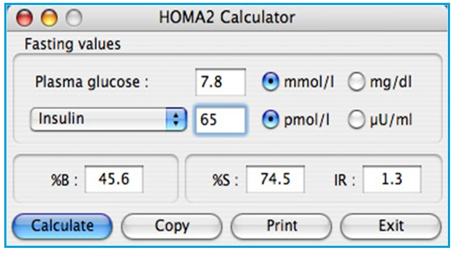
I. Introduction
Insulin resistance (IR) :
II. Aims, Objectives
III. Methodology
IV. Results
V. Discussion
VI. Conclusions
* www.dtu.ox.ac.uk/homacalculator

Slide 12
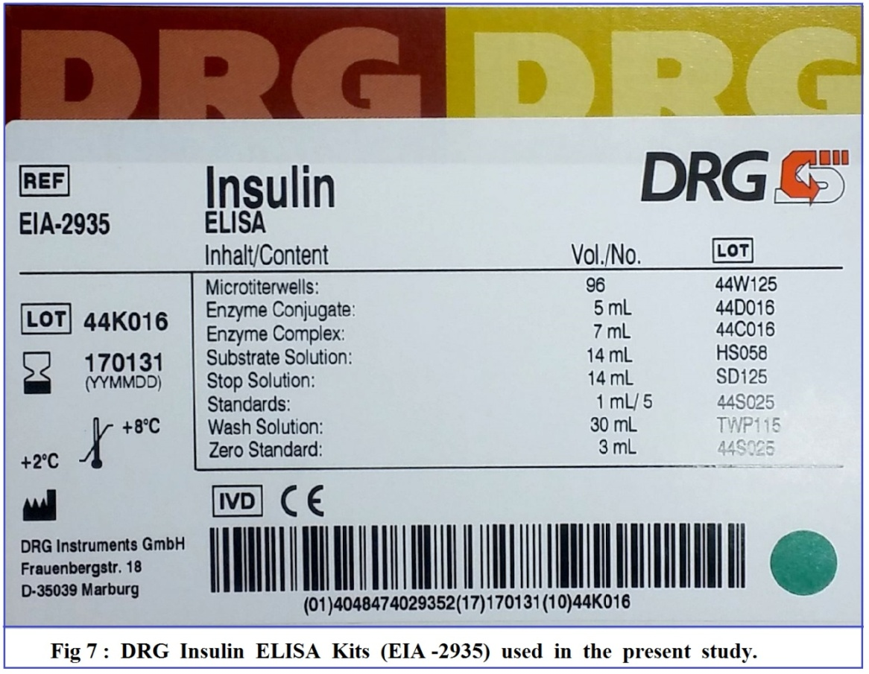
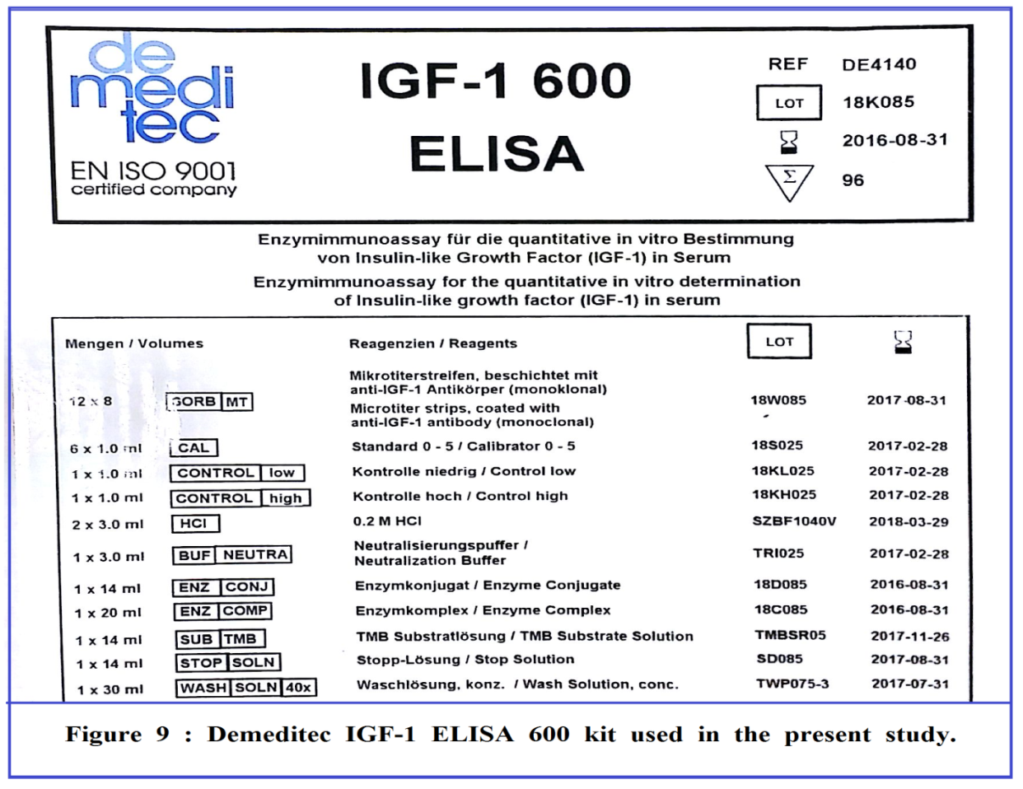
I. Introduction
II. Aims, Objectives
III. Methodology
IV. Results
V. Discussion
VI. Conclusions

Slide 13
RESULTS
HbA1c levels
Insulin Resistance
Vitamin- D levels
Correlation of Vitamin-d with insulin resistance
IGF-1 levels
Correlation of IGF-1 with insulin resistance

Slide 14
I. Introduction
1. Demographic Profile :
II. Aims, Objectives
TABLE 2 : DEMOGRAPHIC PROFILE OF PARTICIPANTS
 | Group I (controls) | Group II (pre-diabetics) | Group III (NDD)
Total | N = 30 | N = 30 | N = 30
Age (mean± SD) | 44.6 ± 12.04 | 45.2 ± 9.55 | 46.13 ± 10.24
Males | 20 (66.67%) | 16 (53.33%) | 17 (58.89%)
Females | 10 (33.33%) | 14 (46.67%) | 13 (43.33%)
BMI (Kg/m²) | 23.1 ± 3.84 | 26.4 ± 3 | 23.9 ± 3.29
WHR (mean± SD) | 0.78 ± 0.05 | 0.83 ± 0.05 | 0.83 ± 0.05
III. Methodology
IV. Results
V. Discussion
VI. Conclusions

Slide 15
I. Introduction
2. Mean Glycated hemoglobin :
II. Aims, Objectives
III. Methodology
IV. Results
V. Discussion
VI. Conclusions

Slide 16
I. Introduction
3. Insulin Resistance (HOMA2–IR) :
II. Aims, Objectives
III. Methodology
IV. Results
V. Discussion
VI. Conclusions

Slide 17
I. Introduction
4. Vitamin- D levels :
II. Aims, Objectives
III. Methodology
IV. Results
V. Discussion
VI. Conclusions

Slide 18
I. Introduction
5. Correlation of Vitamin- D levels and IR (p < 0.001) :
II. Aims, Objectives
III. Methodology
IV. Results
V. Discussion
VI. Conclusions

Slide 19
I. Introduction
6. IGF- 1 Levels :
II. Aims, Objectives
III. Methodology
IV. Results
V. Discussion
VI. Conclusions

Slide 20
I. Introduction
7. Correlation of IGF-1 levels and IR (p < 0.0001) :
II. Aims, Objectives
III. Methodology
IV. Results
V. Discussion
VI. Conclusions

Slide 21
DISCUSSION

Slide 22
I. Introduction
Vitamin-D insufficiency/ deficiency :
Pandemic proportions*
Most prevalent/ preventable nutritional deficiency
90% - Insufficiency (levels <30 ng/mL)*
71.1% - overt deficiency ( <20 ng/mL)*
II. Aims, Objectives
III. Methodology
IV. Results
V. Discussion
VI. Conclusions
* Dutta D, Maisnam I, Shrivastava A, Sinha A, et al. Serum vitamin D predicts Insulin resistance in indiividuals with pre-diabetes. Indian J Med Res. 2013 Dec; 138(6): 853-60.

Slide 23
TABLE 4 : Vitamin -D deficiency in various studies
Place of Study |  | Vitamin- D levels |  | Vitamin D Status
ng/ml |  |  |  | Sufficient | Insufficient | Deficient
This study | 90 subjects |  | - | 10 % | 18.89 % | 71.1 %
Kashmir ^{[85]} | 92 healthy natives |  | - | - | - | 83 %
Delhi ^{[86]} | 642 adults |  | 7 ± 4.08 | - | - | 87 %
Delhi ^{[87]} | 1346 adults, >50 years |  | 9.79 ± 7.61 | 2 % | 6.8 % | 91.2 %
Delhi ^{[88]} | 1829 adolescents |  | 8.3 ± 5.2 | 0.5 % | 2.6 % | 96.9 %
Lucknow ^{[89]} | 92 urban adults |  | 12.3 ± 10.9 | - | - | 78.3 %
Kolkata ^{[90]} | 40 doctors (39 M, 1F) |  | 13.02 ± 4.7 | 2.5 5 % | 5 % | 92.5 %
Mumbai ^{[91]} | 214 urban adults |  | - | - | - | 87.5 %
18 cities ^{[92]} | 2119 HC professionals |  | 14.3 ± 10.6 | 6 % | 15 % | 75 %
Norway ^{[93]} | 939 Europeans |  | 18.8 ± 9.2 | 12.5 % | 26.7 % | 60.8 %
UK NDNS ^{[94]} | 977 adults (>18yrs) |  | 18 ± 9.2 | 13.4 % | 27.2 % | 61.4 %
HELENA ^{[95]} | 1006, in 9 EU countries |  | 23.2 ± 9.2 | 20.3 | 42.4 % | 37.3 %
I. Introduction
II. Aims, Objectives
III. Methodology
IV. Results
V. Discussion
VI. Conclusions

Slide 24
I. Introduction
Vitamin-D levels: relationship with insulin resistance
II. Aims, Objectives
III. Methodology
IV. Results
V. Discussion
VI. Conclusions

Slide 25
I. Introduction
To Conclude :
Vitamin-D deficiency : widely prevalent
Observed levels : controls > prediabetic > NDD
Significant negative correlation with insulin resistance
Similar results seen in IGF-1
Significant negative correlation with insulin resistance
II. Aims, Objectives
III. Methodology
IV. Results
V. Discussion
VI. Conclusions

Slide 26
I. Introduction
Recommendations :
HOMA2-IR used as a measure of IR
Vitamin-D/IGF-1 levels measured in all dys-glycemia
Limitations :
Cross-sectional study
? Causal relationship between
Vitamin-D deficiency and worsening dysglycemia
II. Aims, Objectives
III. Methodology
IV. Results
V. Discussion
VI. Conclusions

Slide 27
Thank You

Slide 29
203 Patients were enrolled
151 previously untreated for HCV, underwent randomization
52 patients previously treated for HCV
101 : daclatasvir + sofosbuvir for 12 weeks
50 : daclatasvir + sofosbuvir for 8 weeks
Daclatasvir + Sofosbuvir 12 weeks
97 %
12 weeks
76 %
12 weeks
98.1 %
92 %
24 weeks
72 %
24 weeks
92 %

