Slide 1
A rare case of disseminated atypical leishmaniasis with pneumocystis pneumonia in a HIV patient with 1st line ART failure.
PRESENTOR - DR. ABHISHEK MITTAL
Resident, Department of Medicine
Dr. RML Hospital.

Slide 2
HISTORY
42 year old, resident of Bihar, married, welder by profession , known case of HIV positive on ART since last 8 years, presented with chief complaints of :
Pain abdomen for 4 – 5 months
Weight loss
Generalised weakness
Loss of appetite and early satiety for last 1 year

Slide 3
HISTORY OF PRESENTING ILLNESS
Patient was apparently well 1 year back when he started to develop generalized weakness , loss of appetite , early satiety with associated weight loss.
Pain abdomen – insidious in onset, mild, dragging sensation in left upper abdomen, non radiating non referred.
No history of fever , yellowing of eyes or urine, vomiting, cough and expectoration, chronic diarrhoea, worms in stool.

Slide 4
PAST HISTORY
Ten years back in 2006 patient had developed fever with generalized weakness and loss of appetite. On examination : hepatosplenomegaly with tip of spleen palpable(on documents), diagnosed as c/o Kala azar and treated with tab. Miltefosine 50mg BD X 28days at a private hospital in BIHAR.
Patient showed slight improvement in symptoms.
Two years later in 2008, patient was diagnosed as HIV+ in Bihar and was referred to ART CENTRE, DR. RML HOSPITAL and is on ART since then.

Slide 5
Later in 2008 patient was also diagnosed with disseminated tuberculosis for which he received ATT for 8 months and was declared cured (no documents available).
History of blood transfusion in the past (patient was on Zidovudine )
No history of diabetes , hypertension, asthma .
PERSONAL & FAMILY HISTORY
No significant history given by patient.

Slide 6
EXAMINATION
Patient was conscious , cooperative and oriented to time , place and person .
Patient was averagely nourished with BMI: 21 kg/m2
VITALS:-
B.P - 120/70 mm Hg in Rt. Arm, supine position
Pulse - 88/min, regular, normovoluemic, no radio-radial or radio-femoral delay. All peripheral pulses are palpable.
Respiratory rate - 20/min regular
Temperature – 100 F

Slide 7
GENERAL PHYSICAL EXAMINATION
Hair texture – Normal
Eyes – pallor ++, no icterus, no conjunctival congestion
Facies - symmetrical /no rashes/ no hyper or hypopigmentation.
Oral cavity – within normal limits, no halitosis/dental caries
No thyromegaly
Nails - No clubbing
Skin – Normal
Lymphadenopathy – left submandibular and left axillary lymph node present. 1cm, mobile, firm, not attached to skin or any structure.
Edema- absent

Slide 8
SYSTEMIC EXAMINATION
Abdominal examination:-
INSPECTION: Normal in shape , slightly distended,
Umblicus inverted,normal in shape,
No prominent veins, no scar marks , sinus
or fistula seen.
PALPATION : soft , nontender , normal temp.
Hepatomegaly present 3 cm below the costal margin, firm consistency, rounded borders
Splenomegaly present massively enlarged 9 cm below the costal margin , reaching up to umblicus, firm smooth surface.
No guarding rigidity, hernial sites normal, genetalia examination within normal limits.
Respiratory , Cardiovascular & CNS examination were within normal limits

Slide 9
PROVISIONAL DIAGNOSIS
Chronic malaria
Disseminated tuberculosis
Lymphoproliferative malignancy
Visceral leishmaniasis

Slide 10
INVESTIGATIONS

Slide 11
DATE | 29 /01/ 2016 | 5 /02/ 2016 | 15 /02/ 2016 | 19 /03/2016 | 28/03/16
E.S.R. | 16 | 20 | 31 | 26 | 30
Hb | 6.8 | 6.1 | 7.2 | 8.9 | 9.2
T.L.C. | LESS THAN 1000 | 1000 | 1100 | 2000 | 2800
D.L.C. | - | 49/27/20/4 | 61/30/8/1 | 66/24/9/1 | 60/36/2/2
PLATELET COUNT | 1.2 LAKH | 1 LAKH | 1.1 LAKH | 1.5 LAKH | 1.5 LAKH
P.C.V. | 21.5 | 16.7 | 29.3 | 21.9 | 26
M.C.V. | 85.4 | 83 | 87.3 | 90.3 | 92.3
M.C.H. | 27 | 30 | 28.7 | 27.6 | 32.8
M.C.H.C. | 31.6 | 36.3 | 32.9 | 30.5 | 35.5
RETIC COUNT | 1.2 | 1 | 1.5

Slide 12
DATE | 29/01/2016 | 5/02/2016 | 15/02/2016 | 19/03/2016 | 28/03/2016
R.B.S. | 108 | 95 | 90 | 132 | 135
UREA/CREAT. | 26/0.9 | 18/0.5 | 25/0.5 | 36/0.6 | 41/1
URIC ACID | 7.3 | 7.2 | 6.7 | 5.4 | 6.8
OT/PT | 37/20 | 40/24 | 51/39 | 66/111 | 28/47
D/I BIL | 0.2/0.4 | 0.3/0.6 | 0.2/0.8 | 0.3/0.7 | 0.2/0.4
ALP | 418 | 426 | 434 | 443 | 412
TOTAL PROT. | 9.8 | 9.2 | 9.3 | 8 | 7.5
ALB./ GLOB. | 1.8/8 | 2.2/7 | 2.2/7.1 | 2.1/5.9 | 3/4.5
TOTAL CHL./TG | 90/130 | 106/103 | 107/163 | 140/122 | 134/103
NA+/K+ | 131/4.2 | 132/5 | 127/4 | 132/4.4 | 140/5
CAL./PHOSP. | 6.7/2.3 | 7.1/3 | 7.1/1.8 | 8/2.2 | 7.8/2
AMYLASE | 63 | 68 | 72 | 78 | 80

Slide 13
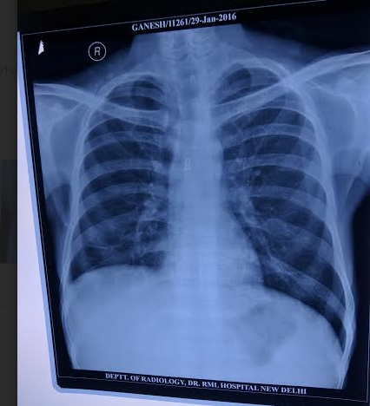
CHEST XRAY ON 28/01/2016

Slide 14
Peripheral smear- s/o pancytopenia
Chest Xray – within normal limits
USG Abdomen- Liver: enlarged 19 cm normal echotexture, no SOL , no IHBRD. Spleen : 18 cm enlarged, normal echotexture. Multiple subcentimetric conglomerated lymph nodes in mesentery noted.
RK-39 : positive (AIIMS)
Malaria serology : Negative (AIIMS)

Slide 15
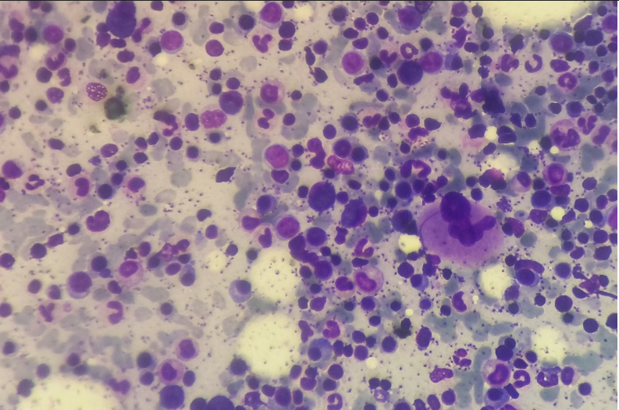
BONE MARROW ASPIRATION

Slide 16
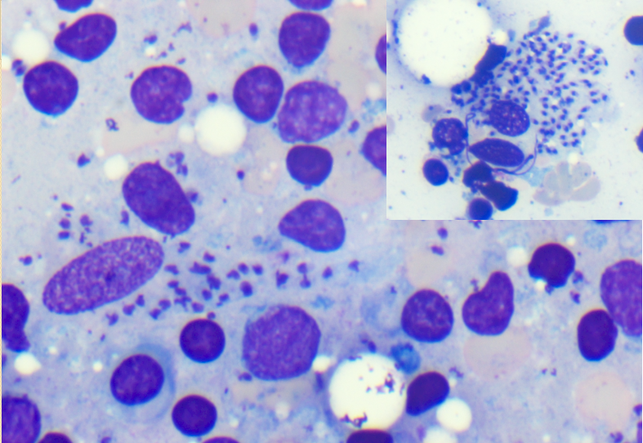
BONE MARROW ASPIRATION

Slide 17
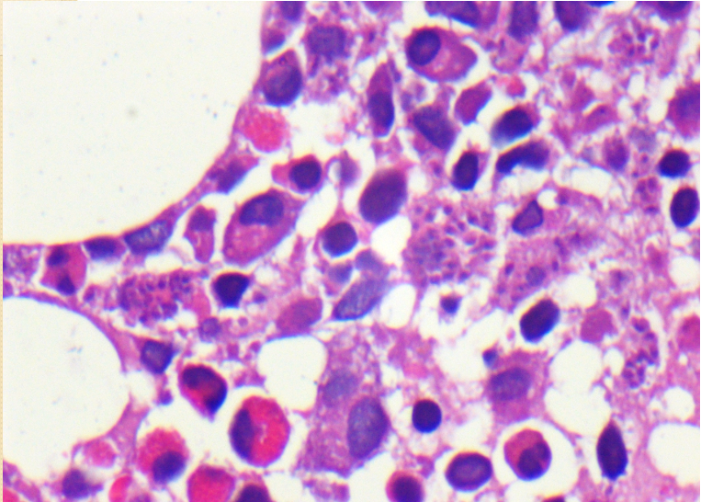
BONE MARROW BIOPSY

Slide 18
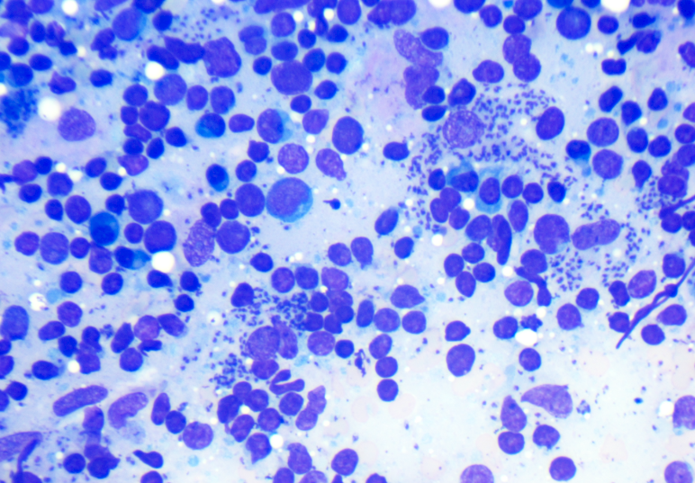
LYMPH NODE BIOPSY

Slide 19
LYMPH NODE BIOPSY

Slide 20
CD4 + counts
At the time of ART initiation , patients CD4 counts were 19/ ul ( 17/03/2008)
Patients CD4 counts were repeated evry 3 – 6 monthly.
Highest CD4 recorded in last 8 years is 92
At the time of admission , his CD4 counts were 36/ ul (9 /02/2016) , which increased to 92/ul at the time of discharge 2 /04 2016).
HIV RNA LEVELS : 437/ul

Slide 21
DIAGNOSIS
AIDS stage 4 with atypical disseminated leishmaniasis.

Slide 22
TREATMENT GIVEN IN HOSPITAL
ART Regimen
Injection Amphotericin B deoxycholate 1mg/kg/day for 28days
Tab. Cotrimoxazole DS 1 tab OD
Tab. Azithromycin 1200mg once a week
Tab. Ranitidine 150 mg BD
Tab. Vitamin B complex OD
Two packed cells were transfused

Slide 23
COURSE DURING HOSPITAL STAY
Patient showed very slight improvement in symptoms including improvement in appetite during 1st month with no decrease in spleen size.
Patient developed breathlessness , high grade fever, tachypnea , tachycardia, cough and expectoration.
Chest Xray – right middle zone, lower zone infiltrates present. ? consolidation
Sputum AFB – negative , sputum for gene expert negative, sputum for liquid bactec culture negative, sputum for gram stain culture senstivity negative.

Slide 24
CHEST XRAY

Slide 25
Sputum KOH mount showed budding yeast cells.
Sputum for PCP fungus – POSITIVE (Patel Chest Center )
Patient was put on tab cotrimoxazole DS 2 tab tds along with steroids for 3 weeks.
Patient improved subsequently and chest xray returned to normal.
As patient was not showing improvement in symptoms , he was started on inj amphotericin B phospholipid complex (earlier NA) 4mg/kg iv every alternate day for 30 days (total dose of 60 mg/kg).

Slide 26
Patient showed symptomatic improvement.
Fever decreased, appetite improved , patient gained 8 kgs weight during hospital stay, spleen regressed by 4 cm, pancytopenia improved, albumin levels increased and globulin decreased.
Bone marrow aspiration was repeated . Bone marrow culture for leishmania- not available.
Bone marrow aspirate showed LD bodies both intracellular and extracellular, less numerous as compared to previous BMA.
Patient was discharged and followed up in OPD.

