Slide 1
CKD-MBD: WHAT’S NEW
DR ANKUR GUPTA
DM NEPHROLOGY (AIIMS)
MRCP NEPHROLOGY (UK)
FELLOWSHIP HYPERTENSION & RENAL TRANSPLANT (OTTAWA, CANADA)
SENIOR CONSULTANT NEPHROLOGY
MA MAX, SHALIMAR BAGH & PITAMPURA
.

Slide 2
CKD-MBD
Lab abnormalities
Bone abnormalities
Tissue calcifications

Slide 3
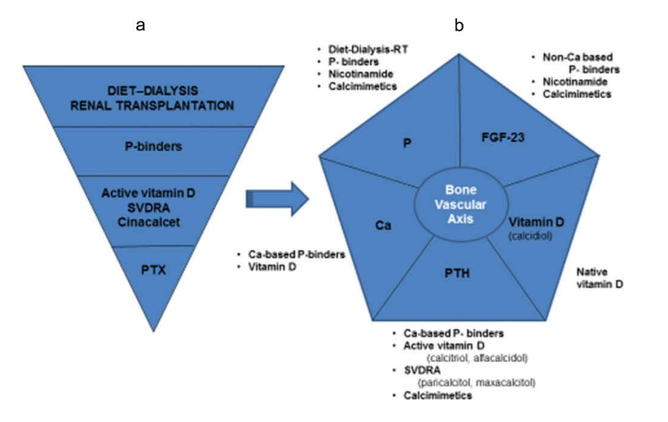
OLD NEW

Slide 4
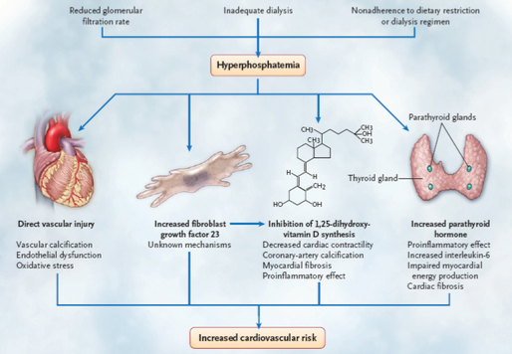

Slide 5
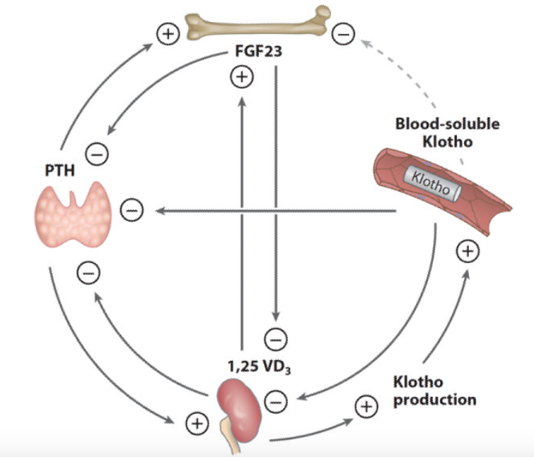

Slide 6
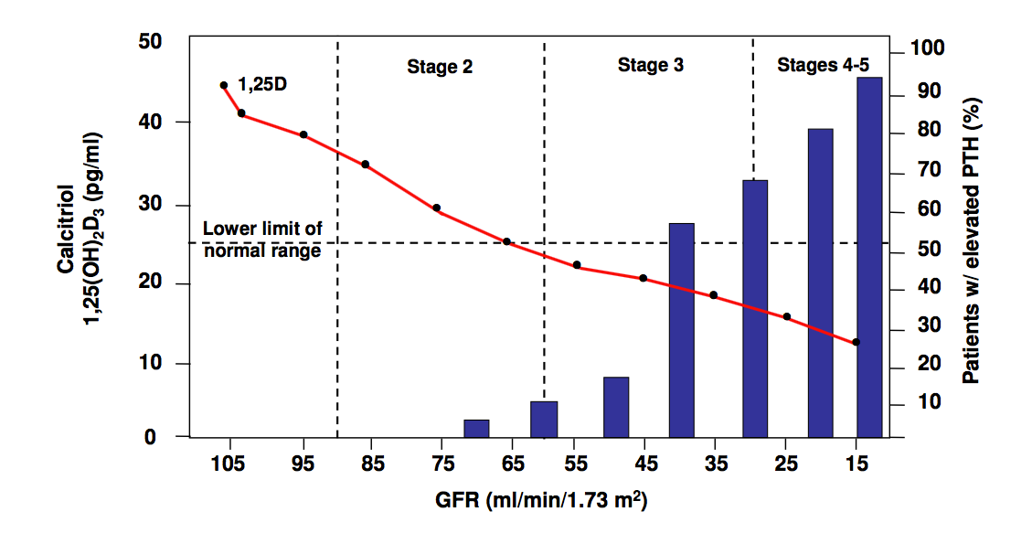
Vit D def & sHPT : early ckd

Slide 7
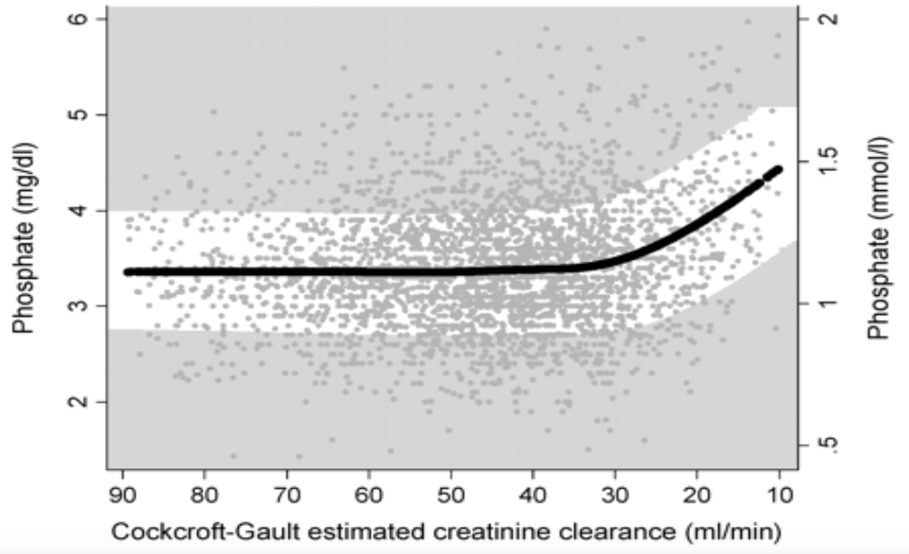
Phosphate levels in ckd

Slide 8
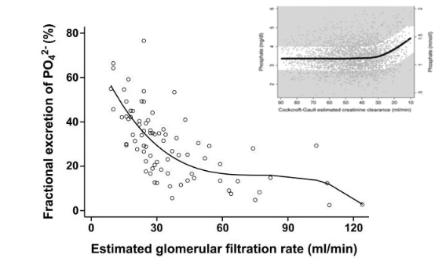
Renal response

Slide 9
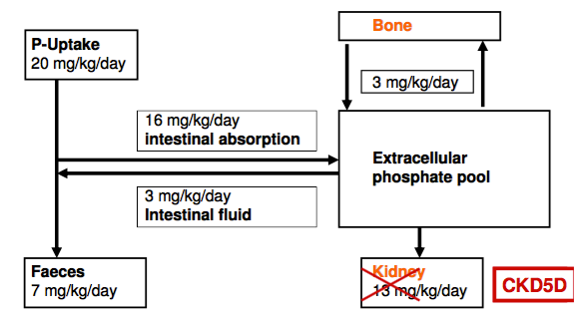
Phosphate balance

Slide 10
P- Toxin
P binder- Cal based or Non Cal based
Tolerance
Adherence
Clinical effectiveness
One that patient will take

Slide 11
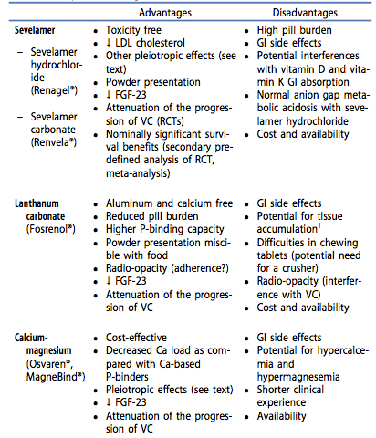

Slide 12
Phosphate binders

Slide 13
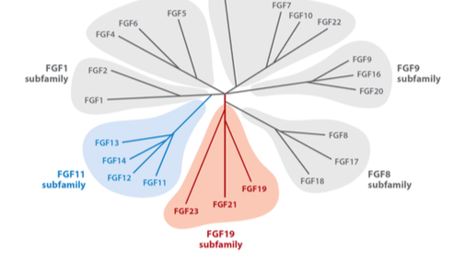
FGFs

Slide 14
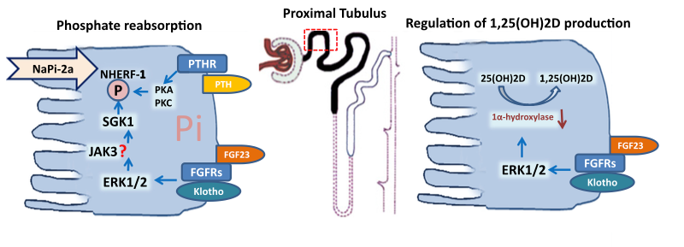
fgf-23 on Proximal tubules

Slide 15
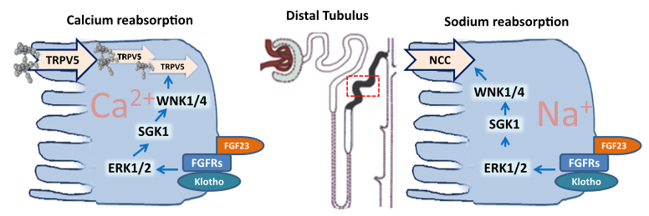
fgf-23 on Distal tubules

Slide 16
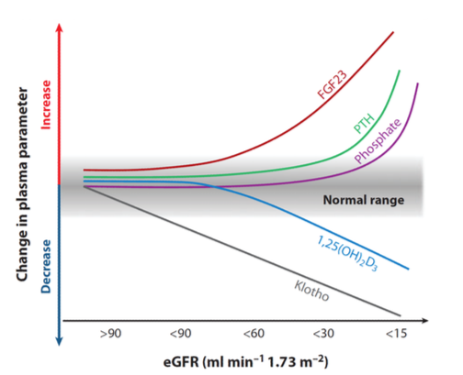

Slide 17
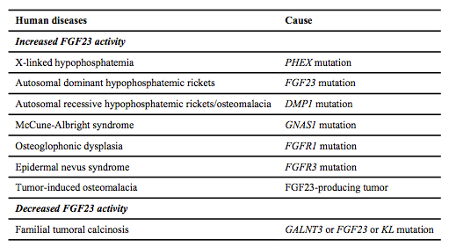
fgf-23 dysregulation

Slide 19
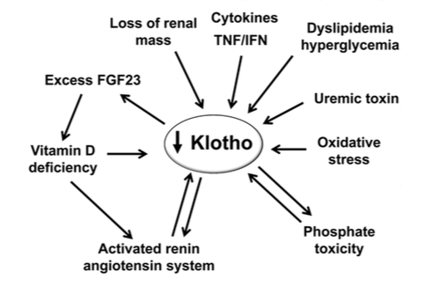
Klotho down regulation in CKD

Slide 20
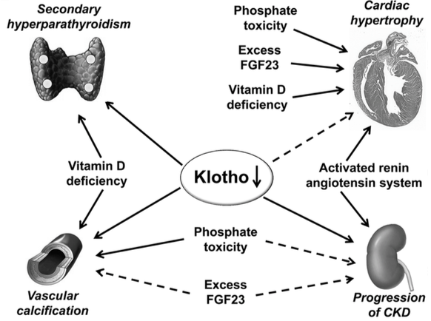
Klotho interaction in CKD

Slide 21
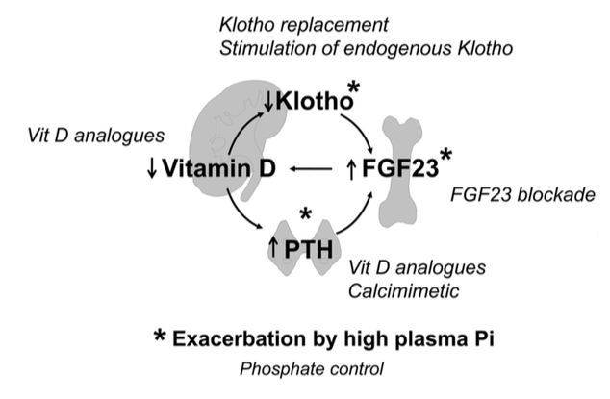
Proposed strategies in CKD

Slide 22
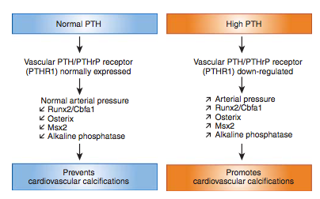
Vascular calcification

Slide 23
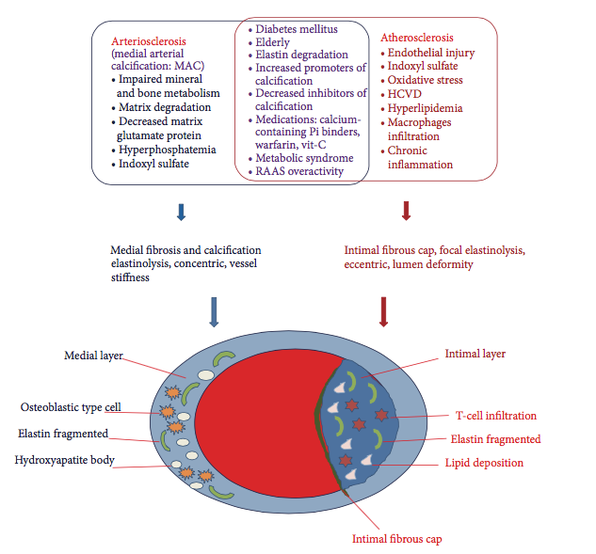
Medial arterial calcification vs atherosclerosis in CKD

Slide 24
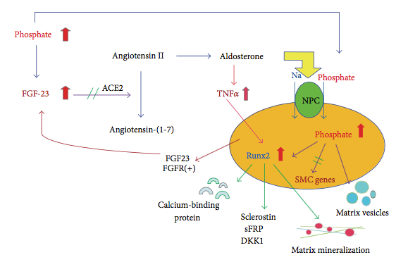
Osteogenic transdifferentiation of VSMC in CKD

Slide 25
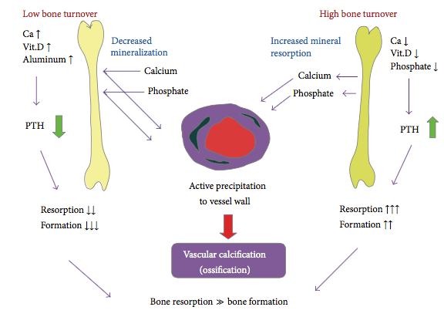
Bone turnover & vascular ossification in CKD

Slide 26
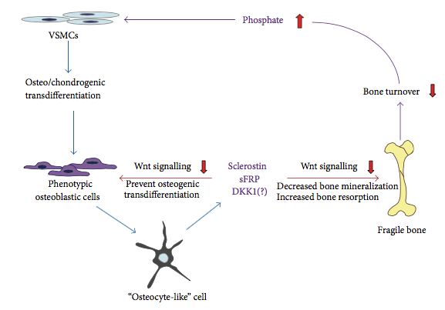
Calcified vessels on burn turnover in CKD

Slide 27
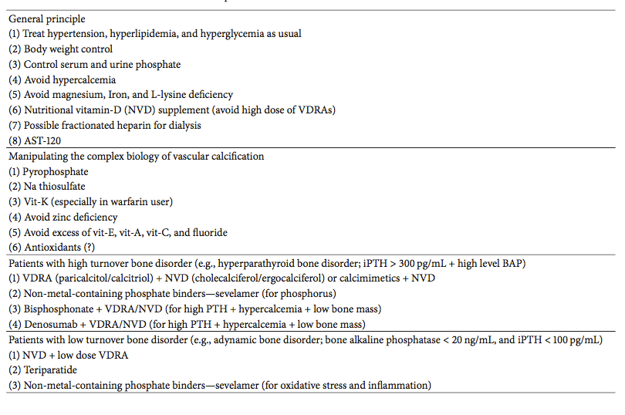
Possible Rx of Vascular calcification in CKD

Slide 28
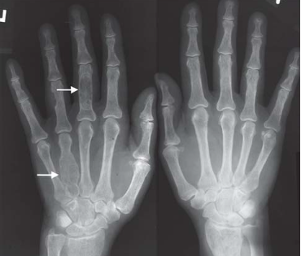

Slide 29
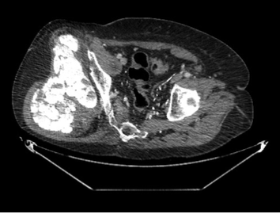

Slide 30
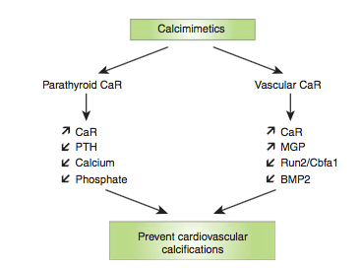
Calcimimetics

Slide 31
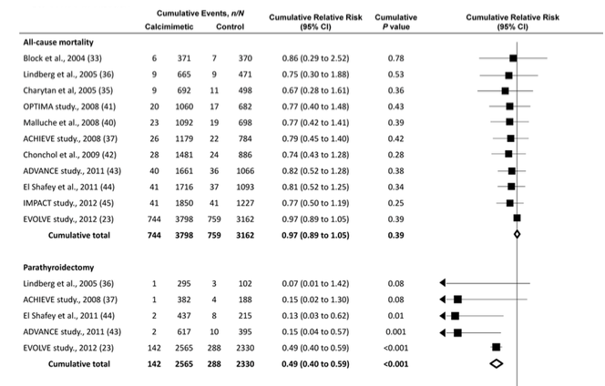

Slide 32
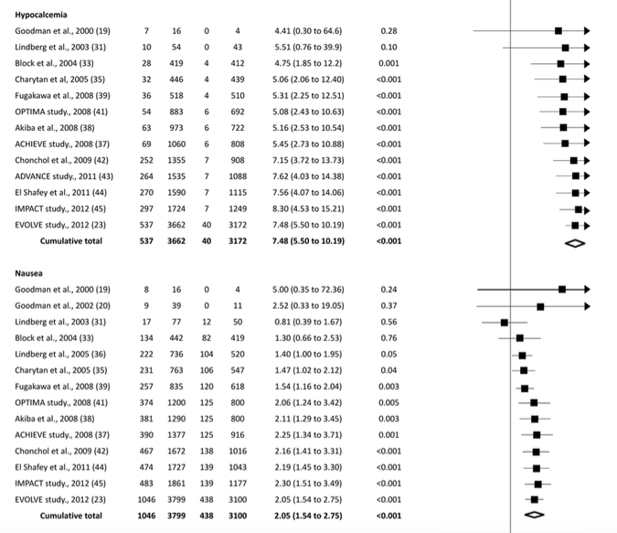

Slide 33
PLOS Medicine 2013

Slide 34
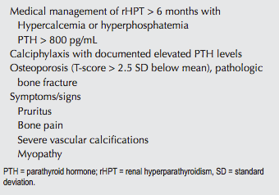
Parathyroidectomy-indications

Slide 35
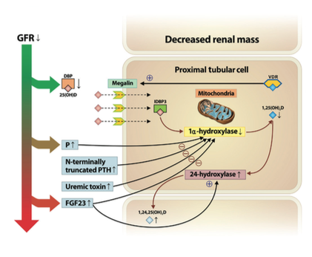
Vit D metabolism in CKD progression

Slide 36
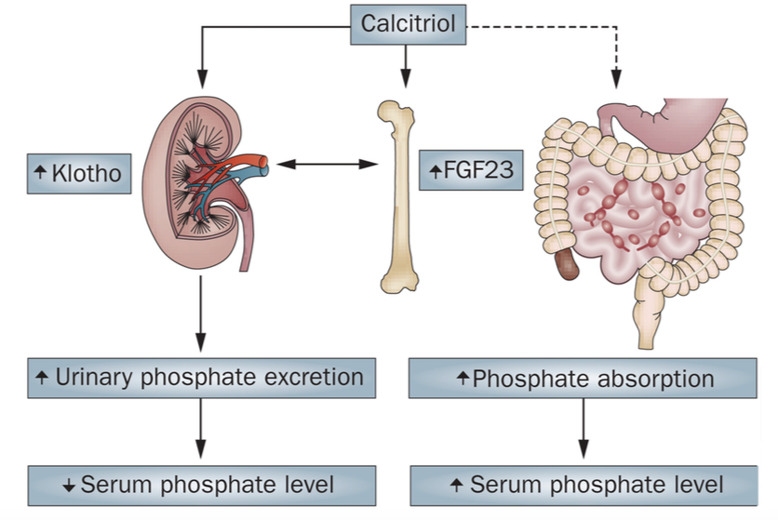

Slide 37
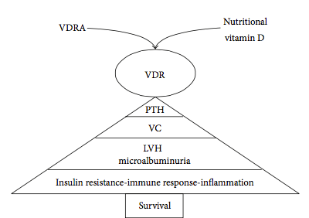

Slide 38
Vit D

Slide 39
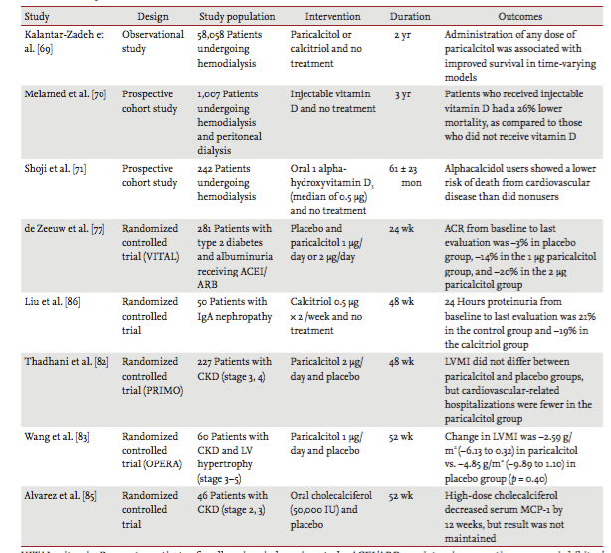

Slide 40
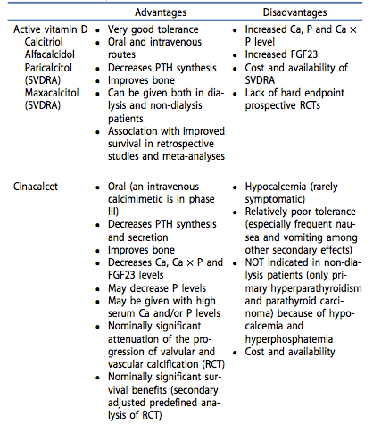

Slide 41
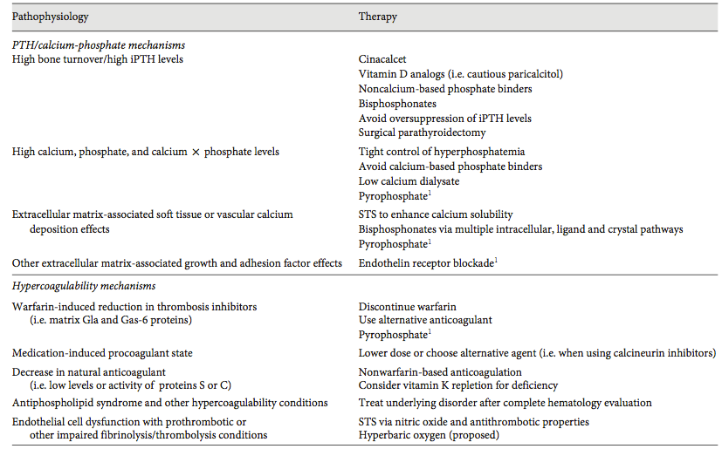
Calciphylaxis

Slide 42
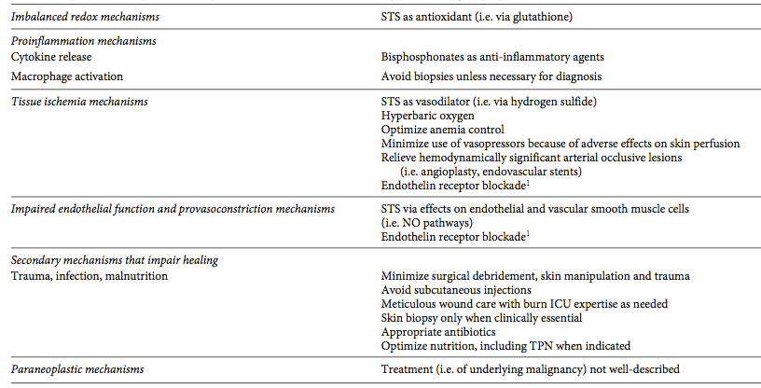
Cont…

Slide 43
Lab evaluation- which test when

Slide 44
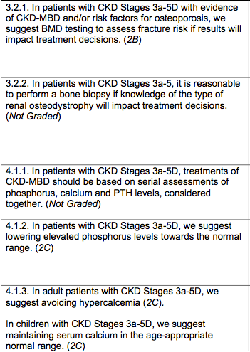
KDIGO GUIDELINES AUGUST 2016

Slide 45
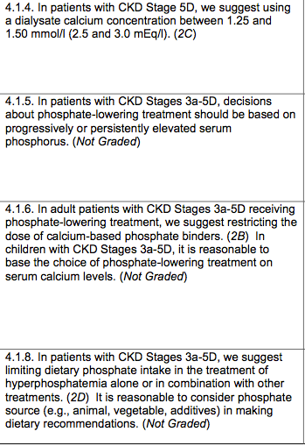

Slide 46
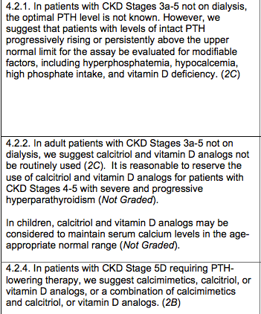

Slide 47
Take home words
KLOTHO
FGF-23
FGF-23

Slide 48
Thank you !

